Slide 1
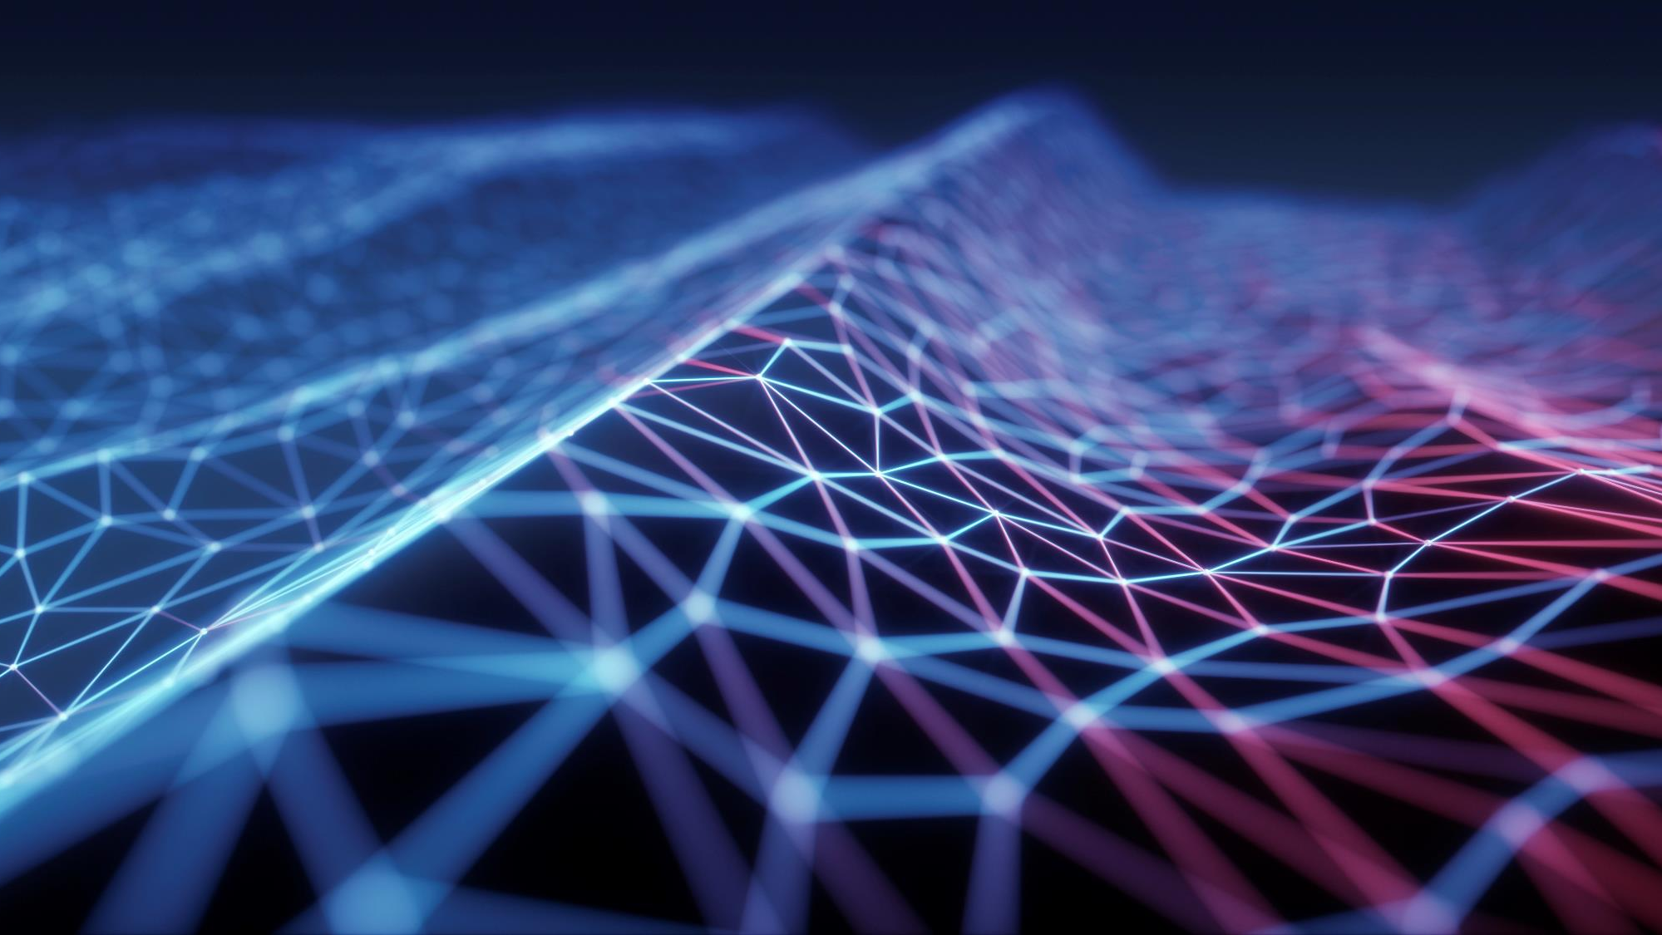
Circuits
Science Masterpiece

Slide 2
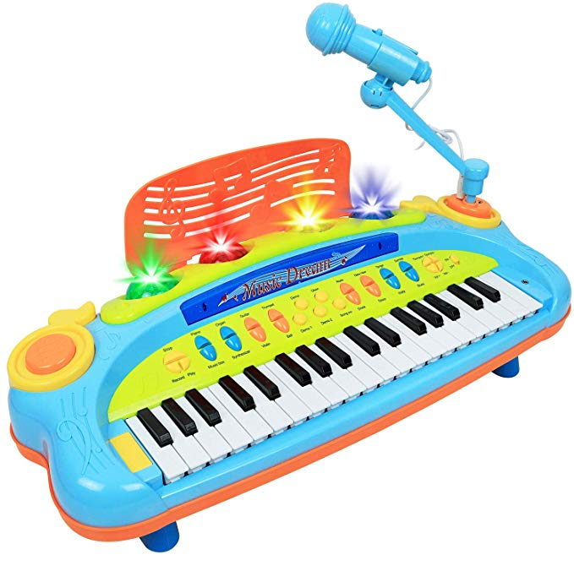
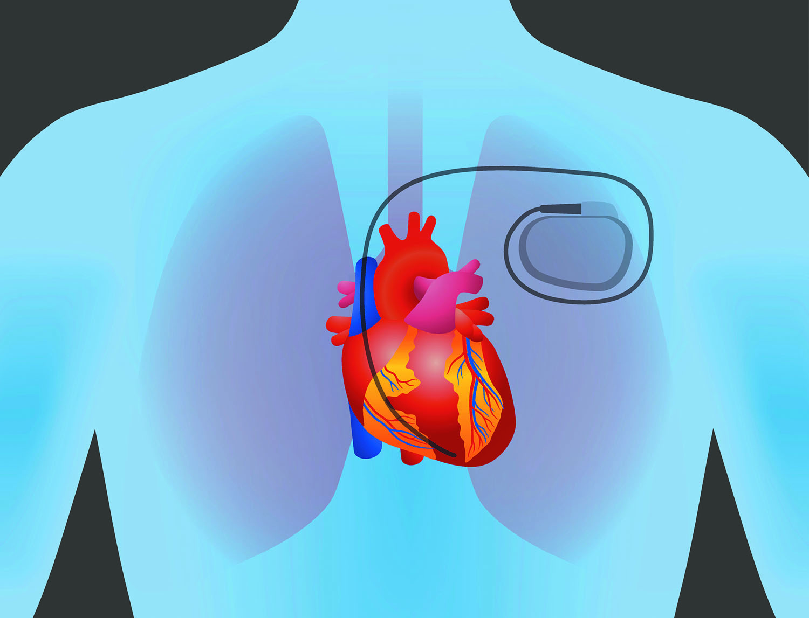


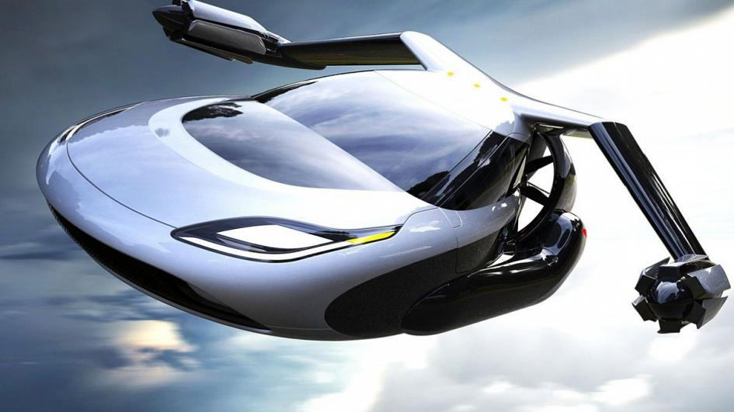
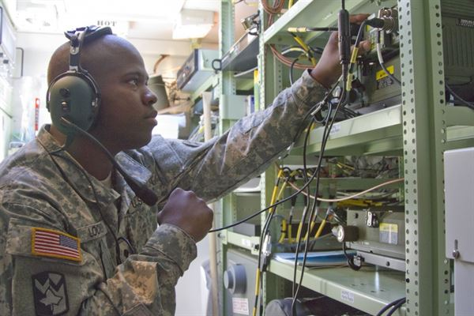
Why Are circuits important?
Circuits are in almost everything, cars, toys, pacemakers, video games, traffic lights…everything with electricity.
For my job, we need our communication to work properly.
You might work on things with circuits one day and could invent something new!

Slide 3


Circuit Video Link

Slide 4
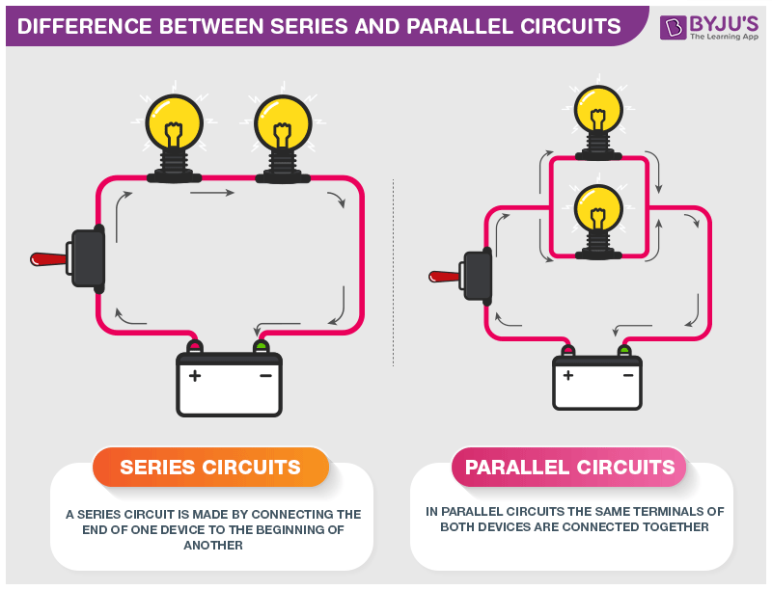
Types of circuits
Series Circuits
Parallel Circuits
Two or more continuous paths for the electrical current.
One continuous path for the electrical current.

Slide 5
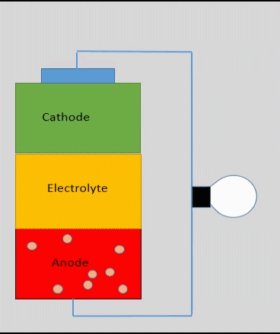
Circuits need a power source
Electrical energy is created from the flow of moving electrons.
Electrons move through a path called a circuit.
You need a power source to produce the flow of electrons.
The chemical reaction in batteries causes a build up of electrons and when connected to a circuit the electrons can be used to power something, like a light bulb.

Slide 6

You Get to build a circuit!

