Slide 1
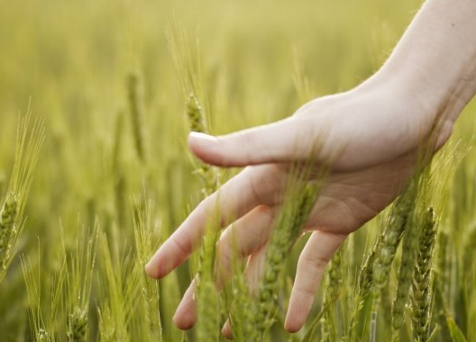
How Does It Feel?
Kindergarten
Science Masterpiece

Slide 2


Sense Of Touch
Touch Video Link

Slide 3
Touch
We gather information about our world through our senses.
Through our sense of touch, we can determine if something is smooth, rough, hot or cold, ect.
Touch is one of our 5 senses
- Can you name the other 4?

Slide 4
Vocabulary
Smooth – having an even surface, the opposite of “rough”
Cold – having a low temperature, not warm
Hot – having a high temperature, very warm
Size – how big something is
Weight – how heavy something is
Senses – the ways our sense organs give us information about the world, include touch, sight, hearing, smell, and taste
Touch – the sense by which we feel physical objects
Texture – the feel or look of a surface
Hard – very firm, the opposite of “soft”
Soft – not firm, the opposite or “hard”
Rough – having an uneven surface, the opposite of “smooth”

Slide 5
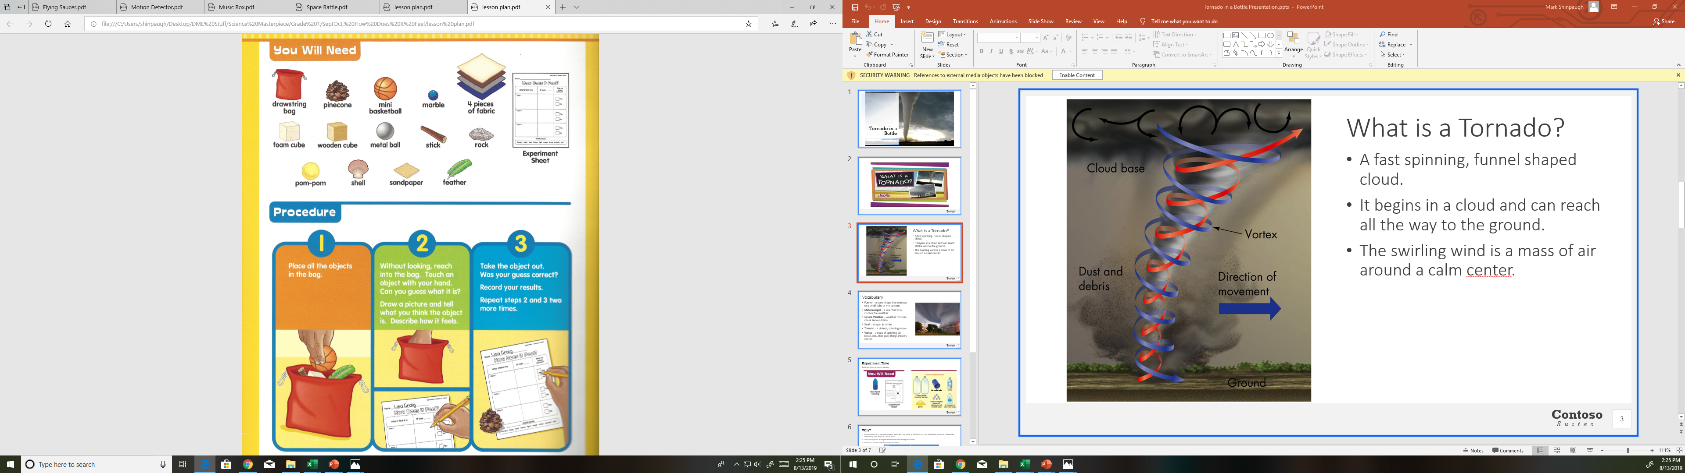
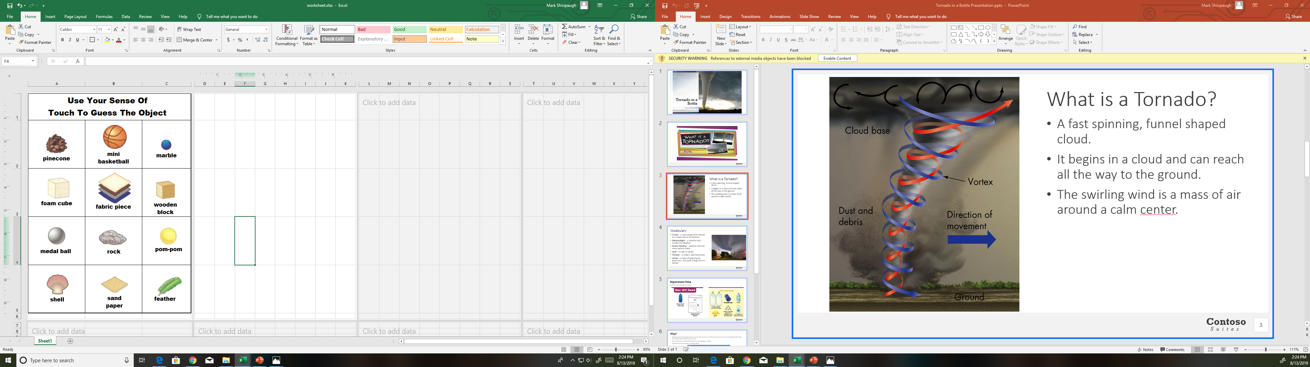

Experiment Time
Let’s guess the object, using your sense of touch!

Slide 6
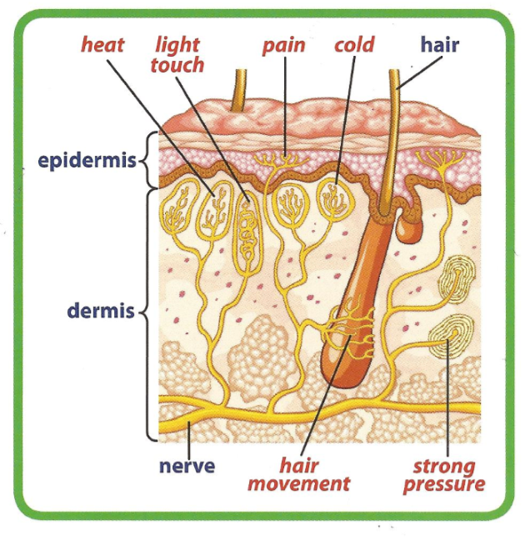
Conclusion
Our skin is the bodies largest sensory organ.
It can feel many different sensations, such as pressure, texture, and temperature because of different types of receptors or sense cells.
When the receptor is activated it sends a message through the nerves to the brain.
The brain thinks about the information and tells the body how to react.
Touch is one of our 5 senses
- Can you name the other 4?

Slide 7
Questions
There were 2 different cubes in the bag. How did they feel different? How did they feel the same?
Can you name 3 things that felt rough?
The marble, the mini basketball, the pom-pom, and the metal ball are all round. How could you tell the difference between them?
Can you use your other senses to learn more about the objects?
The End

