Slide 1
Sound WAVES
Science Masterpiece

Slide 2

Introduction to sound
Link To Sound Video

Slide 3
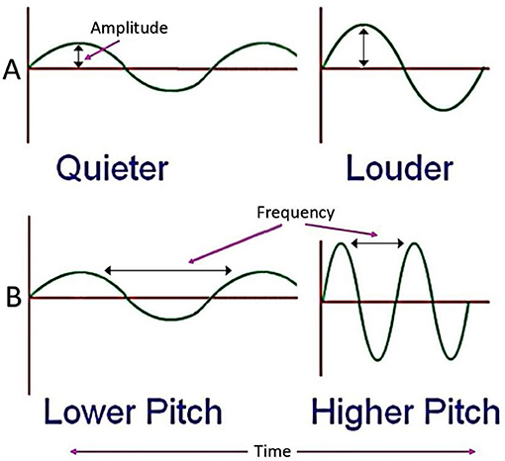
Vocabulary
Sound – anything that can be heard
Sound Waves – waves that form when a sound is made, moving through the air and carrying the sound to your ears
Frequency – the number of times that something (such as a sound wave or a radio wave) is repeated over a period of time
Amplitude – the height of the sound wave, affects the loudness or the volume

Slide 4
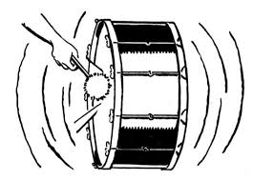
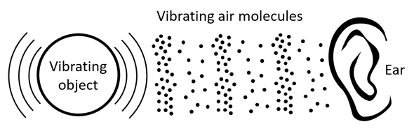

Vocabulary words
Conductor – an object that allows sound waves to travel
Vibrate – to move with fast, short, back-and-forth motions
Vibration – the movement produced from vibrating
Reverberate – a noise that is repeated as an echo

Slide 5
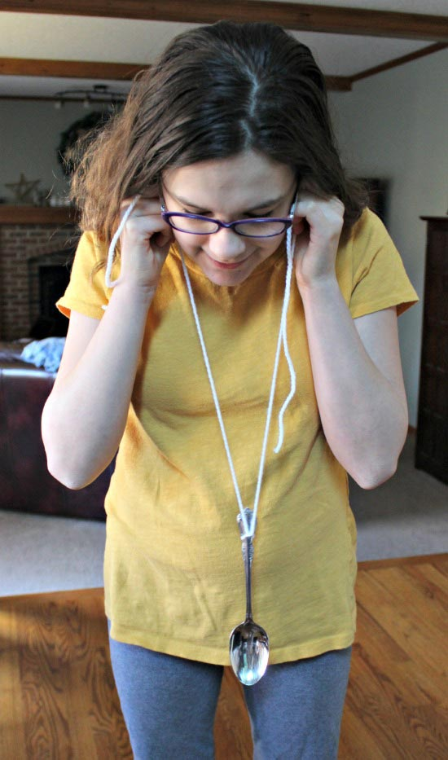
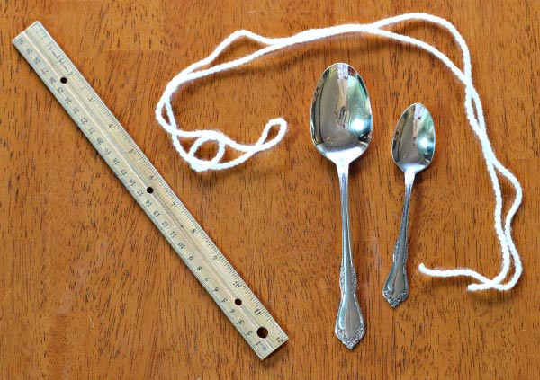
Experiment time
Supplies
A ruler
Two different size spoons
About 4 feet of string or yarn
Experiment
Create a loop in the middle of the yarn, insert the spoon handle. Pull tightly so the spoon hangs in the center of the yarn.
Take each string and wrap it around your point finger on each hand.
Then push the string against your ear (not inside your ear).
Let your spoon hang below your waist
Have someone gently hit the ruler against the round part of the spoon.

Slide 6
Conclusion
When the ruler hits the spoon, it creates vibrations which make sound waves. These sound waves travel up the yarn and to your ears instead of just spreading through out the room.
The yarn acts as the conductor, or object that allows sound waves to travel.
The sound waves continue for a while after you hit the spoon because the waves are reverberating, or going back and forth.

Slide 7
Cool Sound Facts
Believe it or not, there is no sound in space because there are no molecules there. Here on Earth, we have air molecules which vibrate to our ears.
The loudest natural sound on Earth is caused by an erupting volcano.
Dogs are able to hear sounds at a much higher frequency than humans can.
Whale voices are able to travel a whopping 479 miles through the waters of the ocean.
The speed of sound is about 1,130 feet per second in dry air at 68 degrees Fahrenheit.

