Slide 1
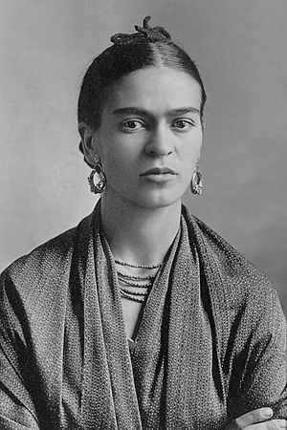

Frida Kahlo
July 6, 1907 – July 13, 1954

Slide 2
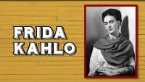

Slide 3
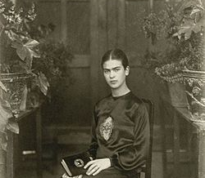
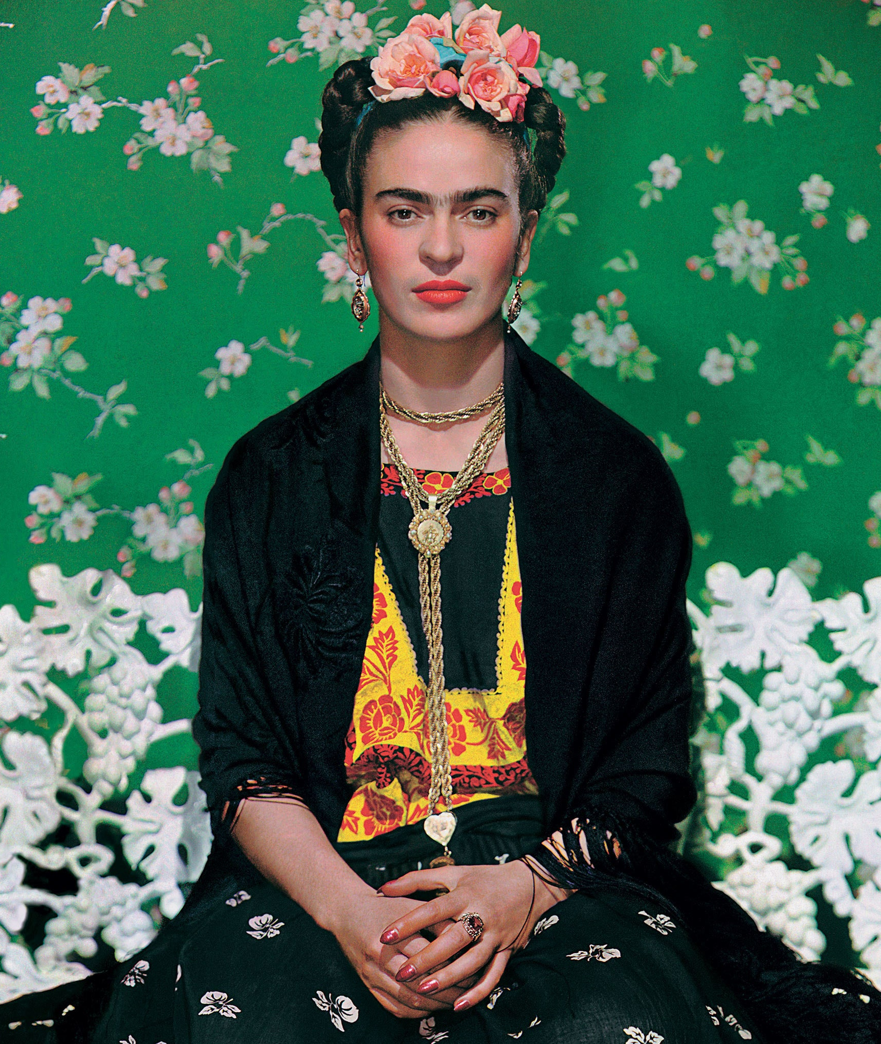
LIFE OF FRIDA KAHLO
Born in Mexico in 1907 & is one of Mexico’s most famous artists
Her Father was a photographer & took many beautiful photos of her
Frida Kahlo had over 30 surgeries in her life to fix injuries to her spine, collarbone, ribs, shoulder, foot & pelvis.
Her body never healed, so Frida worked from a wheelchair or bed the rest of her life.

Slide 4
Frida Kahlo was born in a blue house
She called the house, “La Casa Azul”, which means blue house
Now it is the Frida Kahlo Museum.

Slide 5
Art Work
During her lifetime, Frida created some 200 paintings, drawings and sketches related to her experiences in life
She produced 143 paintings, 55 of which are self-portraits.
When asked why she painted so many self-portraits, Frida replied: "....because I am the subject I know best."

Slide 6
Discussion…
What’s going on in this artwork?
What was your first reaction to this artwork? Why do you think you had the reaction?
Does your opinion about the artwork change the longer you look at it? Why?
Describe the lines in this artwork
What verbs would you use to describe this artwork?

Slide 7
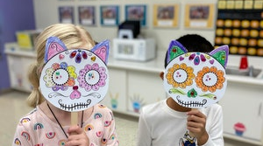
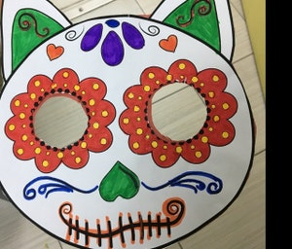
Today’s Art Lesson…
Kahlo Masks

