Slide 1
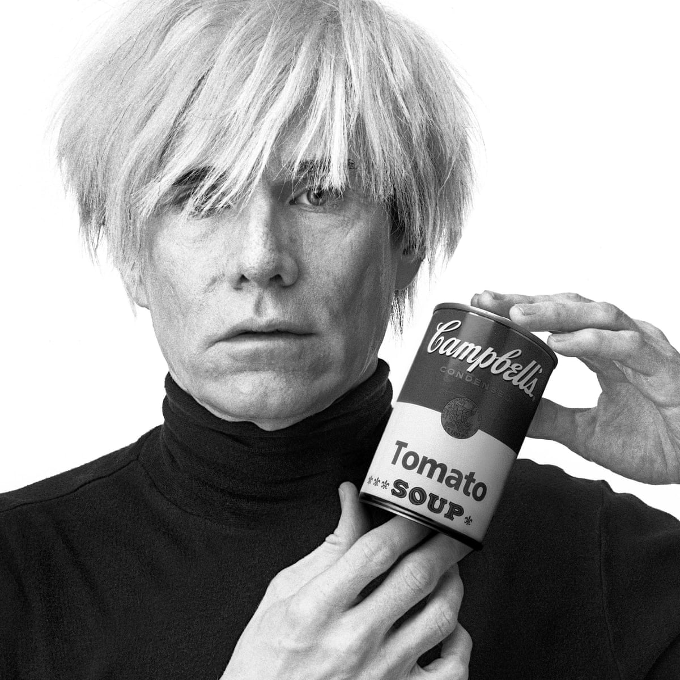
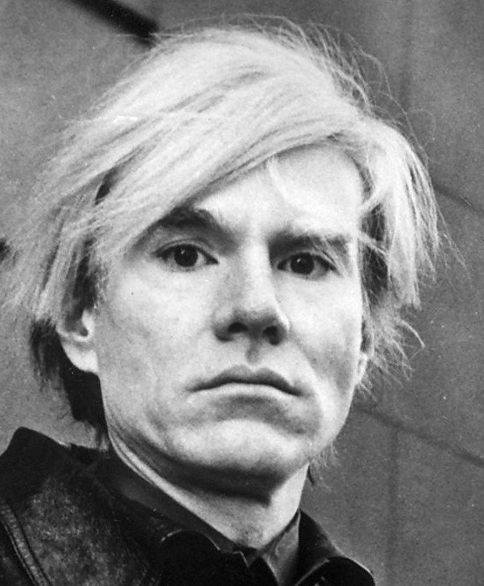
Andy Warhol
August 6, 1928 – February 22, 1987

Slide 2
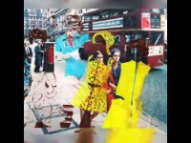

Slide 3

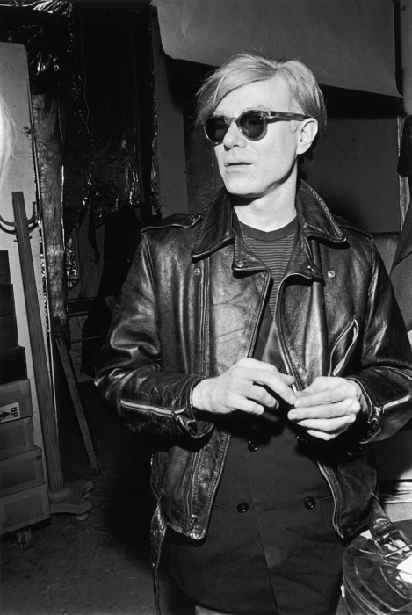
Life of Andy Warhol
Andy was born in 1928 in Pittsburg, Pennsylvania here in the United States!
Pop art means Popular Art
Andy Warhol is most famous Pop Artist from 20th Century
He makes normal everyday objects into art

Slide 4
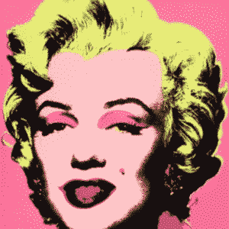
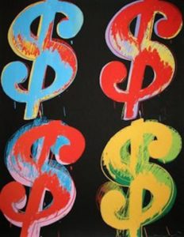
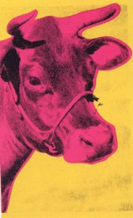
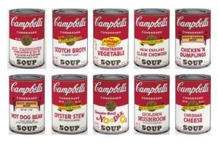

Art Work
Andy’s most popular works of art include:
  Marilyn (1962)
  Campbell’s Soup (1962)
  Cow Series (1966)
  Dollar Sign (1981)
Fun Fact: Andy got sick as a kid and stayed in bed for a long time, his Mother always made him campbell’s soup. He painted the soup cans because it reminded him of his childhood
There is a museum in Pittsburg, PA that displays all Andy’s Art
What do you notice about his paintings?

Slide 5
Discussion…
What’s going on in this artwork?
What was your first reaction to this artwork? Why do you think you had the reaction?
Does your opinion about the artwork change the longer you look at it? Why?
Describe the lines in this artwork
What verbs would you use to describe this artwork?

Slide 6
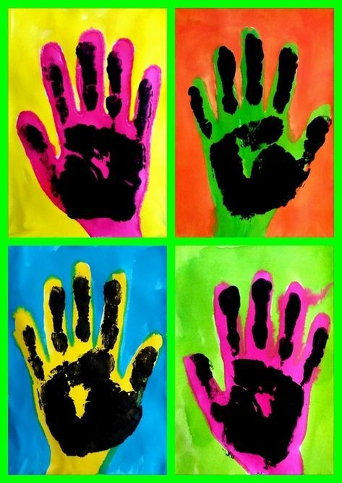
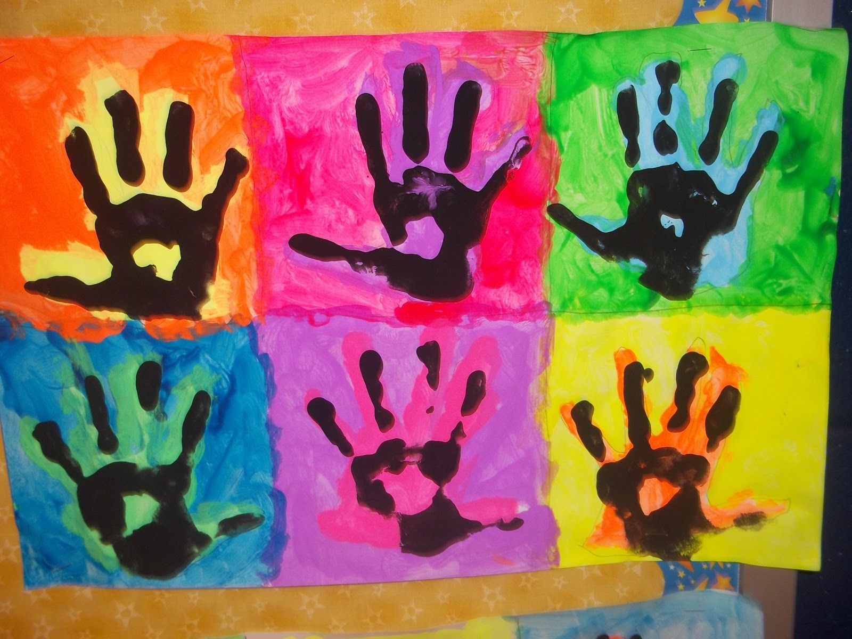
Today’s Art Lesson
Neon Handprints!

