Slide 1
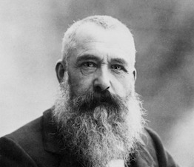
Claude Monet
November 14, 1840 – December 5, 1926

Slide 2
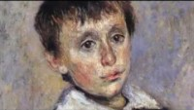

Slide 3
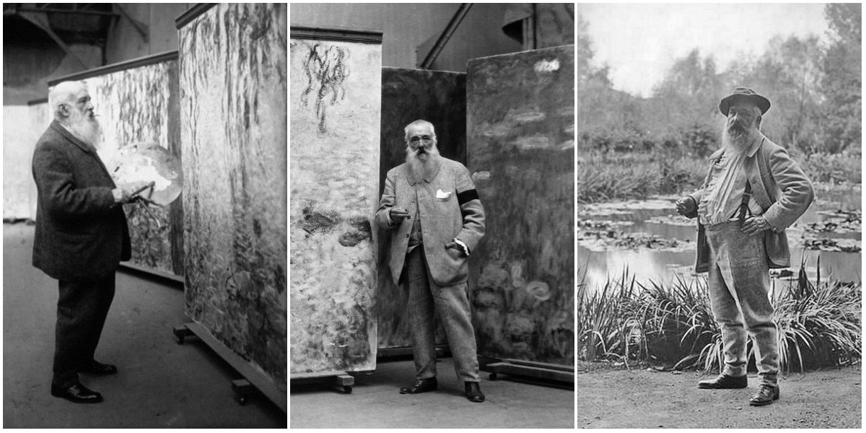
Life of Claude Monet
Monet was born in Paris, France in 1840
He attended art school until he was 16 years old
At school he sold charcoal drawings called caricatures. These were drawings of people that exaggerated certain features
Monet saw many artists using Traditional painting styles, but he wanted to try different ways of painting
He experimented with quick strokes of his brush to create images of light. This style became known as Impressionism.
Monet is now known as the leading artist of Impressionism

Slide 4
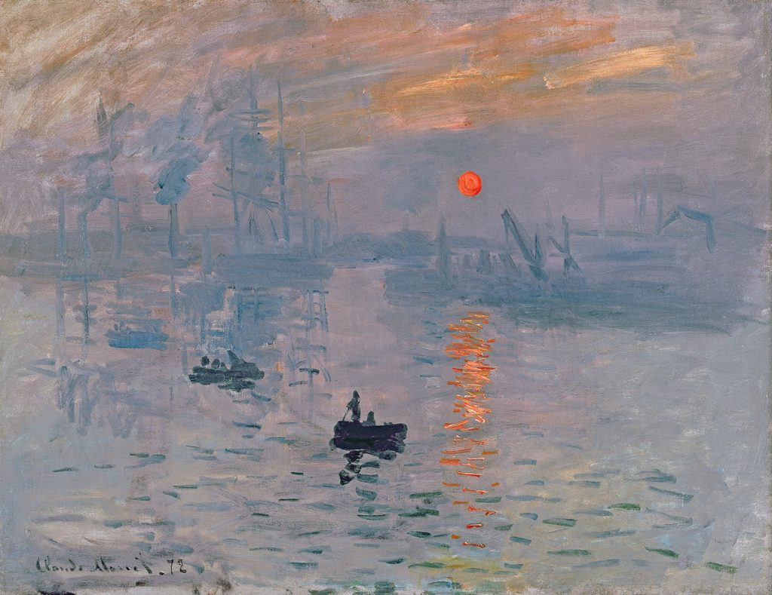
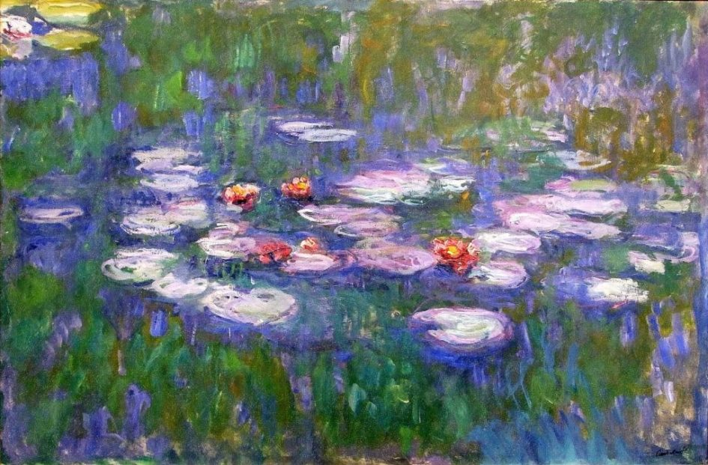
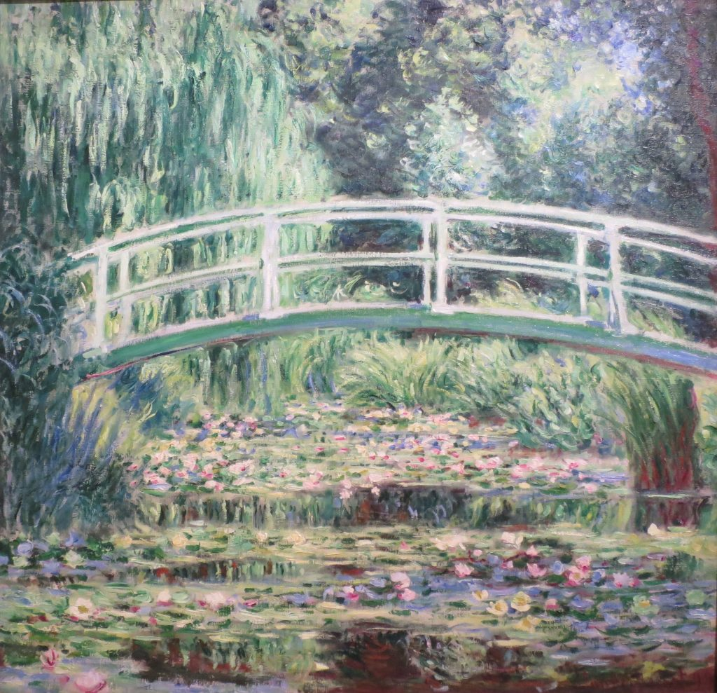
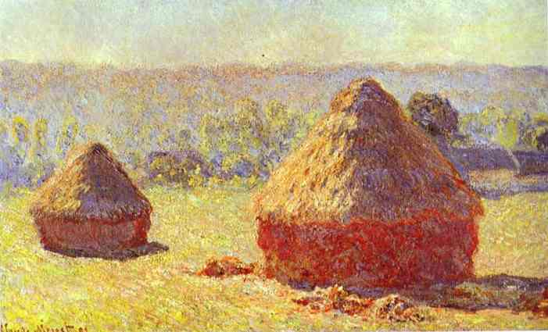
Art
Work
Impression, Sunrise (1872)
Japanese Bridge over a Pond of Water Lilies
Haystacks at the End of Summer (1890/1891)

Slide 5
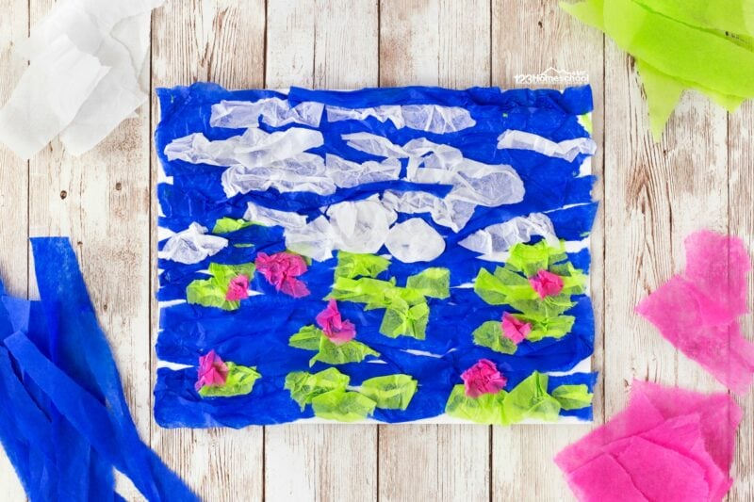
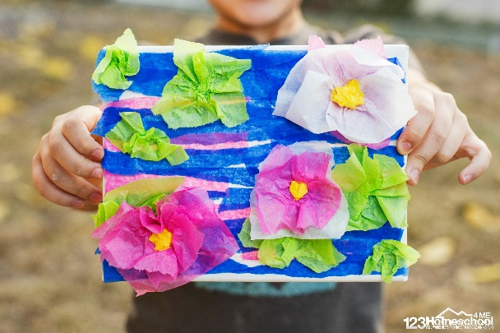
Today’s Art Lesson
Pond of Water Lily
Design your pond with water and lily pads
Use the tissue paper to add flowers to your lily pads
  Cut tissue into medium circles or squares
  Put your finger in the center of the tissue and twist light around your finger then glue to your Lily Pad
  Don’t forget to add your flowers center!

