Slide 1
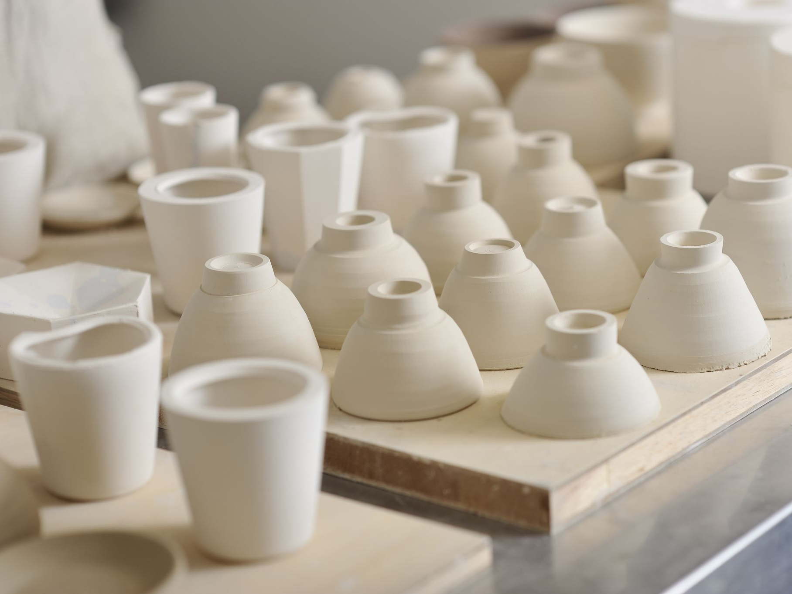


Paul Klee (Clay)
December 18, 1879 – June 29, 1940

Slide 2

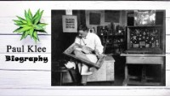

Slide 3

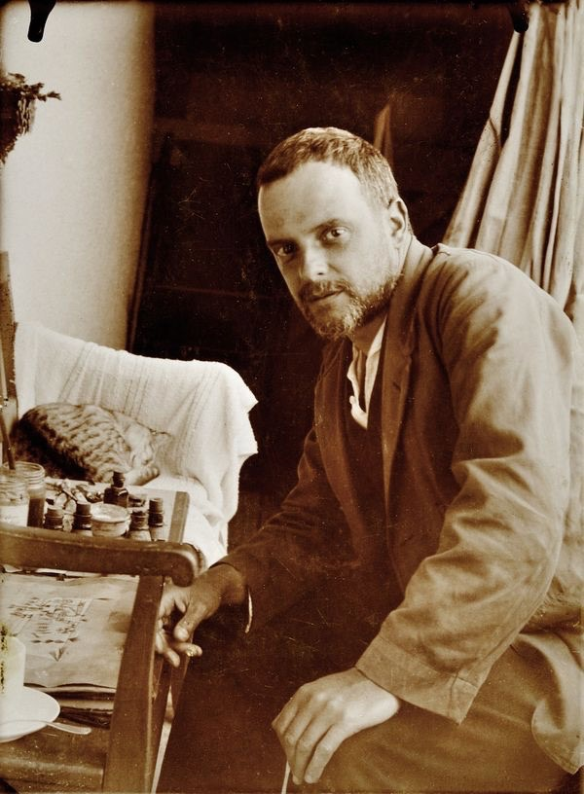
Life of Paul Klee
Paul was a very talented violin player at a very young age
Klee was called to serve in WW1 where he painted camouflage onto planes
Paul was a teacher of abstract art in Germany
He loved children’s art! Often, children’s art inspired his own work
He was an abstract artist.
Paul completed around 10,000 paintings & 4,800 drawings in his lifetime

Slide 4
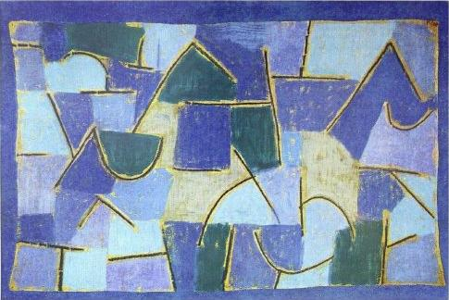
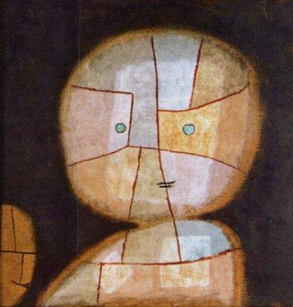
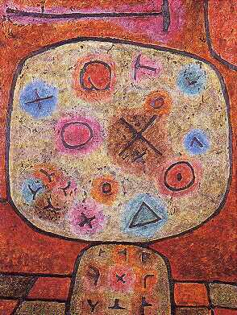
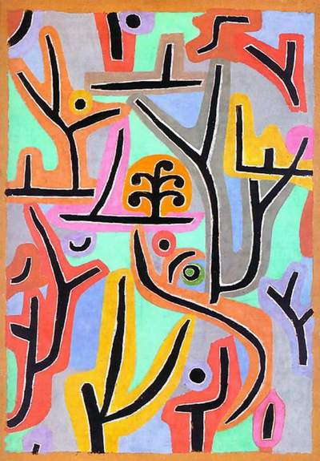
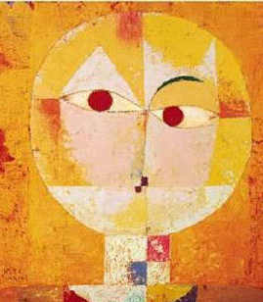
Art Work

Slide 5

Discussion…
What’s going on in this artwork?
What was your first reaction to this artwork? Why do you think you had that reaction?
Does your opinion about the artwork change the longer you look at it? Why?
Describe the lines in this artwork
What describing words would you use to tell about his artwork?

Slide 6
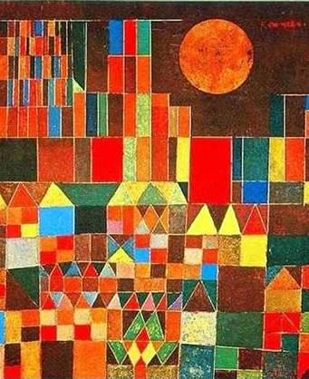
“THE CASTLE AND THE SUN” 1928
What is the first thing you see in this picture?
What shapes do you see?
Do any shapes repeat?
What colors do you see?

Slide 7
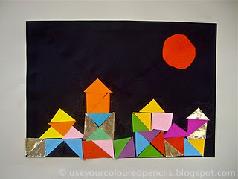
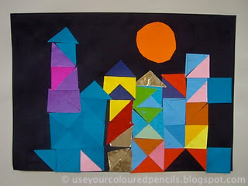
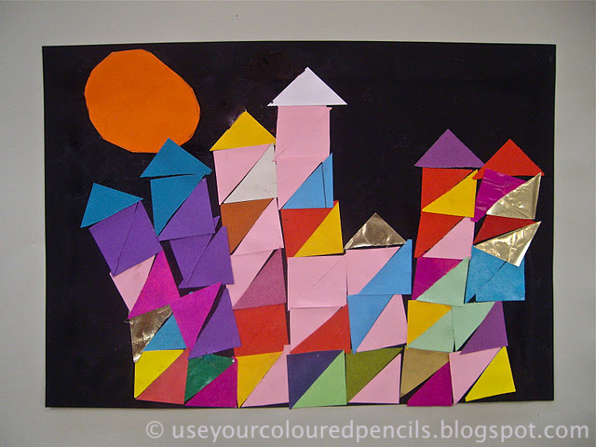
Today’s Art Project…
Klee Castle

