Slide 1
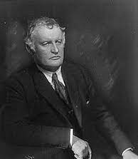
Edvard Munch
(pronounced moonk)
December 12, 1863 – January 23, 1944

Slide 2
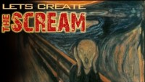

Slide 3
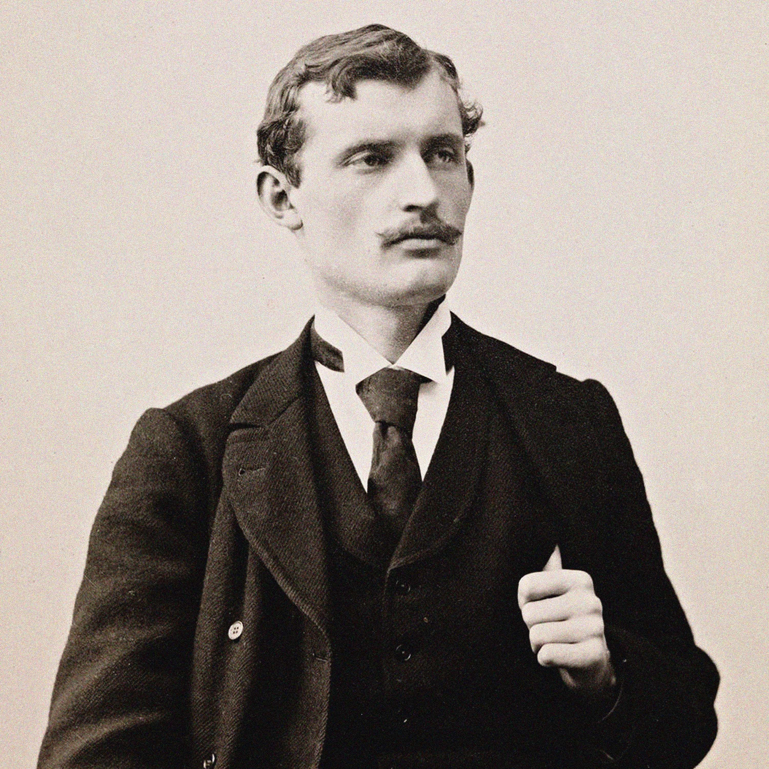
Life of Edvard Munch
Edvard Munch was born in 1863 in a rustic farmhouse in the village of Loten, Norway
His Father was a Doctor
Edvard had 3 sisters & 1 brother
He was an expressionist who painted 1,789 known paintings
Edvard is well known for his use of emotion such as fear. His way of seeing things had a large influence on expressionism of the 20th century
Expressionism is a style of painting in which the artist seeks to express an emotional experience
Munch died shortly after his 80th birthday. He willed over 2,000 works of art to the city of Oslo (capital of Norway) which built a museum in his honor

Slide 4
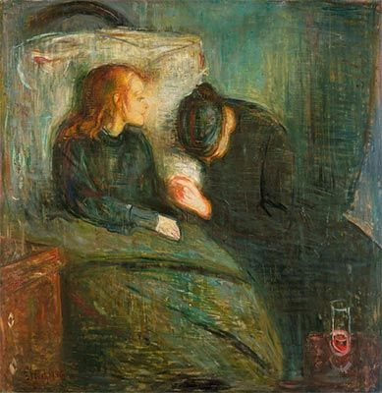
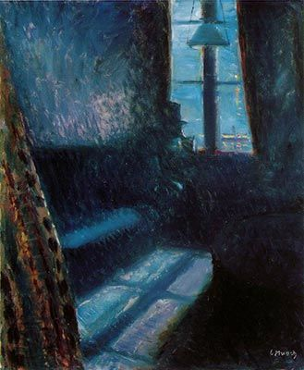
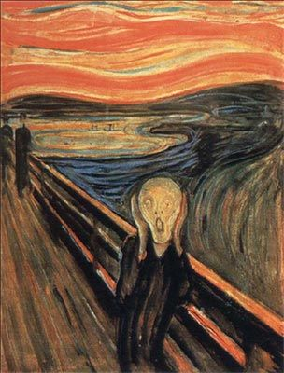
Art Work
The Sick Child (1885)
Night in St. Cloud (1890)
The Scream (1893)

Slide 5
Discussion…
What’s going on in this artwork?
What was your first reaction to this artwork? Why do you think you had the reaction?
Does your opinion about the artwork change the longer you look at it? Why?
Describe the lines in this artwork
What verbs would you use to describe this artwork?

Slide 6
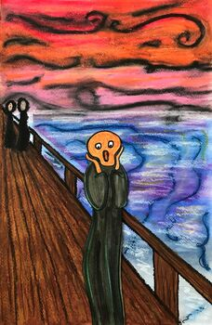
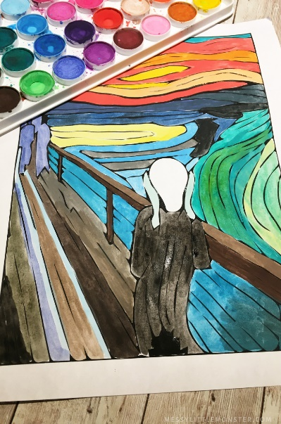
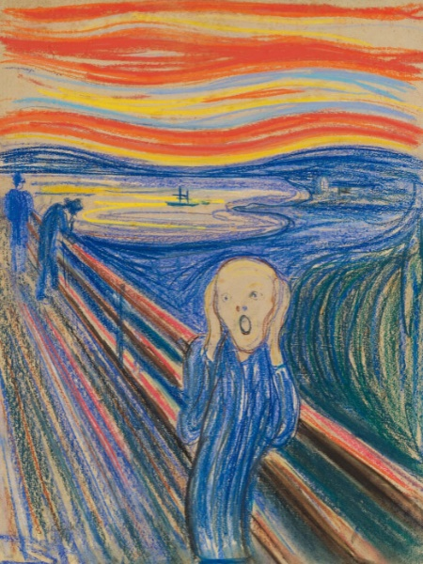
Today’s Art Lesson…
The Scream

