Slide 1
Jeff Koons
Born: January 21, 1955

Slide 2


Slide 3
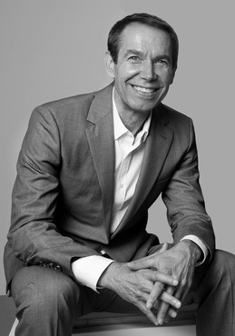
Life of Jeff Koons
Born in York, Pennsylvania – he is currently 68 years old
His Father was a furntiture dealer/Interior Designer & his Mother was a seamstress
When Koons was young his Father would put his artwork in the window of the shop to attract visitors
Went to Maryland Institute of Art in Baltimore
He is an important American Contemporary Artist – Pop Art Specifically
Known for his paintings & sculptures
Jeff gets inspiration from everyday objects, most often, childhood objects. He wants his art to spark fond, happy memories

Slide 4
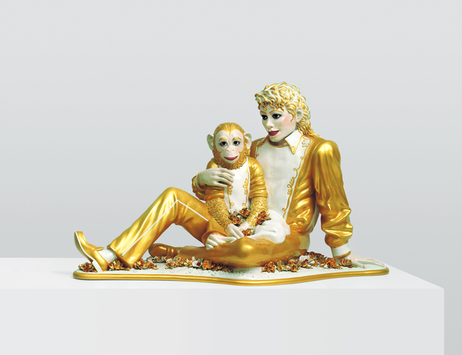
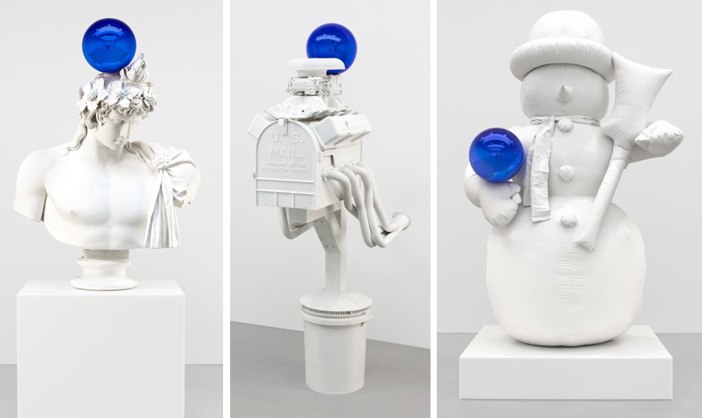

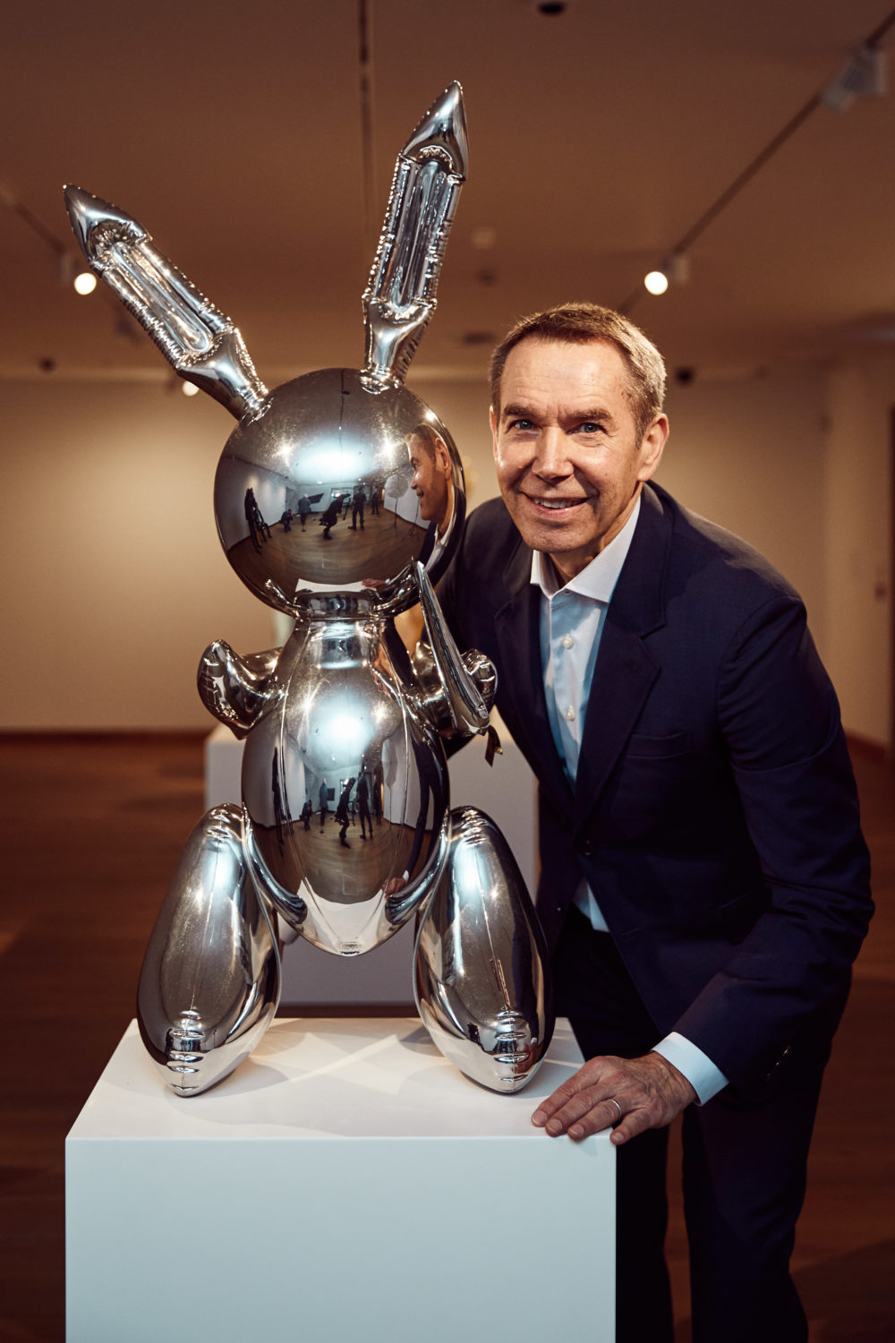
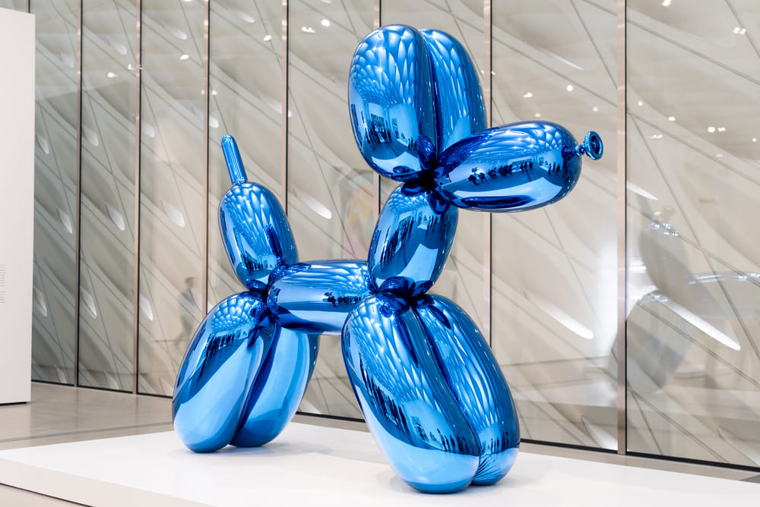
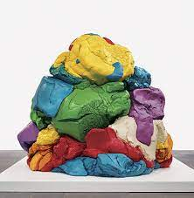
Michael Jackson and Bubbles, 1988
Art Work
Gazing Ball Series, 2013
Balloon Dog (1994–2000)
Rabbit, 1986
Play-Doh (1994–2014)

Slide 5
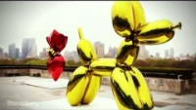

SPEAKER & CHIEF EXECUTIVE OFFICER
Follow me on social media <AtSocialHandleHere>

Slide 6
Discussion…
What’s going on in this artwork?
What was your first reaction to this artwork? Why do you think you had that reaction?
Does your opinion about the artwork change the longer you look at it? Why?
Describe the lines in this artwork
What verbs would you use to describe this artwork?

Slide 7
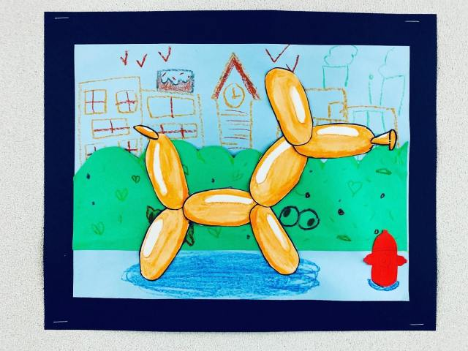
Today’s project…
Balloon Dog

