Slide 1

Dale Chihuly
September 20, 1941 – Still Living

Slide 2
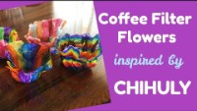

Slide 3
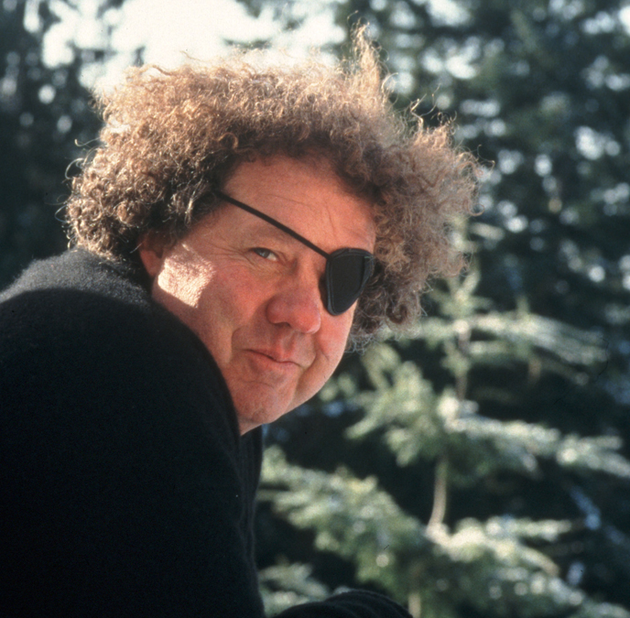
The life of dale chihuly
Born in Tacoma, Washington
Studied Interior Design at Washington University in 1960
Chihuly a Masters of Science & a Masters of Fine Arts
Founded Pilchuck Glass School in 1971 where he taught for over 10 years
In 1976 he had an accident which resulted in blindness in his left eye
Dale a retail store at the Bellagio in Las Vegas

Slide 4
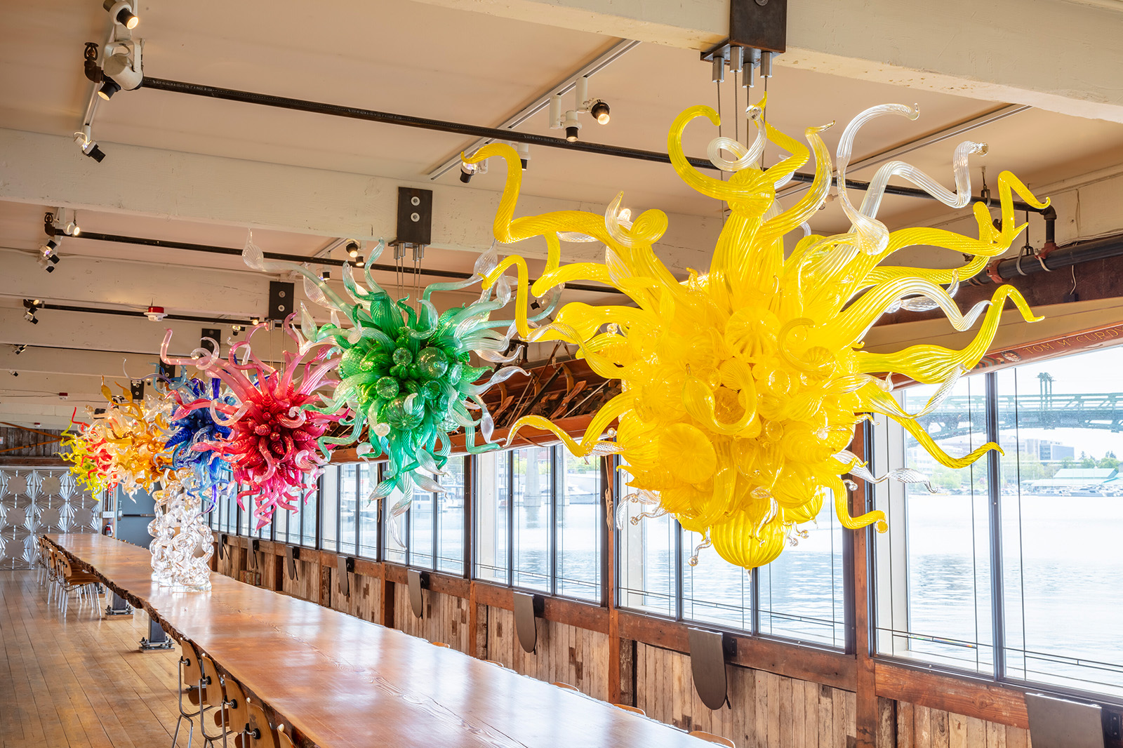
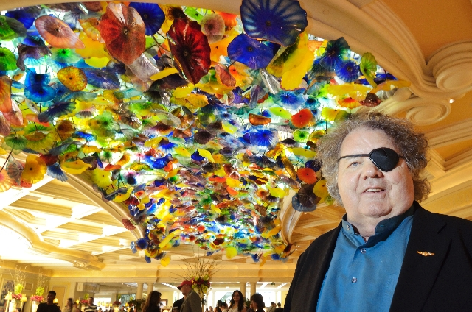
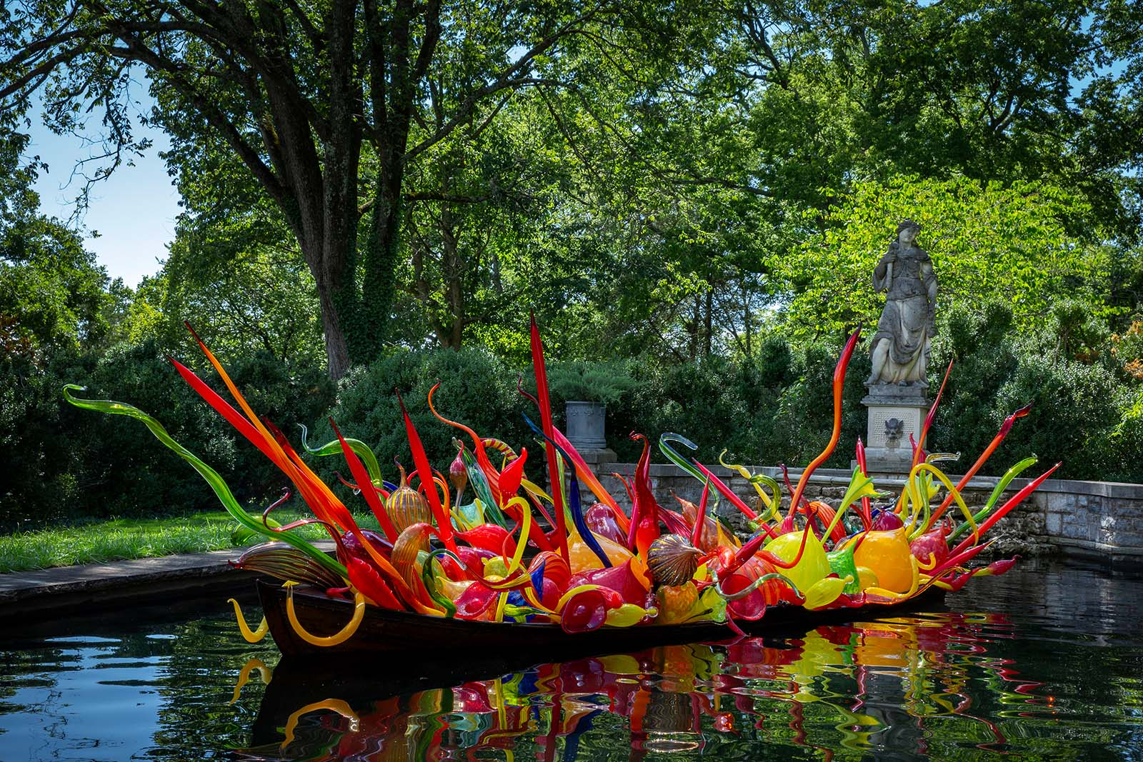
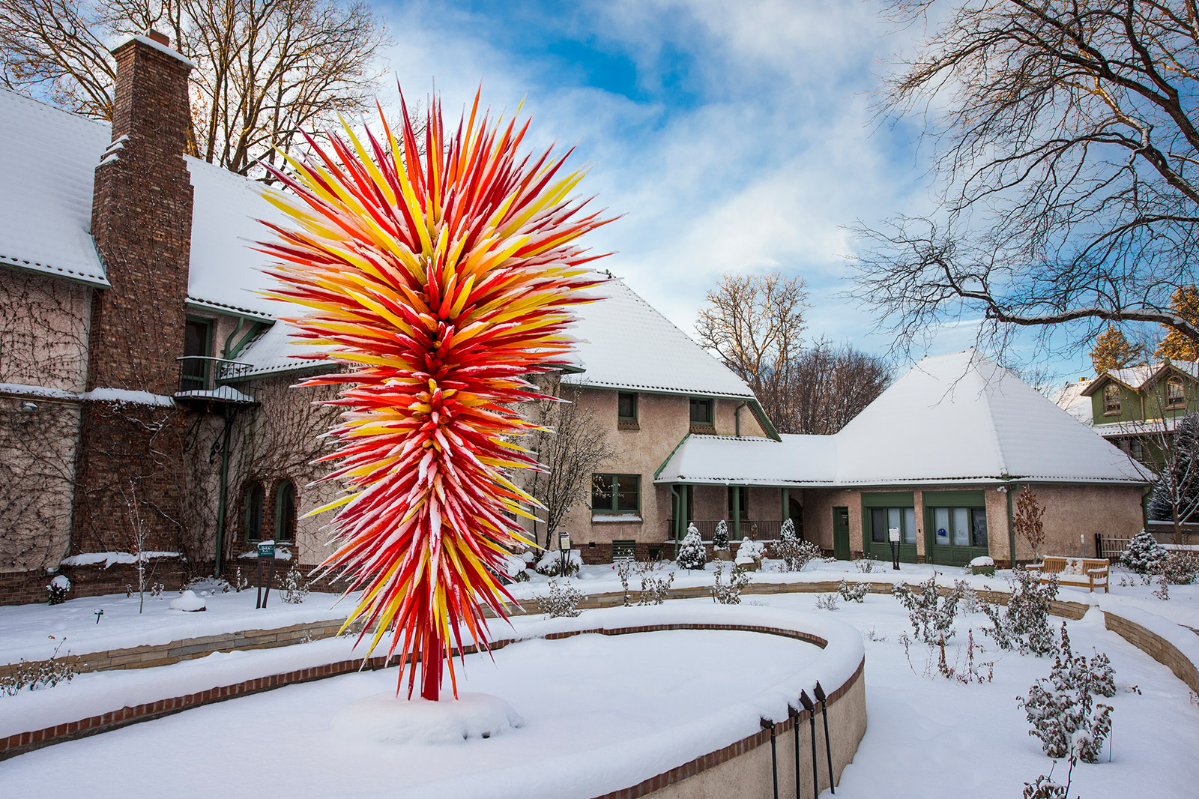
Art Work
Chandeliers, The Evelyn Room, The Boathouse, Seattle, 2019
Art Blossoms at the Bellagio in Las Vegas
<Fiori Boat, 2018, 6½ x 24½ x 8'
Cheekwood Estate & Gardens, Nashville, installed 2020
Colorado, 2014 >
Size: 14½’x 8½’x 8½’
Denver Botanic Gardens

Slide 5
Discussion…
What’s going on in this artwork?
What was your first reaction to this artwork? Why do you think you had the reaction?
Does your opinion about the artwork change the longer you look at it? Why?
Describe the lines in this artwork
What verbs would you use to describe this artwork?

Slide 6
Today’s Art Lesson…

Slide 7
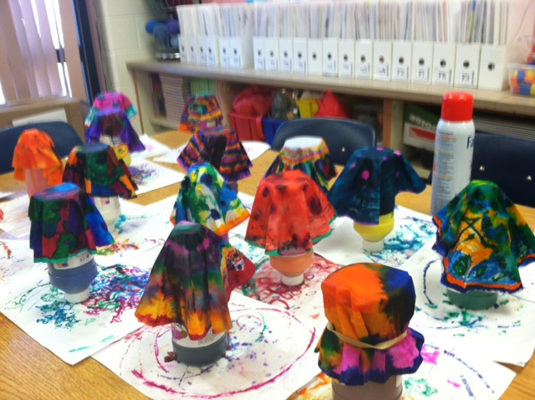
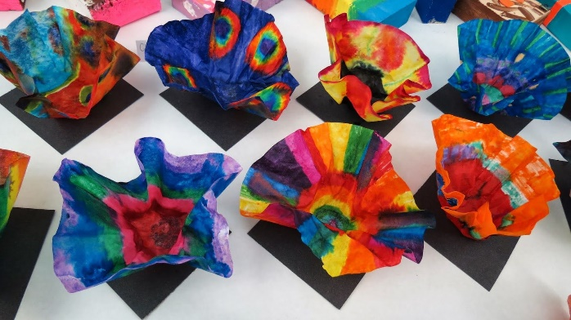
examples

