Slide 1
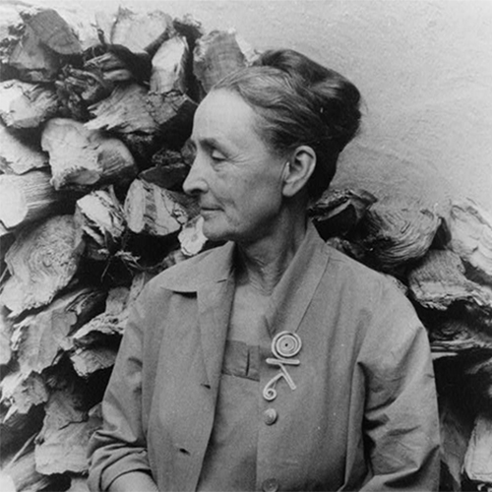
Georgia O’Keeffe
November 15, 1887 – March 6, 1986

Slide 2
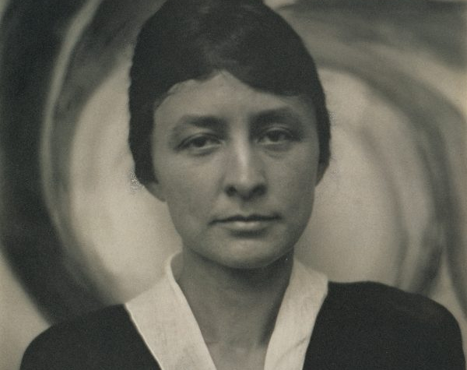
Life of GeorgiA O’Keeffe
Known as Mother of American Modernism
2nd of 7 children
Grew up on a farm in Wisconsin
Studied at Art Institute of Chicago
O'Keeffe taught art at public schools in Amarillo, Texas, from 1912 to 1914
O'Keeffe split her time between New York and painting in New Mexico. She was particularly inspired by Ghost Ranch, north of Abiquiú, and she decided to move into a house there in 1940
Later in life O'Keeffe suffered from macular degeneration and began to lose her eyesight
She was 98 years old when she passed away

Slide 3
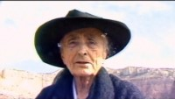

Slide 4
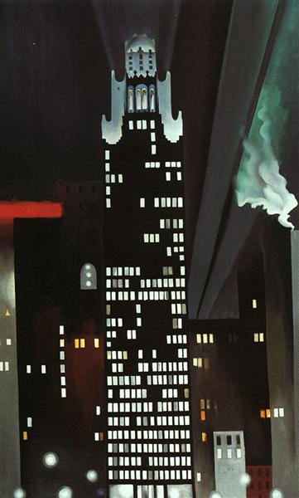
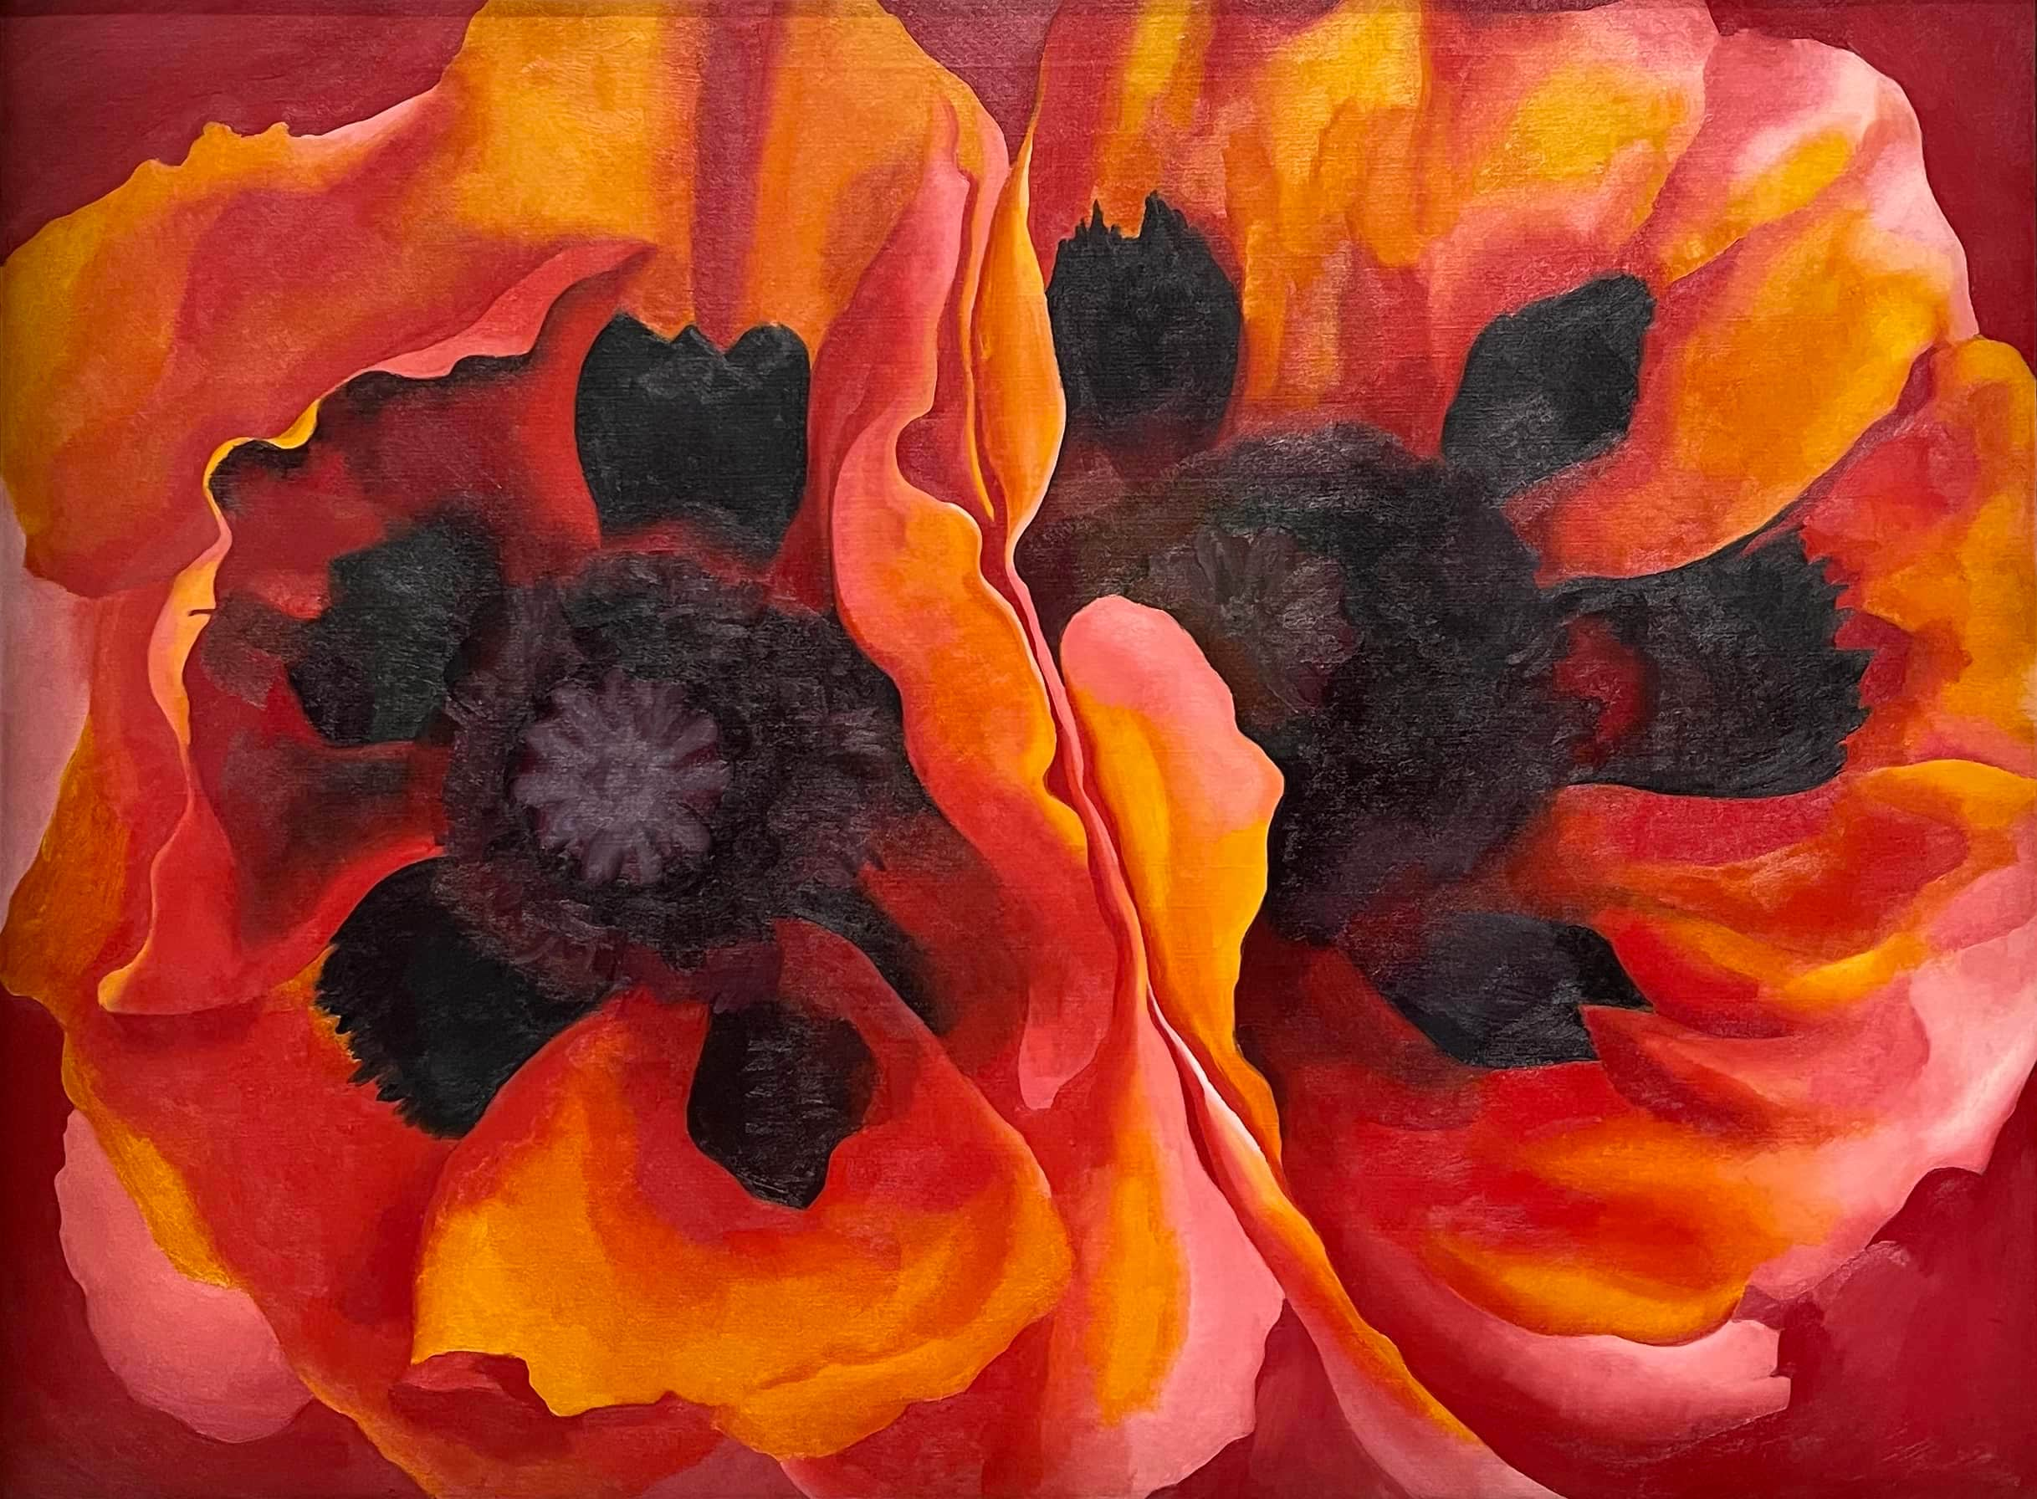
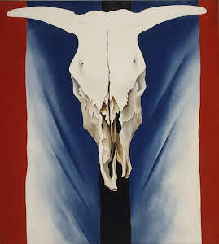
Famous
Art work
Radiator Building – Night New York
Oriental Poppies
American modernism was a cultural movement in the United States, showing both progressive transformation and optimism in the future.
It is a reflection of life in America during the 20th century and the continuing socially climbing middle class
Georgia began experimenting, leading her to develop highly abstracted art. Her drawings and paintings are large scale, extreme close-ups of flowers, leaves, and trees or combinations of skulls and flowers.
Cow’s Skull: Red, White & Blue

Slide 5
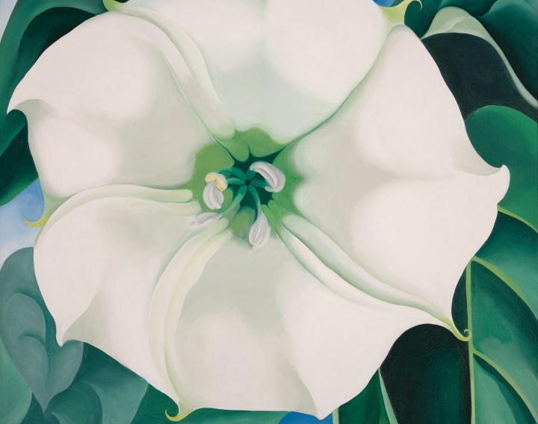
Jimson Weed
Completed in 1936
This work was commissioned by Elizabeth Arden a cosmetic magnate. She wanted to hang this painting in the exercise room of her new salon to encourage and boost her client’s energy
It was Sold at an auction by the Georgia O’ Keeffe Museum, for $44,405 million

Slide 6
Discussion…
What’s going on in this artwork?
What was your first reaction to this artwork? Why do you think you had the reaction?
Does your opinion about the artwork change the longer you look at it? Why?
Describe the lines in this artwork
What verbs would you use to describe this artwork?

Slide 7
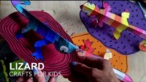
Today’s art project
Desert lizard
Georgia loved the desert. She saw the beauty in its simple landscape & captivating creatures!
Be sure to use bright colors and bold patterns like O’Keeffe

