Slide 1

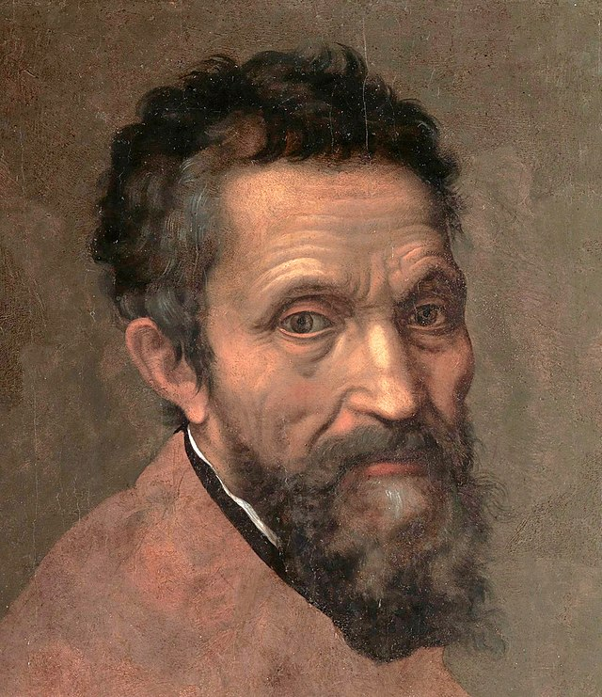
Michelangelo
March 6, 1475 – February 18, 1564

Slide 2


Slide 3
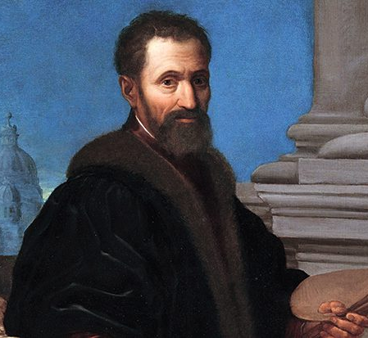
Life of Michelangelo
Born in Caprese, Italy, outside of Florence on March 6, 1475
When he was a baby his mother became to ill to care for him, so he lived with a stone-mason's family until he was 10 years old. Since he was always surrounded by chisels and stone, he joked that this was why he loved to sculpt.
His childhood was lacking in affection which resulted in him being rather grumpy his whole life
Michelangelo was thought to be the greatest artist who ever lived.
He was a sculptor, painter & architect, but was most proud of his sculptors.

Slide 4
Art Work
Battle of the Centaurs –
Michelangelo completed when he was 16 years old!
David - His most famous sculpture - it resides in the Accademia museum in Florence, Italy
Carved out of a single slab of stone, the statue is 14.24 ft tall
From the Biblical story of David and Goliath, it was meant to symbolize the heroic courage of the people of Florence

Slide 5
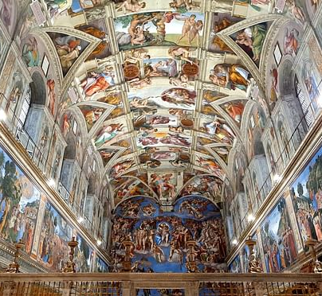
The Sistine Chapel
Michelangelo was commissioned by Pope Julius ll to sculpt a tomb, but last minute was switched to painting the chapel ceiling instead. Michelangelo was not happy.
He painted on his back, using custom scaffolding which was 59 feet above the floor
The ceiling contains approx. 400 life size figures, over a space of 5600 square feet
Completed between 1508-1512. He said of the work, “After 4 tortured years, I felt as old and as weary as Jeremiah. I was only 37, yet friends did not recognize the old man I had become.”
The Sistine Chapel can still be seen today in The Vatican in Rome

Slide 6

Discussion…
What’s going on in this artwork?
What was your first reaction to this artwork? Why do you think you had the reaction?
Does your opinion about the artwork change the longer you look at it? Why?
Describe the lines in this artwork
What verbs would you use to describe this artwork?

Slide 7
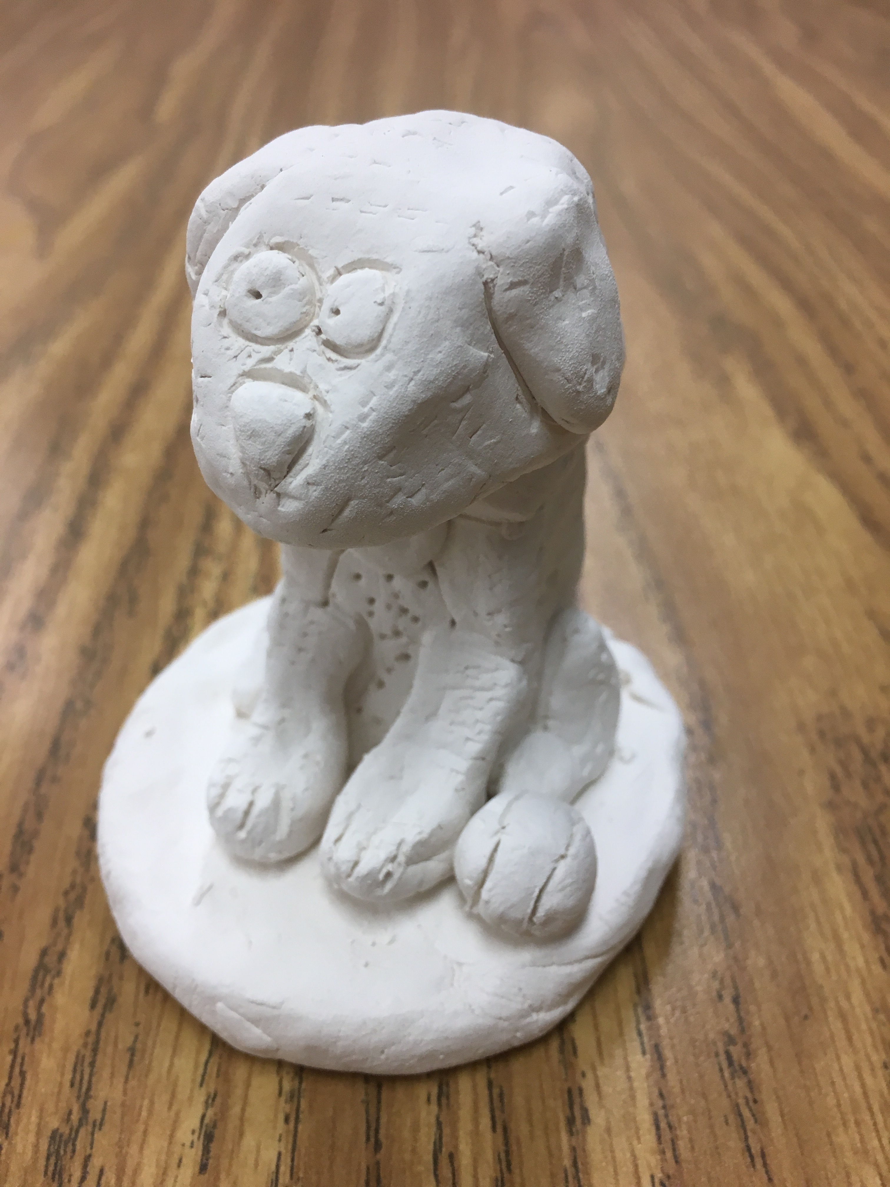
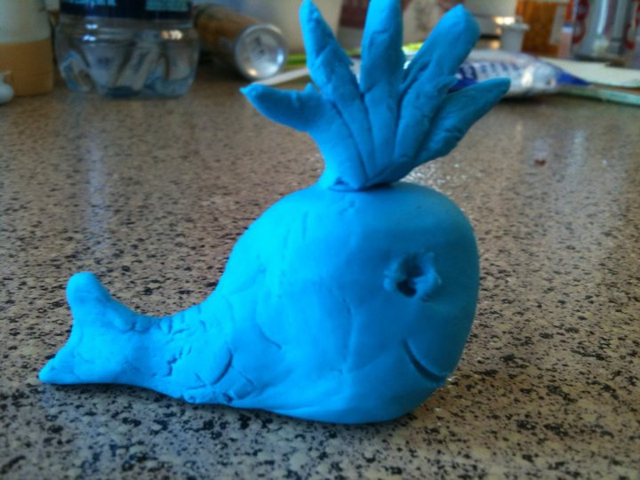
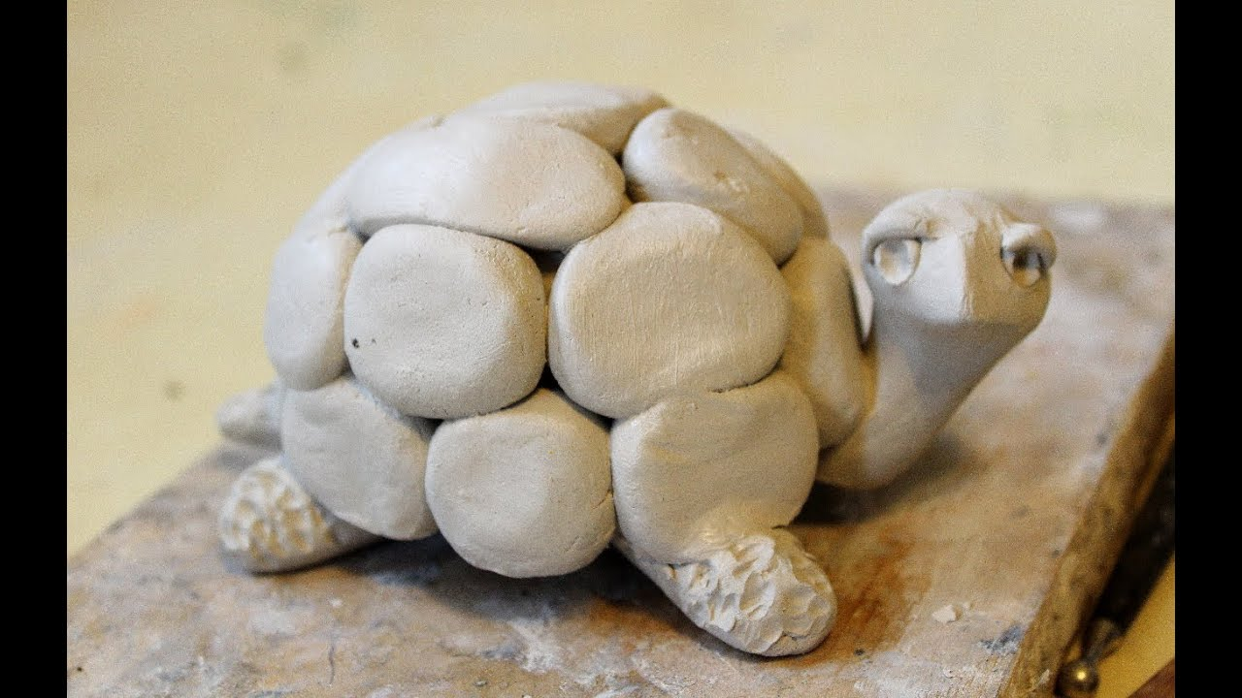
Today’s Art Project
Scuplting!

