Slide 1

Roy Lichtenstein
October 27, 1923 -September 30, 1997

Slide 2
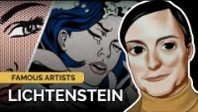

Slide 3
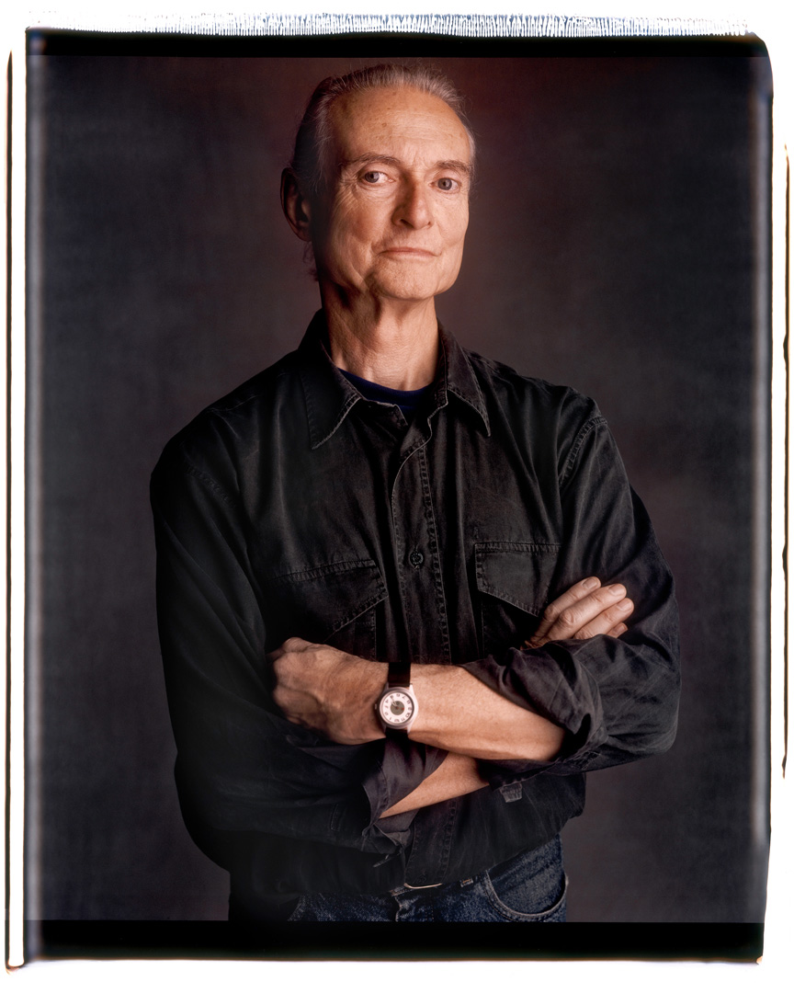
Life of Roy Lichtenstein
Born in Manhattan, New York
Roy served in World War II
When we returned from war he finished his college degree in fine arts from Ohio State
He worked as a window display designer for department stores, industrial designer & commercial art instructor

Slide 4
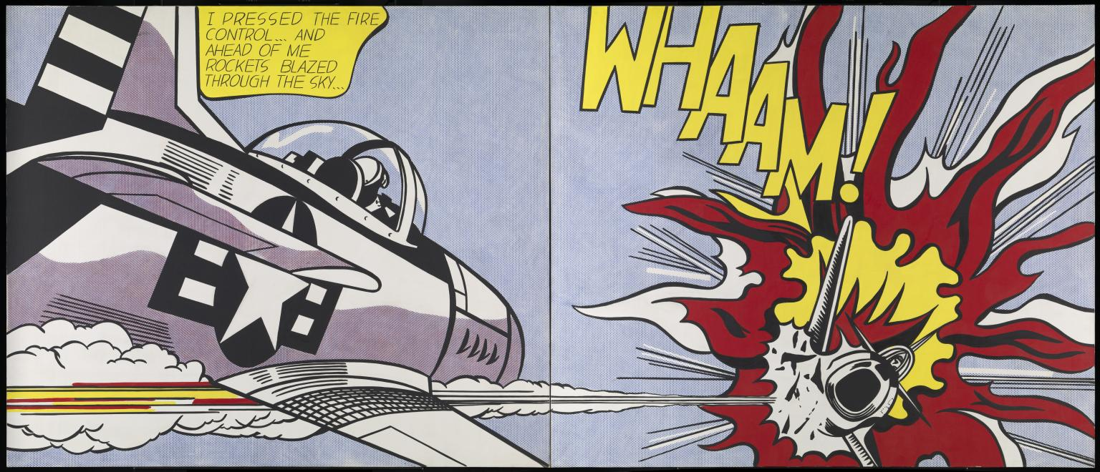
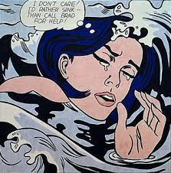
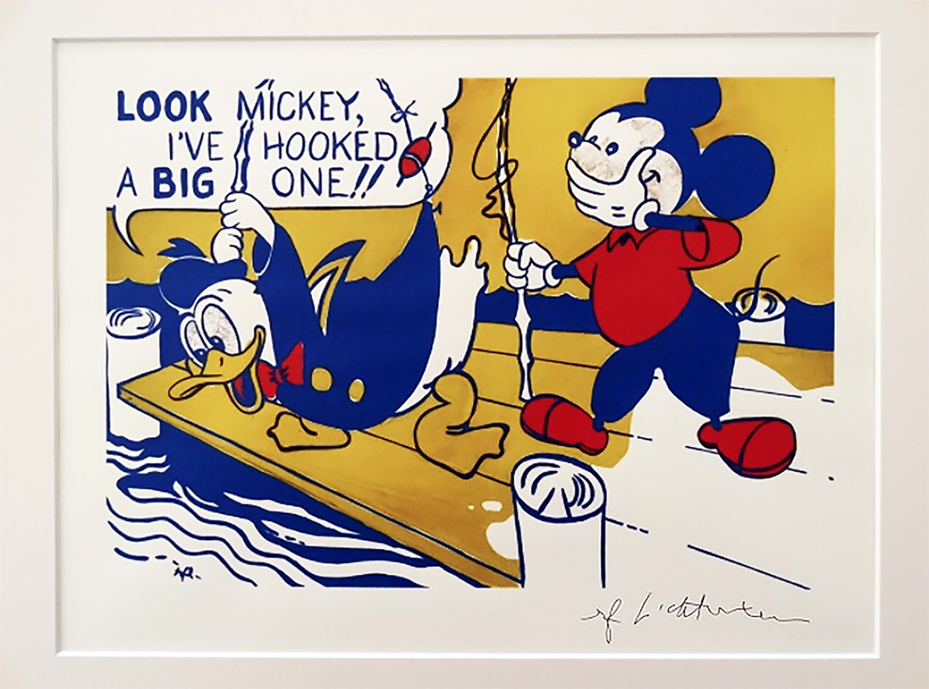
Art Work
WHAM! (1963)
Look Mickey(1961) marks the drastic change in Lichtenstein's career. The story goes, that he painted it for his kids who had said that "daddy could not paint as well as the images in the comic books".
Drowning Girl(1963)

Slide 5
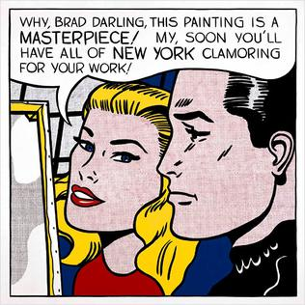
Art Work
Without Dots
Lichtenstein worked a lot with stencils, producing rows of oversized ben-day dots, that make his paintings look machine made. He did not want his brush strokes to be seen.
Using ben-day dots and stripes he made his still lives truly unique and Pop Art like.
Masterpiece(1962) - His most expensive piece which sold for $165 million in January 2017
With Dots

Slide 6

Discussion…
What’s going on in this artwork?
What was your first reaction to this artwork? Why do you think you had the reaction?
Does your opinion about the artwork change the longer you look at it? Why?
Describe the lines in this artwork
What verbs would you use to describe this artwork?

Slide 7
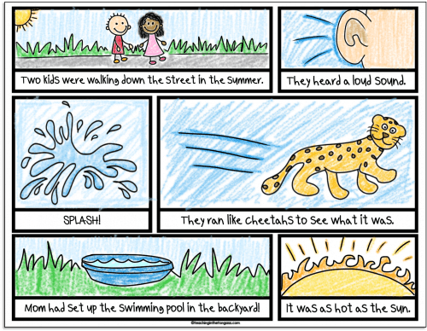
Today’s Lesson…
COMIC STRIPS

