Slide 1

Grant WOod
February 13, 1891 – February 12, 1942

Slide 2


Slide 3

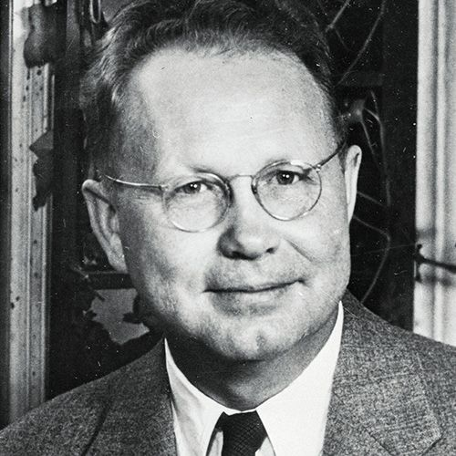
Life of grant wood
Grant DeVolson Wood was born in Anamosa, Iowa in
Wood first enrolled in an art school in Minneapolis, Minnesota when he was 19 but returned a year later to Cedar Rapids to teach in a one-room schoolhouse
When he was 22, he enrolled at the Art Institute of Chicago and worked as a silversmith
From 1920 to 1928, he made four trips to Europe, where he studied many styles of painting
In 1932, Wood helped found the Stone City Art Colony near his hometown to help artists get through the Great Depression
During this time, he also initiated an American Art movement known as Regionalism - it rejected abstract art from Europe and focused on figurative paintings of rural, Midwestern, American themes
He taught painting at the University of Iowa’s School of Art from 1934 until his death in 1942
American Gothic is one of the most famous painting in American art and one of the few images to reach the status of cultural icon, along with da Vinci’s Mona Lisa and Edvard Munch’s The Scream

Slide 4

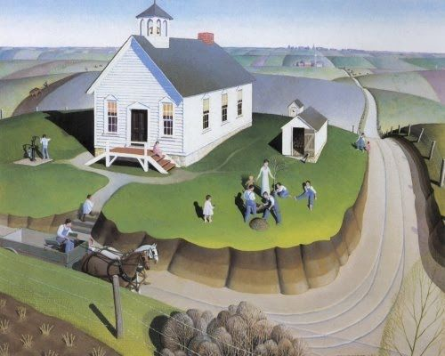
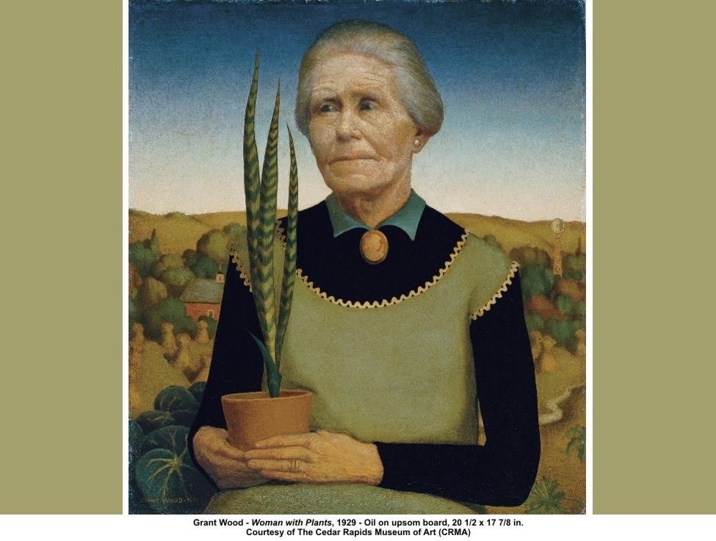
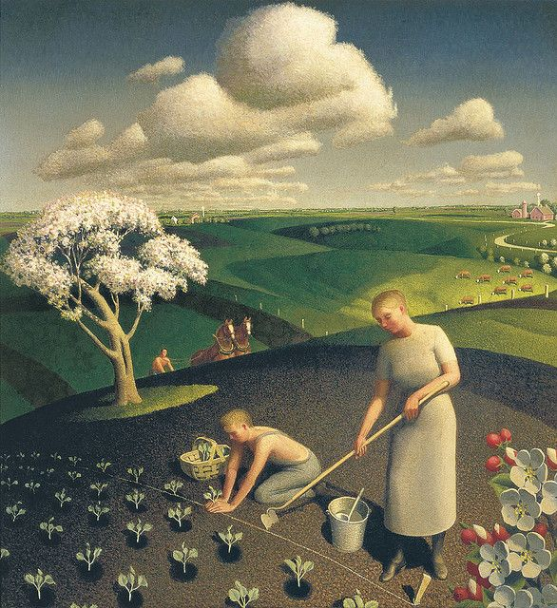
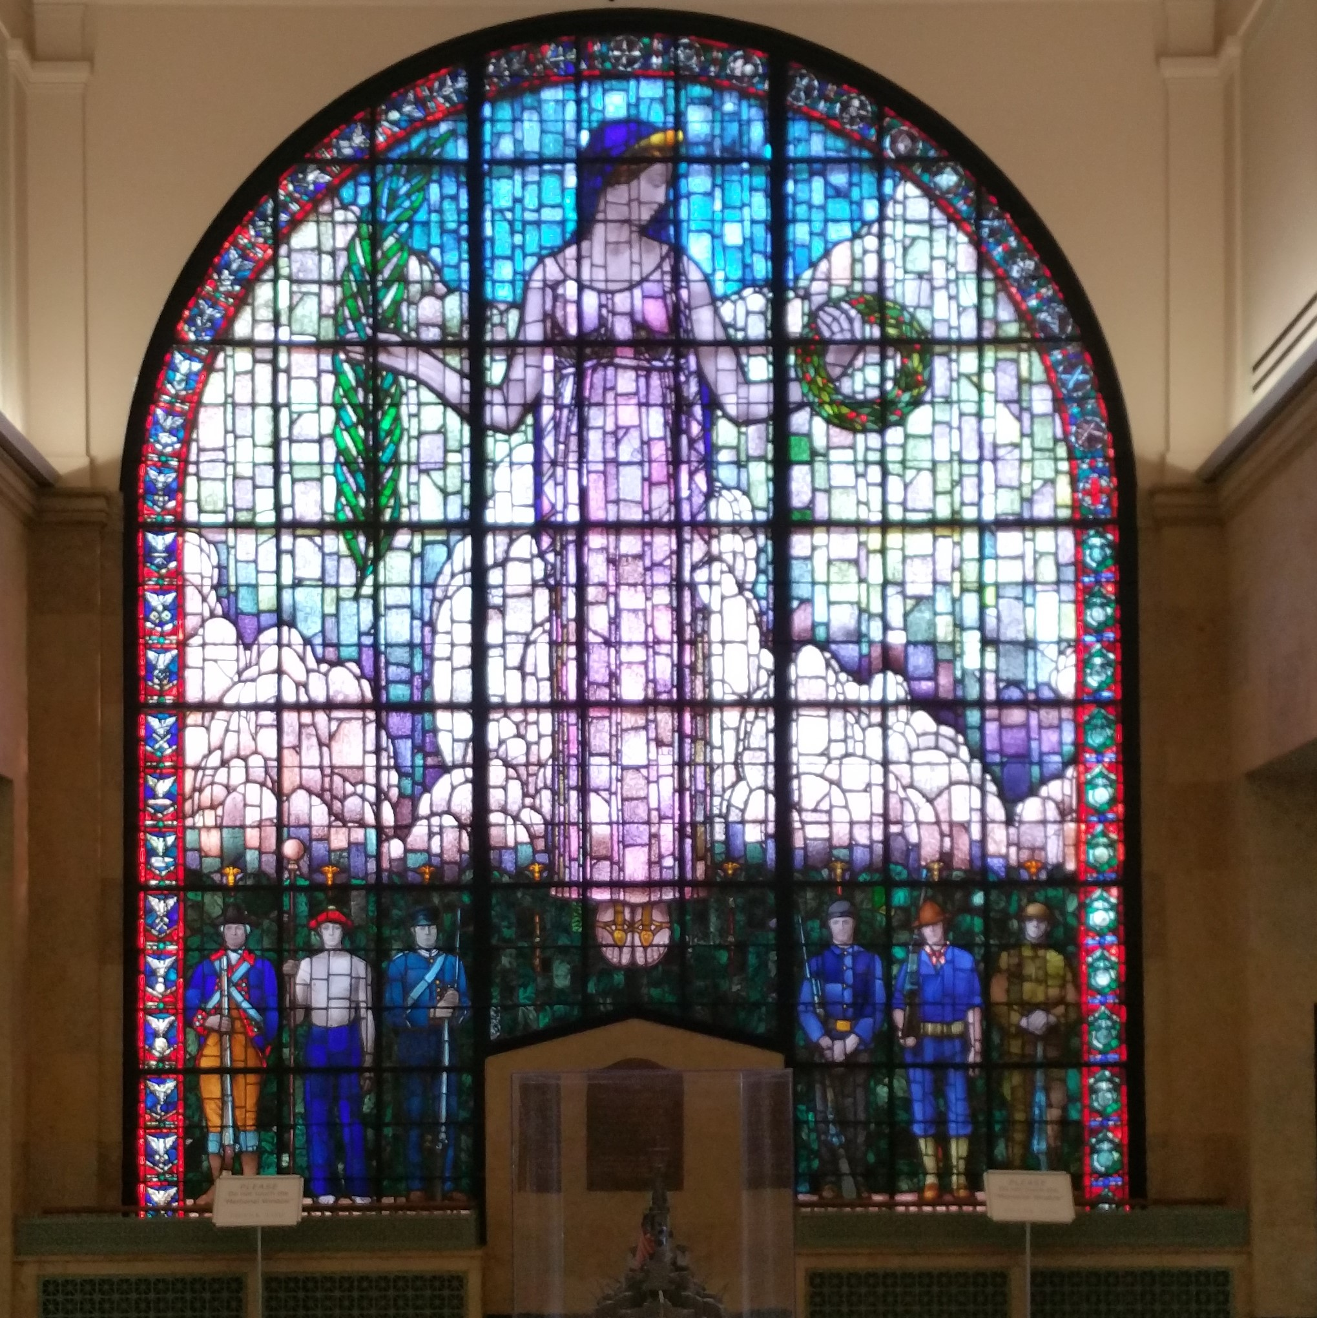

Art work
Arbor Day, 1932
This design is depicted on the 2004 Iowa State Quarter. The quarter shows a one-room schoolhouse with a teacher and students planting a tree and the words "Foundation in Education
Grant Wood designed and built the stained glass window at the Veterans Memorial Building in Cedar Rapids, Iowa. The window includes a 16 foot "Lady of Mourning" and life size soldiers from the Revolutionary War through WWI.
Spring in the Country, 1941​
Veterans Memorial Window, 1929
Woman with pLants, 1929​

Slide 5

Discussion…
What’s going on in this artwork?
What was your first reaction to this artwork? Why do you think you had the reaction?
Does your opinion about the artwork change the longer you look at it? Why?
Describe the lines in this artwork
What verbs would you use to describe this artwork?

Slide 6

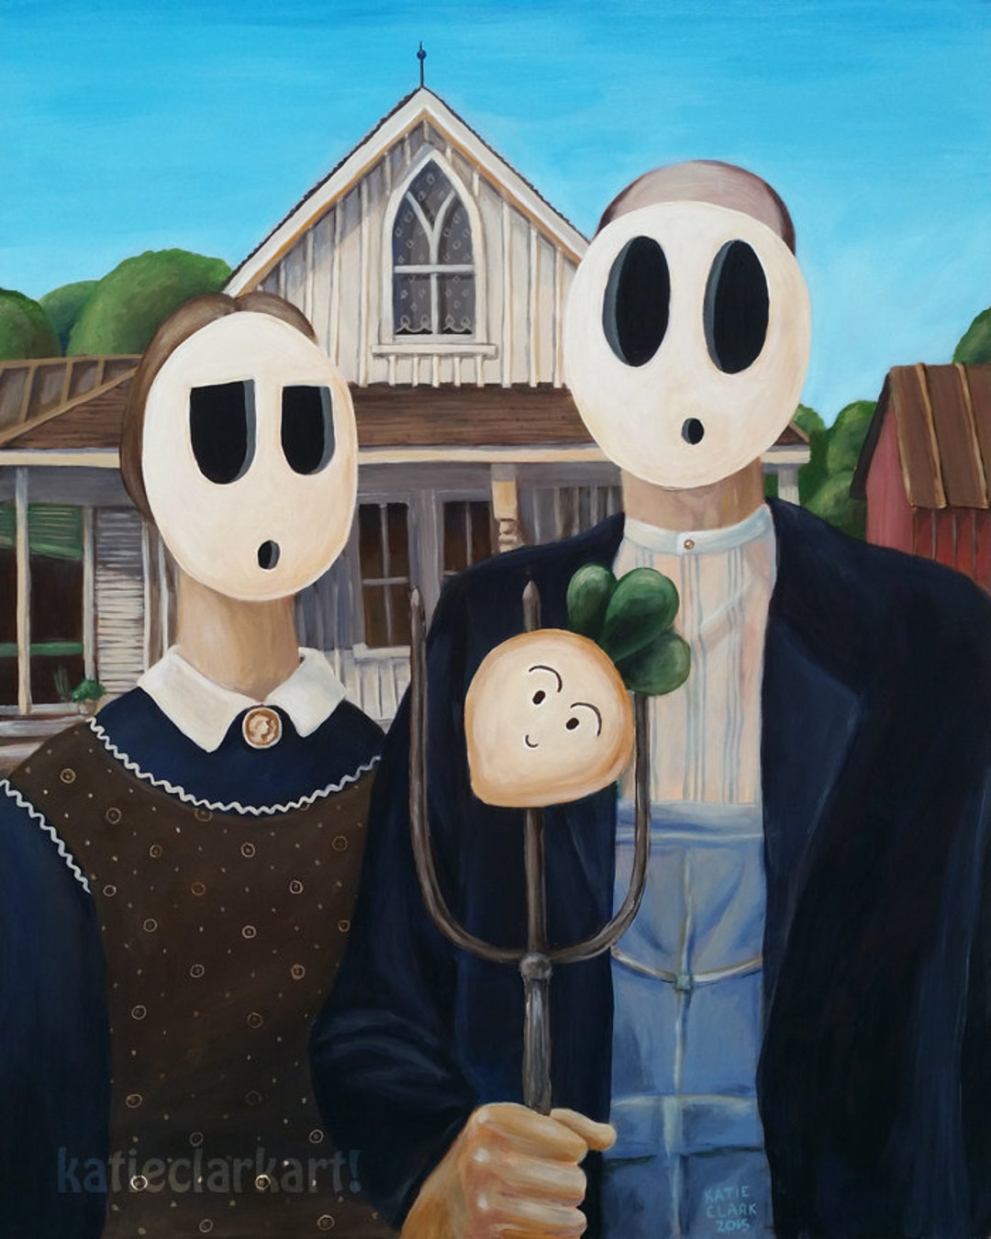
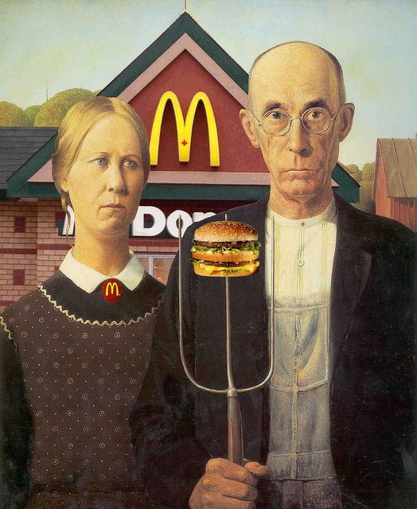

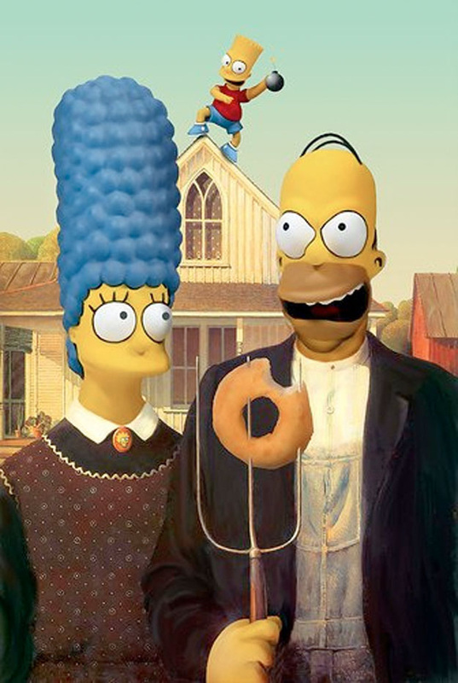
Todays Art Lesson…
American Gothic Parody

