Slide 1
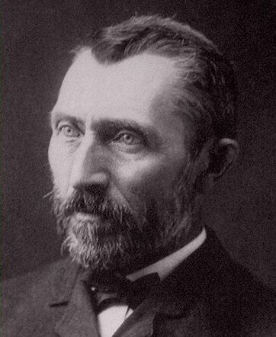
Vincent Van Gogh
March 30, 1853 – July 29, 1890

Slide 2
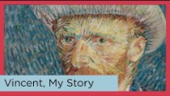

Slide 3
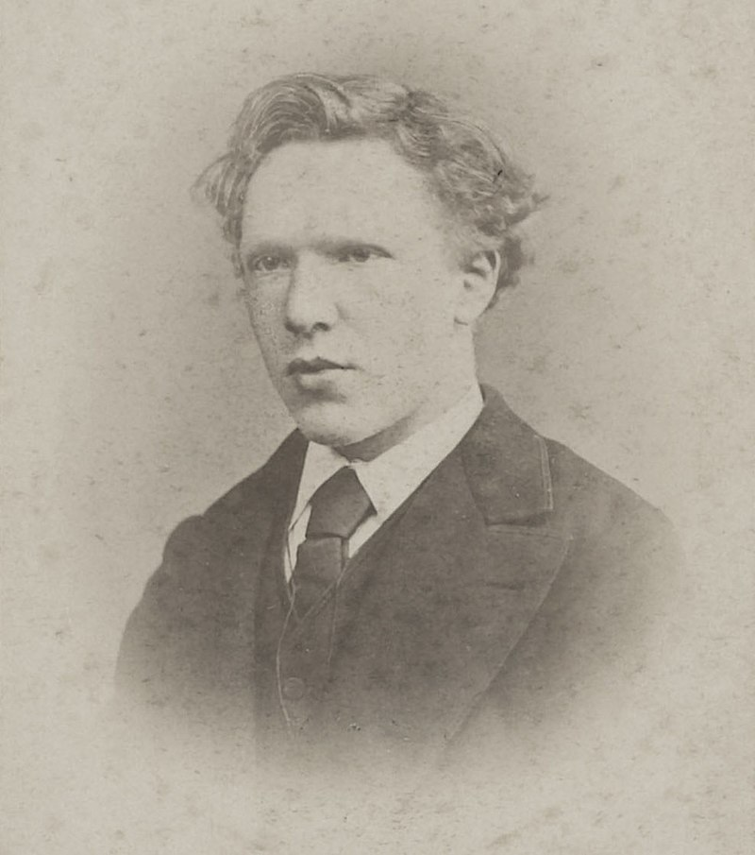
Van Gogh:
Interesting Facts
Completed 900 paintings in 10 years
Suffered from severe mental illness his entire life
Despite coming from a well-off family, he spent his adult life in poverty. His diet consisted of bread & coffee.
He was the pioneer of the post-impressionistic selfie
During a 3-year period he painted 43 self portraits. This was due to lack of funds to pay for a model
His other cost saving trick was re-using his canvases. It is often wondered what could be hiding under those 900 paintings!
Only known photograph of Van Gogh at age 19

Slide 4
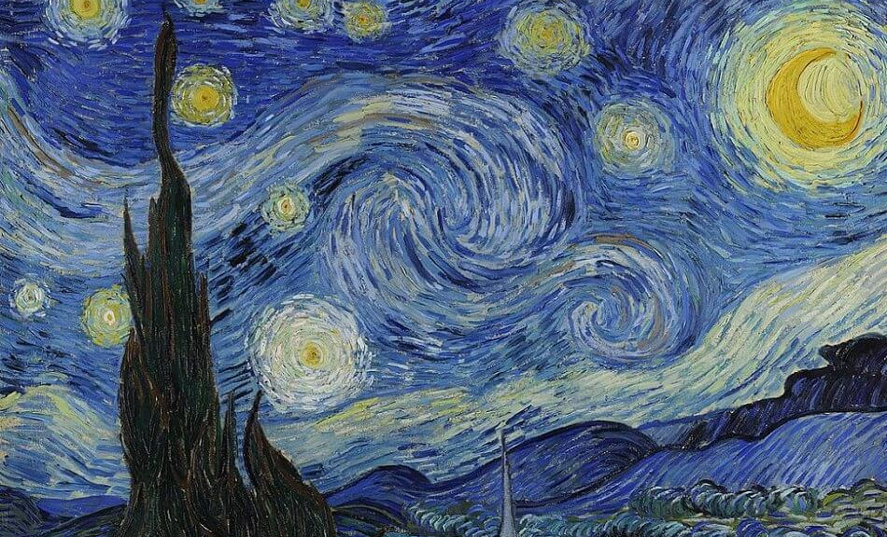
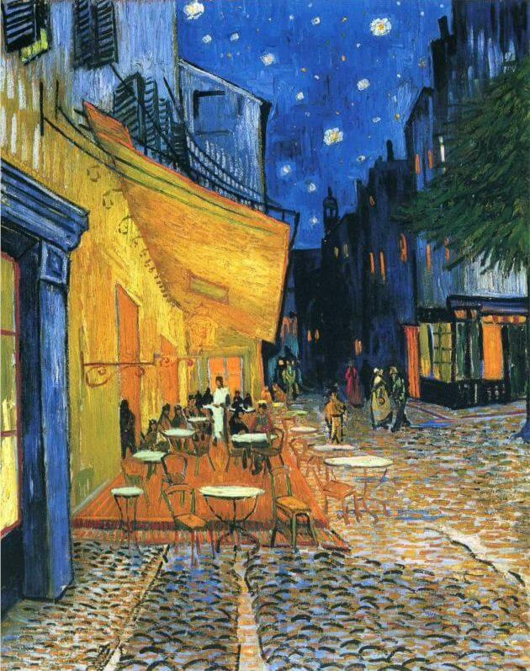
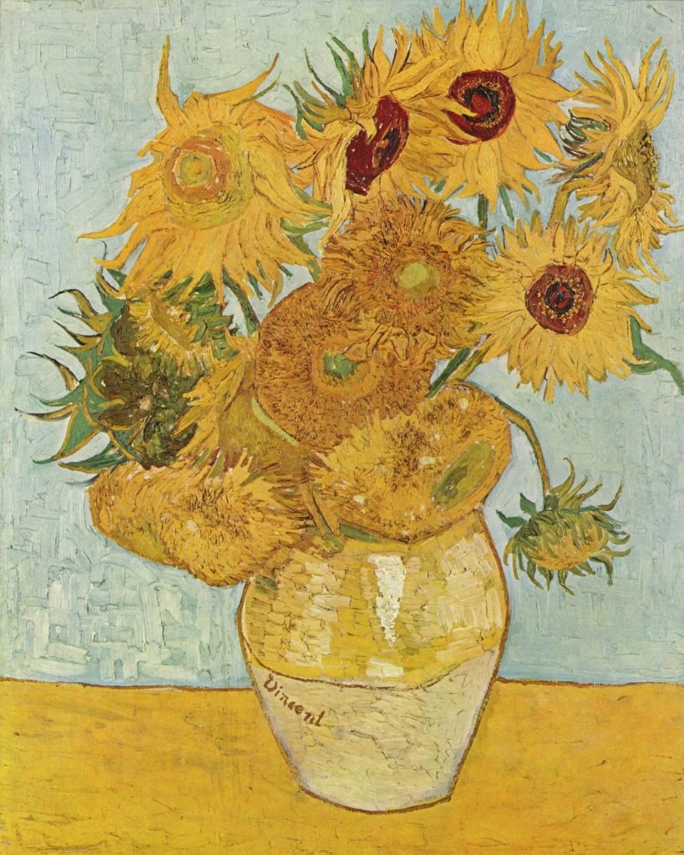
Art
Work
Although Vincent van Gogh's paintings are virtually priceless today, his art went unrecognized during his lifetime
The Starry Night (1889) - Vincent van Gogh night stars painting depicts the view outside his sanatorium room window at night
Café Terrace at Night (1888) - Van Gogh never signed "Café Terrace at Night." However, he specifically mentioned the painting in three pieces of correspondence, so art historians are confident that he painted it. The café in the painting is still in existence, renamed the Café Van Gogh.

Slide 5
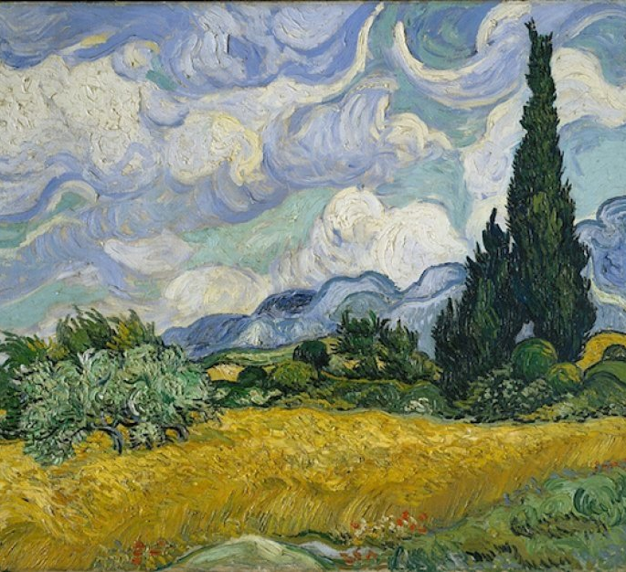
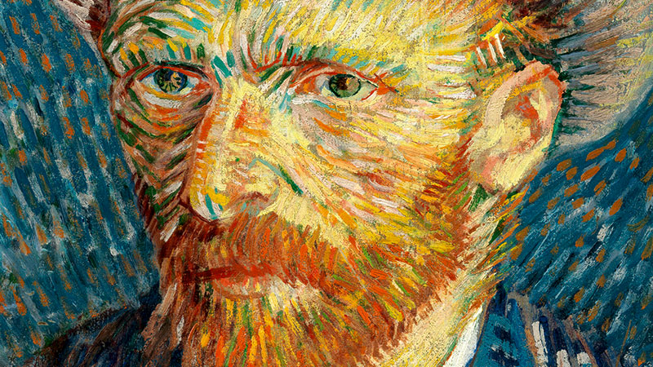
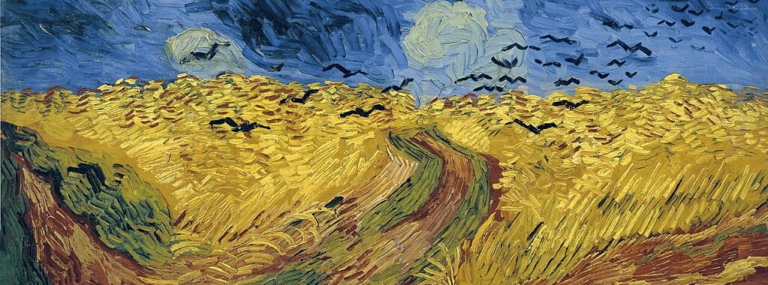

Slide 6
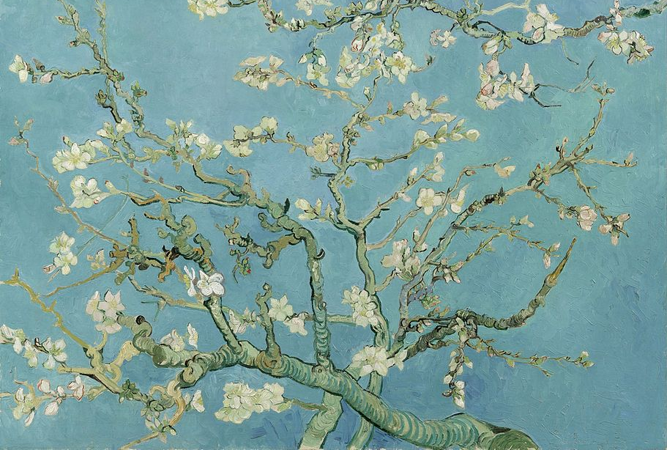
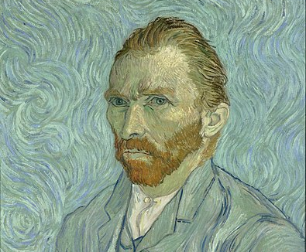
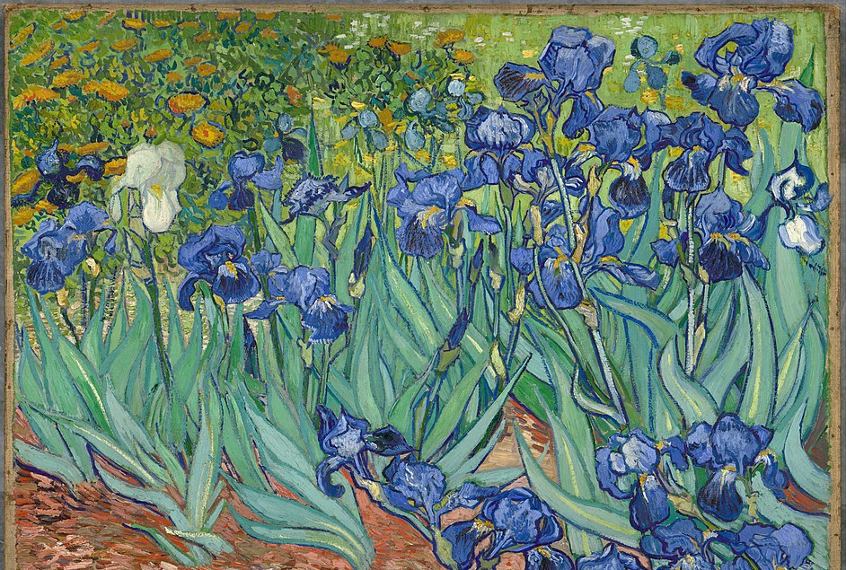

Slide 7

Discussion…
What’s going on in this artwork?
What was your first reaction to this artwork? Why do you think you had the reaction?
Does your opinion about the artwork change the longer you look at it? Why?
Describe the lines in this artwork
What verbs would you use to describe this artwork?

Slide 8
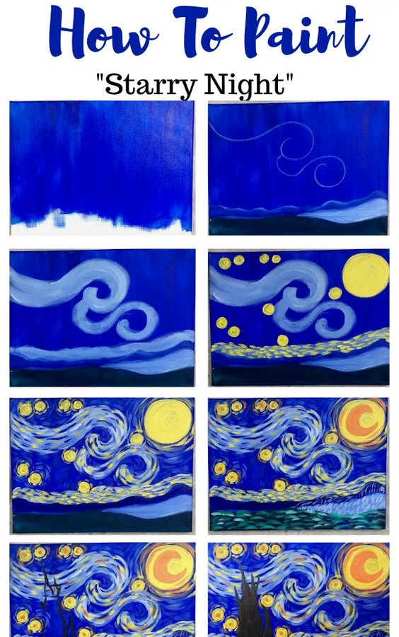
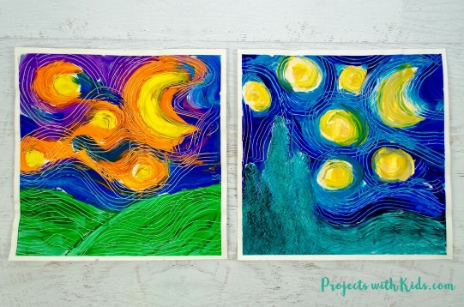
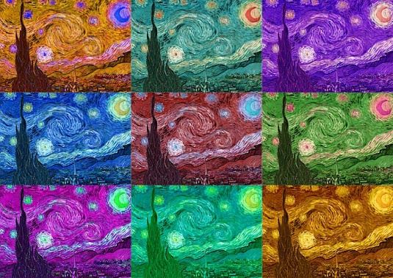
Today’s Art Project
Starry Night

