Slide 1
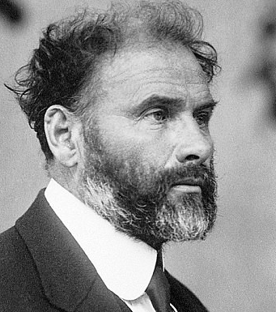

Gustav Klimt
July 14, 1862 – February 6, 1918

Slide 2
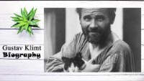

Slide 3
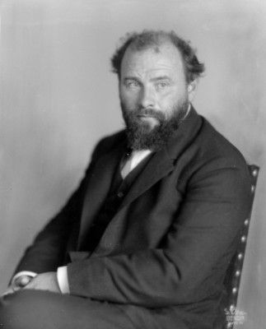
Life of Gustav Klimt
Gustav Klimt was born in Austria, the second of seven children-- three boys and four girls.
His father, Ernst Klimt, was a gold engraver, who was financially unsuccessful.
Klimt lived in poverty for most of his childhood.
Klimt was enrolled, at 14, in the Vienna School of Arts and Crafts in 1876, where he studied until 1883 and received training as an architectural decorator.
Klimt began his painting career by painting interior murals in large public buildings.
In 1897, Klimt was the leader of a group of Austrian artists dedicated to artistic freedom and a style of art known as Art Nouveau
Art Nouveau is French, and it means “new art.”
Gustav Klimt incorporated the finest and most luxurious materials at his disposal including marble, gold-leaf, silver and semi-precious stones in his paintings

Slide 4
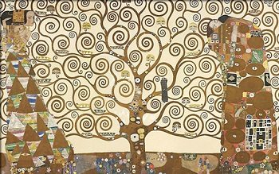
Tree of Life
The “Tree of Life” is an important symbol used by many different religions and cultures. It signifies the connection between heaven and earth and the underworld.
Look at the shapes and lines in The Tree of Life. The swirling branches twist, twirl, turn, and spiral, reaching for the sky.
The roots turn into the earth beneath, creating the connection between heaven and earth.
The two women on either side of the Tree signify Klimt’s belief that females preside over every living thing that is born, grows, and then returns back into the earth. For example, “Mother Nature”
Another interpretation is that the Tree, reaching for the sky, is a symbol of man's perpetual yearning for becoming more, yet his roots are still bound to the earth. Roots can also signify “home”

Slide 5
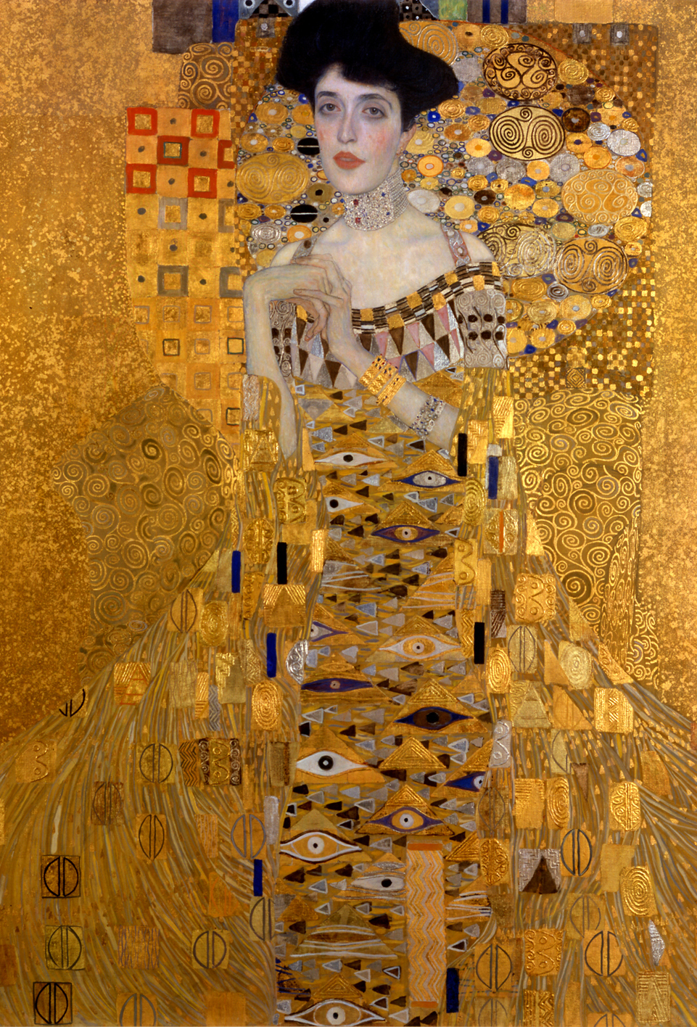
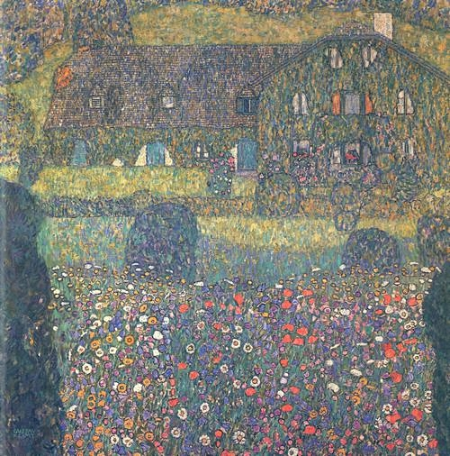
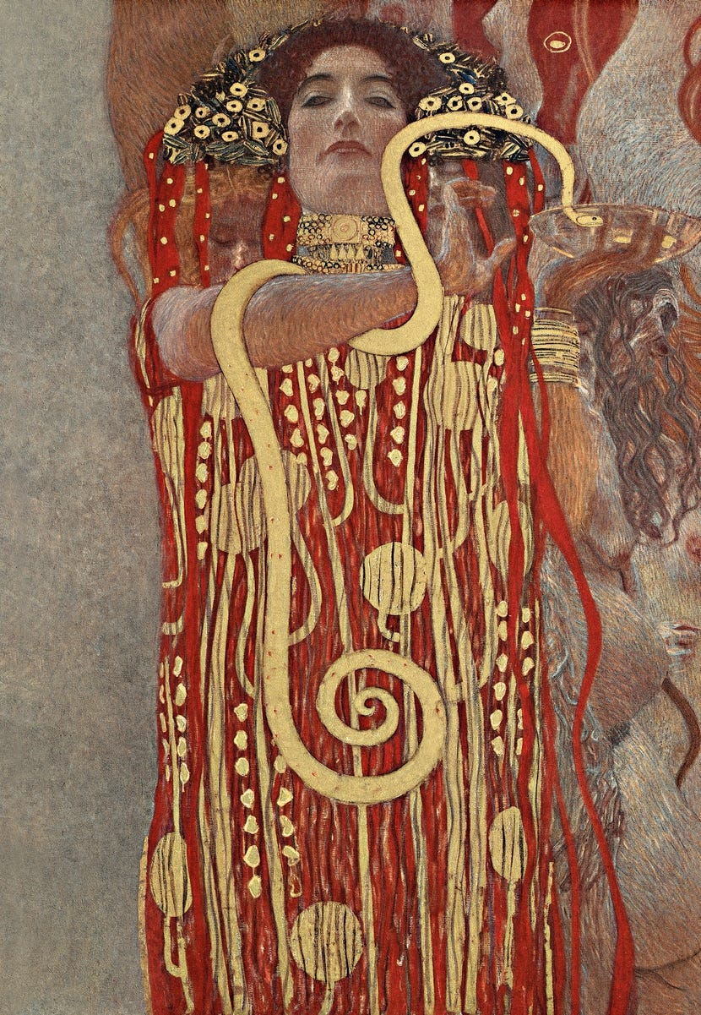
Art
Work
FUN FACT!
Klimt’s portrait of Adele Bloch-Bauer (shown below) sold in 2006 at auction for more money than any other painting ever had before: $135 million!
A movie was made about this painting called Woman in Gold.
Medicine (1901)
Landhaus am Attersee (1914)
In November 2003 this painting sold for
$29 million

Slide 6
Discussion…
What’s going on in this artwork?
What was your first reaction to this artwork? Why do you think you had the reaction?
Does your opinion about the artwork change the longer you look at it? Why?
Describe the lines in this artwork
What verbs would you use to describe this artwork?

Slide 7
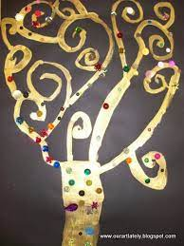
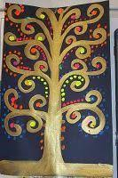
Today’s art lesson
Using pencil QUICKLY sketch your trees outline with all your swirly branches – Remember to use the whole page.
Paint your tree using Klimt’s favorite…GOLD!
Add some bling and/or hidden objects with meaning to your life
Have fun!
Tree of Life

