Slide 1
Pablo Picasso
October 25, 1881 – April 8, 1973

Slide 2
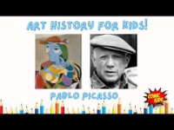

Slide 3
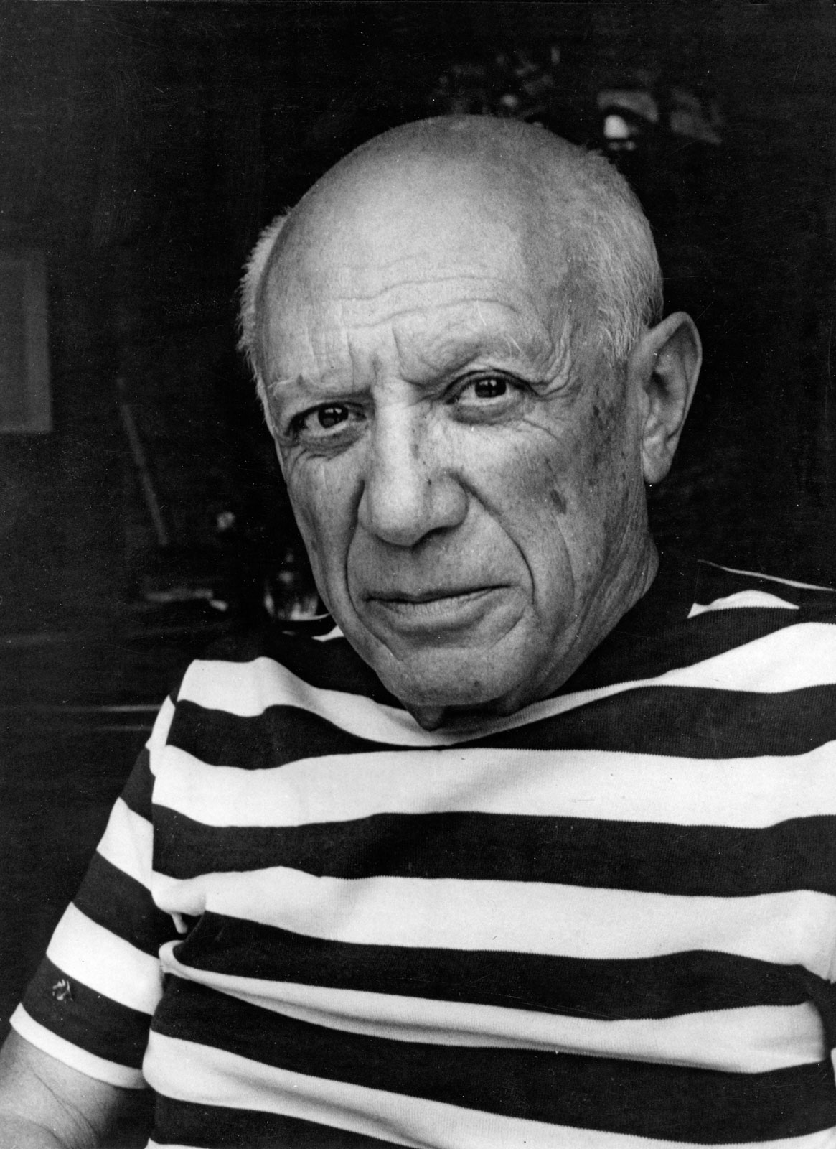
Life of Pablo Picasso
At his baptism, Picasso was christened…Pablo Diego José Francisco de Paula Juan Nepomuceno María de los Remedios Cipriano de la Santísima Trinidad Martyr Patricio Clito Ruíz y Picasso – THAT’S 23 NAMES!!
Spanish painter from the 20th Century
Picasso was a post-impressionism, surrealism & cubist artist…he was very talented, and his “style” changed over the course of his career
He was one of the pioneers of the style Cubism
Picasso made over 50,000 pieces of artwork in his lifetime

Slide 4
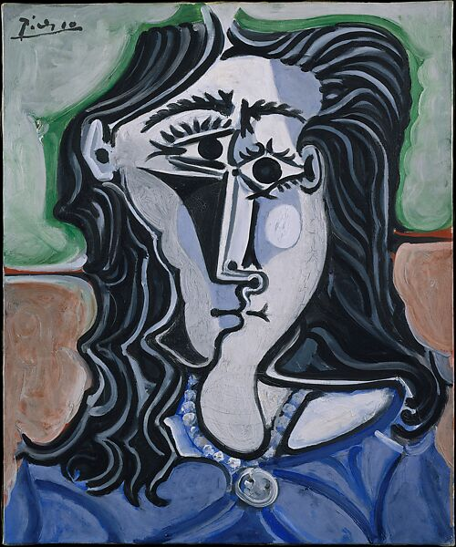
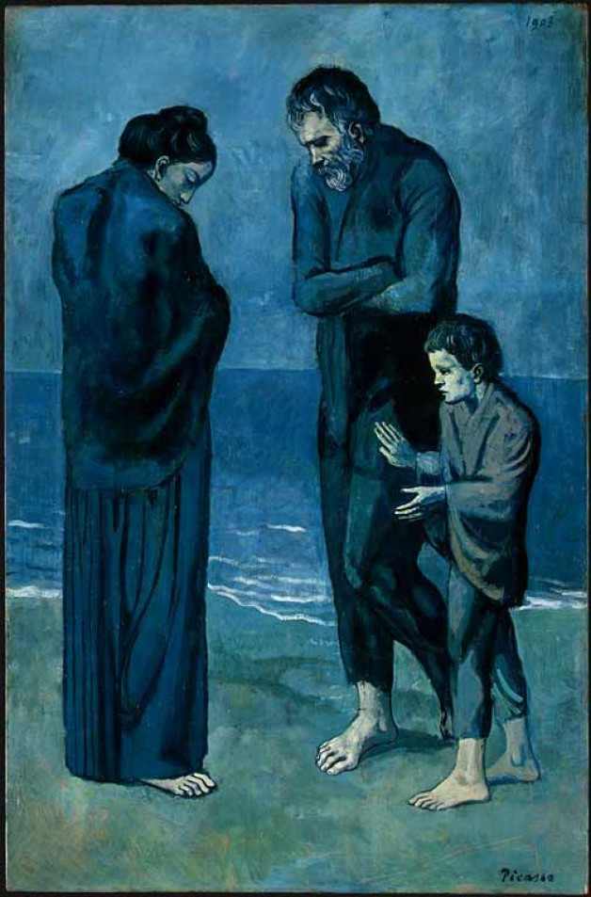
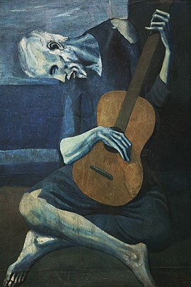
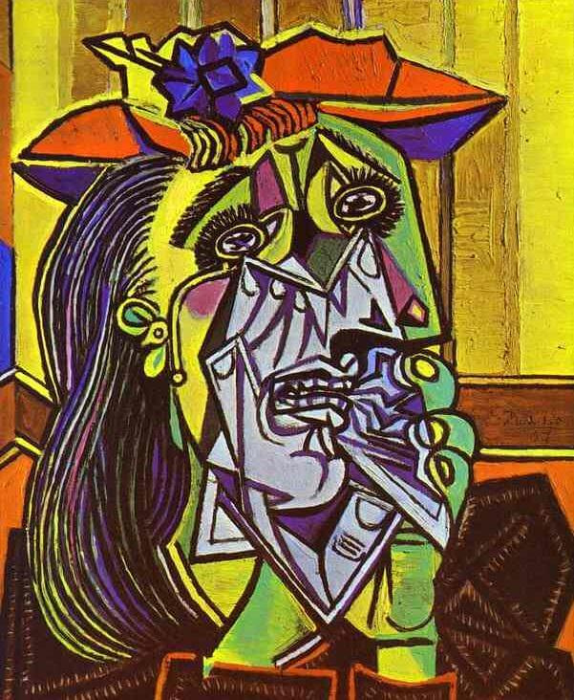
Art Work
Head
of a Woman (1960)
The Old Guitarist (1903-04)
The Weeping Woman (1937)
The Tragedy (1903) – during his “Blue Period”

Slide 5
Discussion…
What’s going on in this artwork?
What was your first reaction to this artwork? Why do you think you had the reaction?
Does your opinion about the artwork change the longer you look at it? Why?
Describe the lines in this artwork
What verbs would you use to describe this artwork?

Slide 6
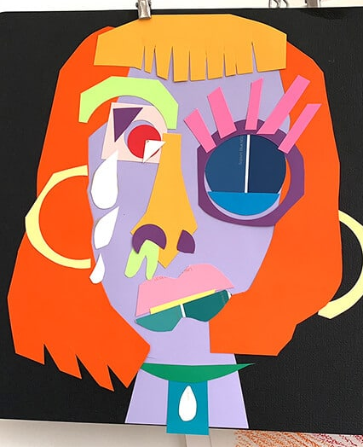
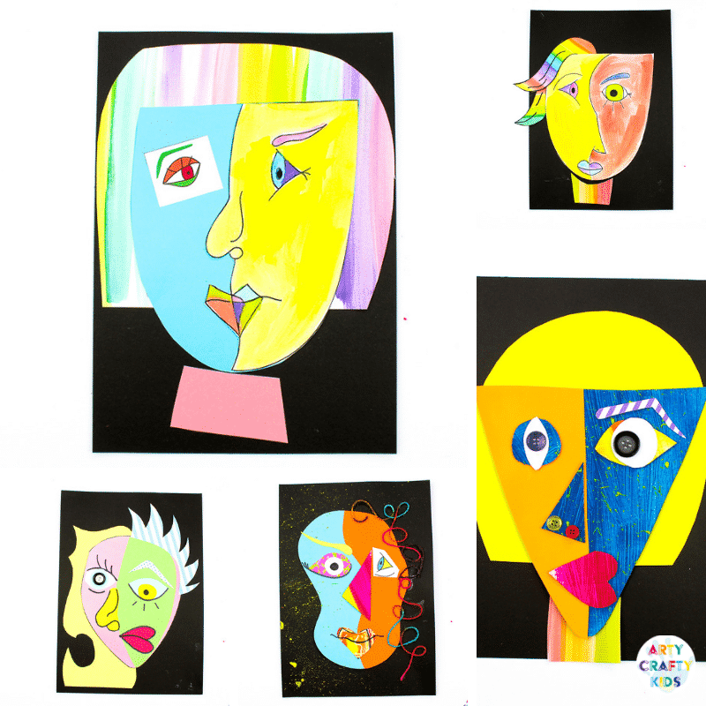
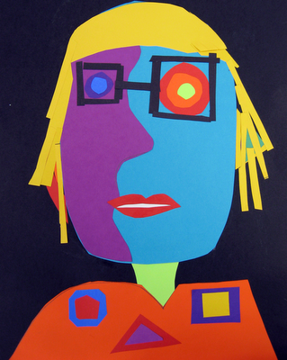
Today’s Lesson…
Self Portrait Collages

