Slide 1
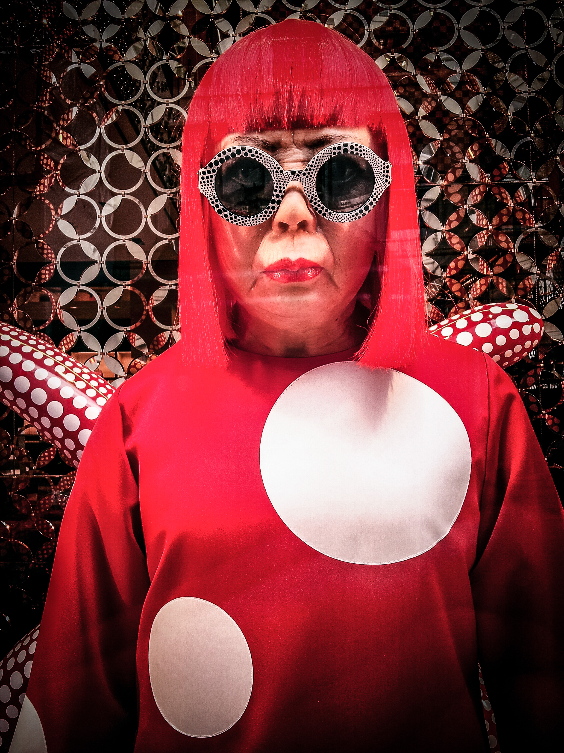
Yayoi Kusama
March 22, 1929 – Still Living

Slide 2


Slide 3
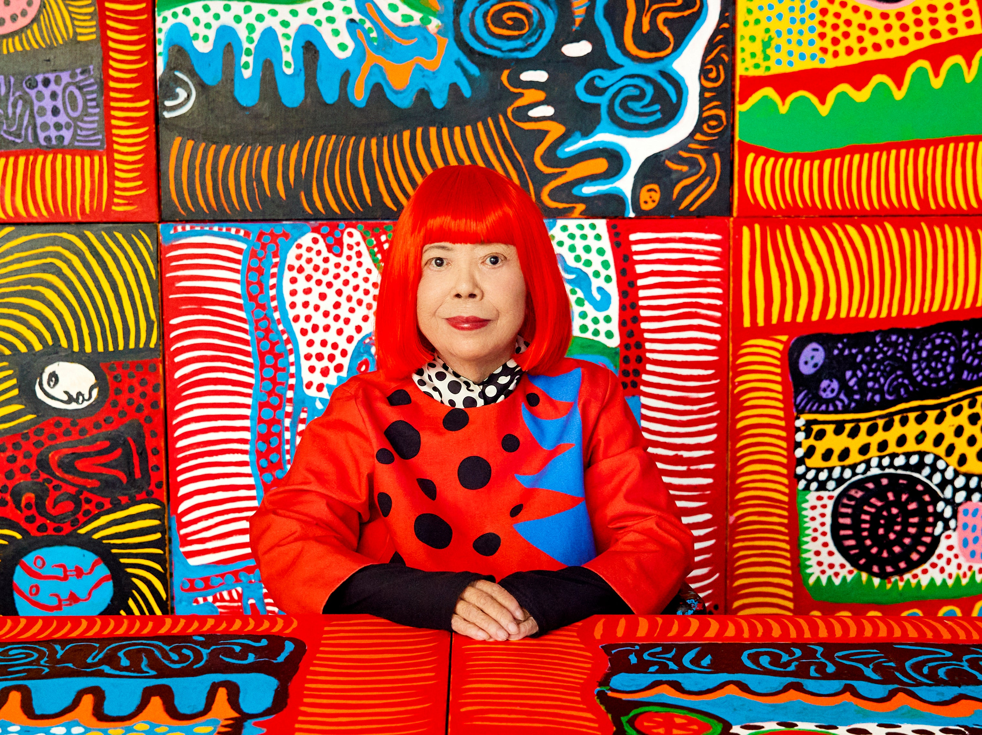
Life of Yayoi Kusama
Yayoi was born in Japan in 1929
She loved drawing and painting and although her parents didn't want her to be an artist, she was determined
When her mom tore up her drawings, she made more. When she could not afford to buy art materials, she used mud and old sacks to make art.
Yayoi Kusama is a Japanese artist who is sometimes called “The princess of polka dots”
She also creates environments of dots. She calls these rooms her “Infinity Rooms,” and creates them by installing hundreds of flashing colored LED lights into mirrored rooms.
Although she makes lots of different types of art – paintings, sculptures, performances and installations – they have one thing in common, DOTS!

Slide 4
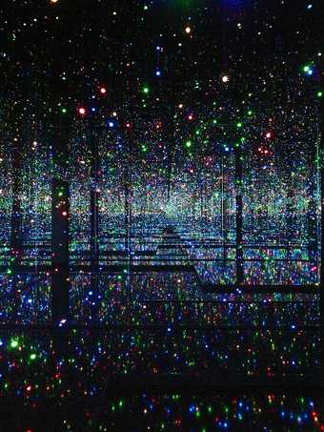
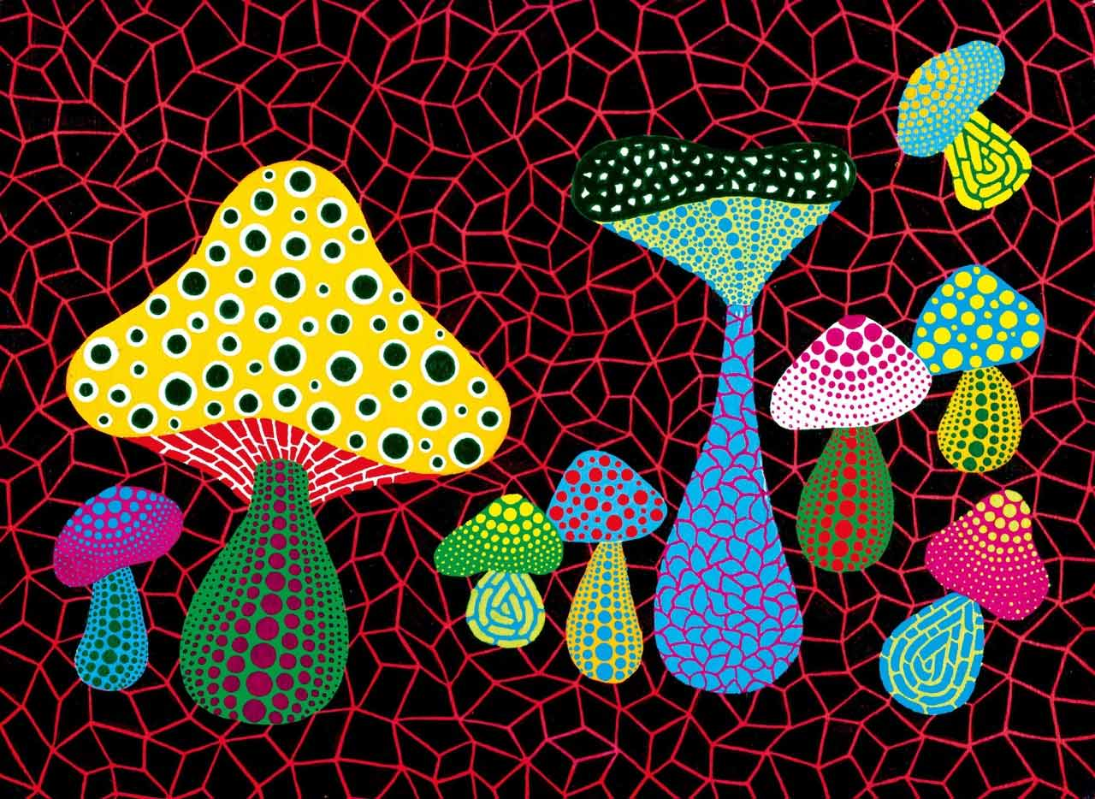
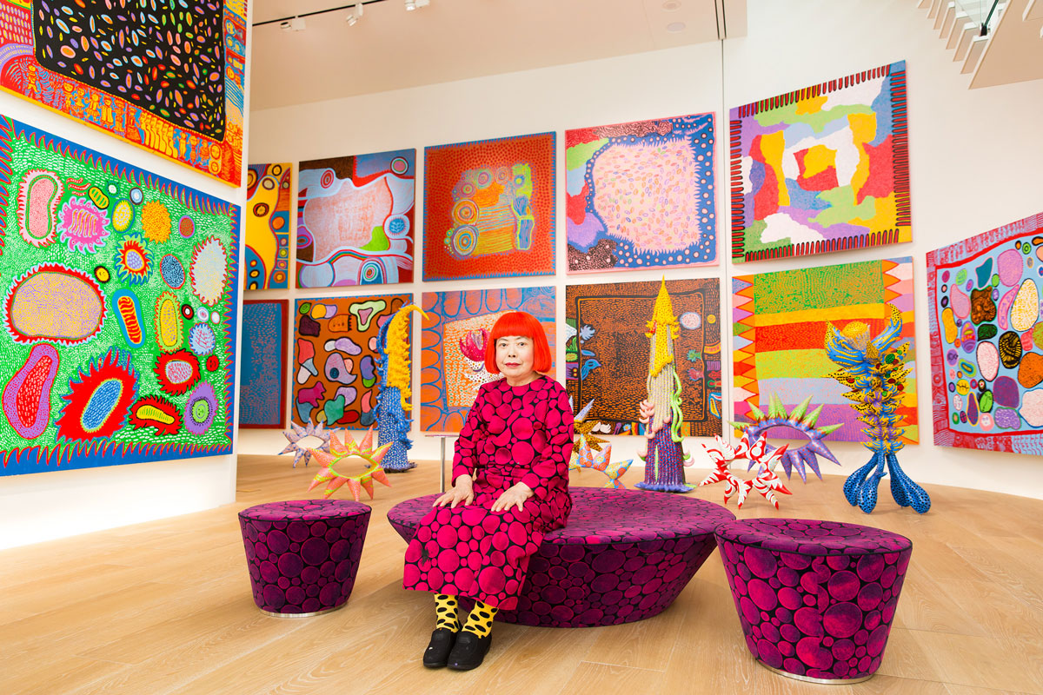
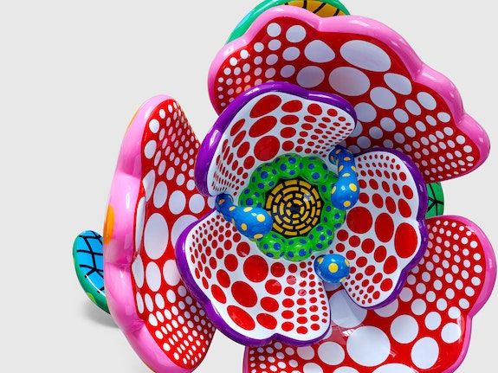
Art work
Yayoi Kusama, Mushrooms, 2005
Infinity Mirrored Room
I Spend Each Day Embracing Flowers, 2023
Yayoi Kusama with recent works in Tokyo, 2016

Slide 5
Discussion…
What’s going on in this artwork?
What was your first reaction to this artwork? Why do you think you had the reaction?
Does your opinion about the artwork change the longer you look at it? Why?
Describe the lines in this artwork
What verbs would you use to describe this artwork?
“
”

Slide 6

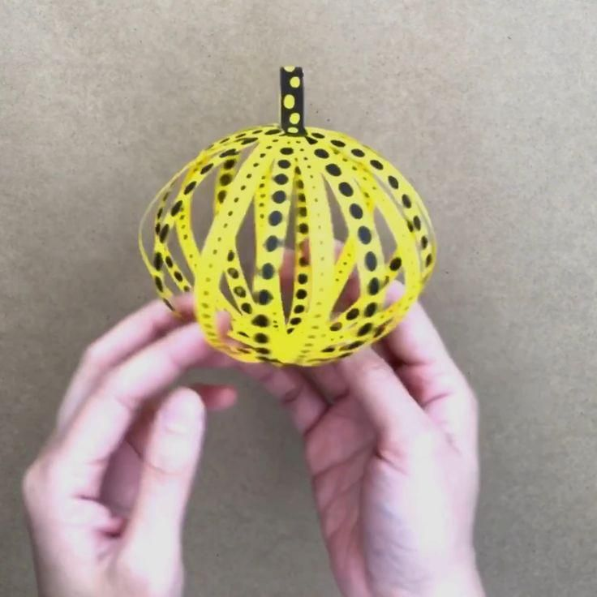
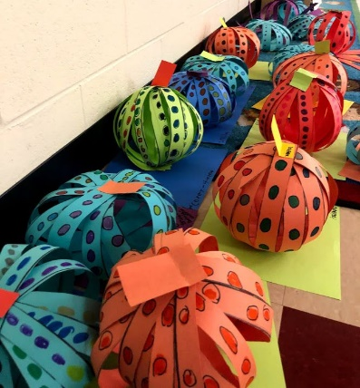
Today’s Art Lesson…
**Example video, you do not need to watch whole video if you’re ready to start ☺

