Slide 1
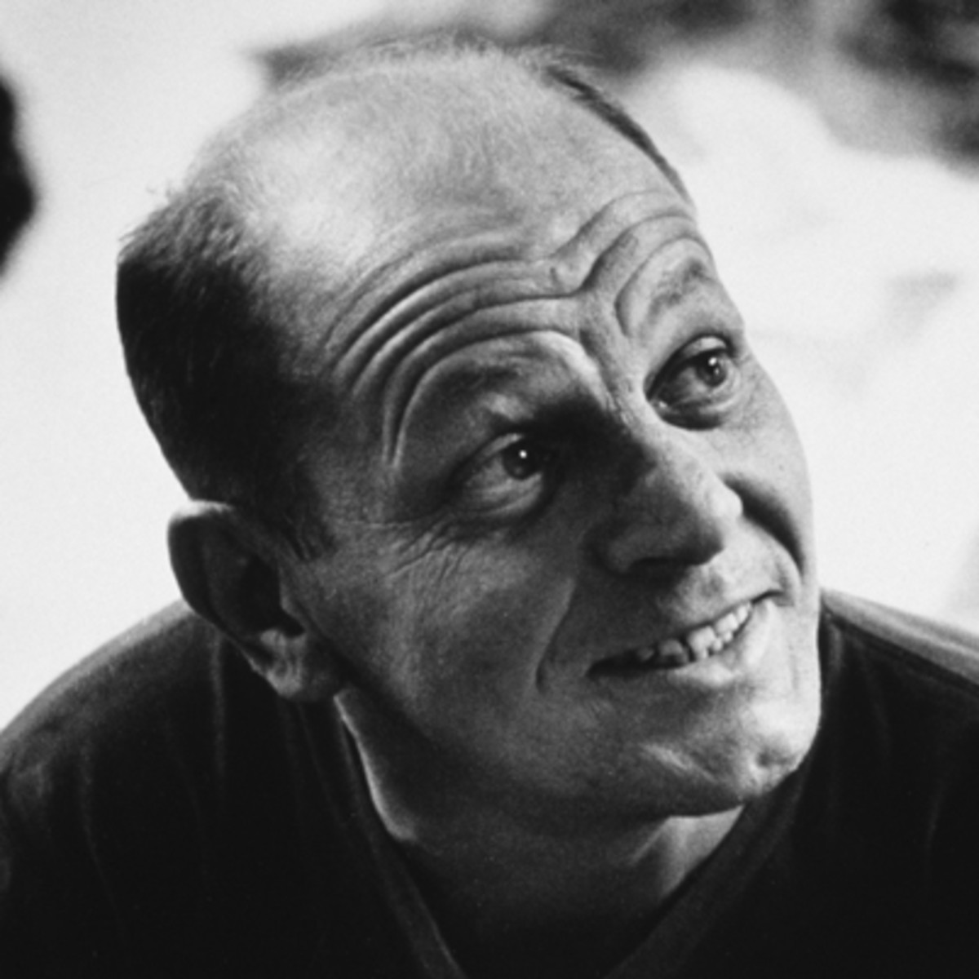
Jackson Pollock
January 28, 1912 – August 11, 1956

Slide 2
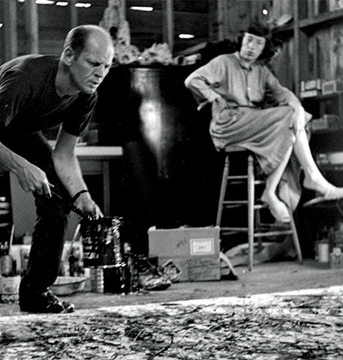
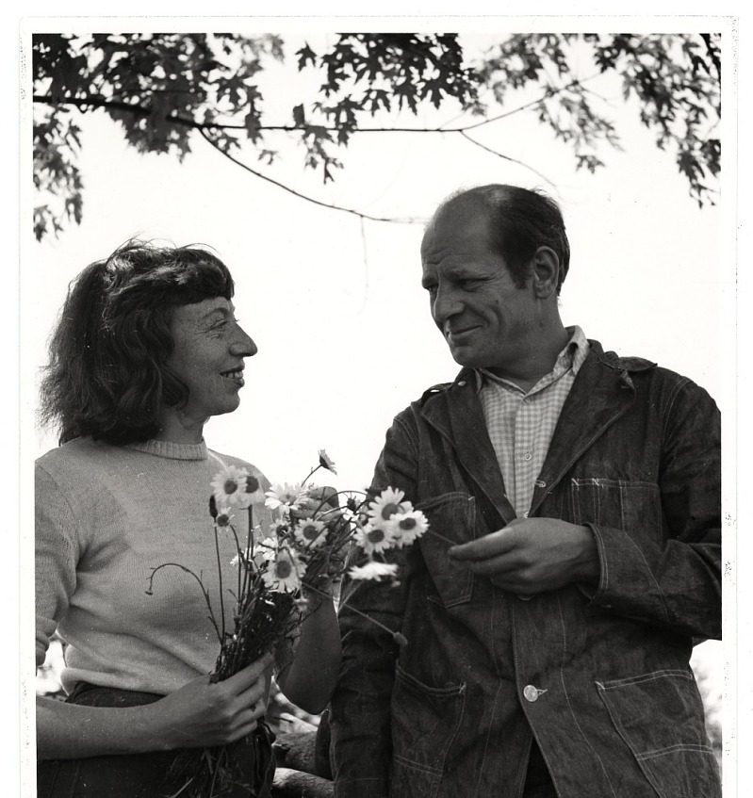
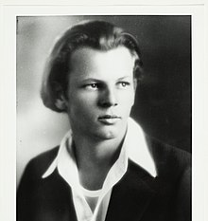
Life of Jackson
Pollock
Pollock moved a lot as a child, Phoenix Arizona was one of the places he lived the longest
Leader of Abstract Expressionist Movement
He never sold a painting for more than $10,000 in his lifetime and was often hard-pressed for cash. His work was more appreciated abroad.

Slide 3


Slide 4
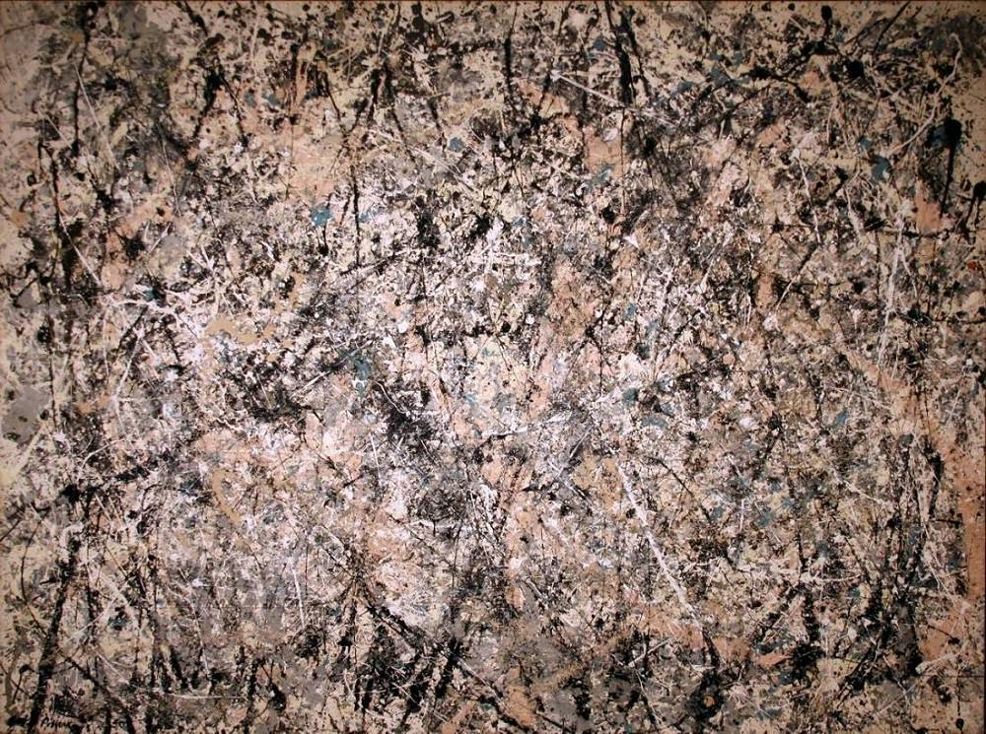
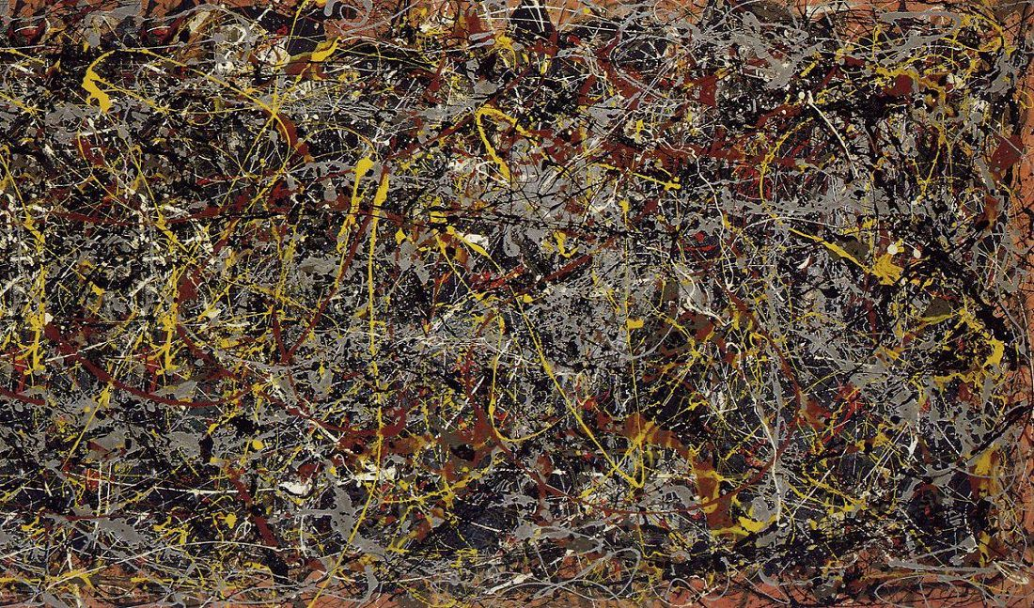
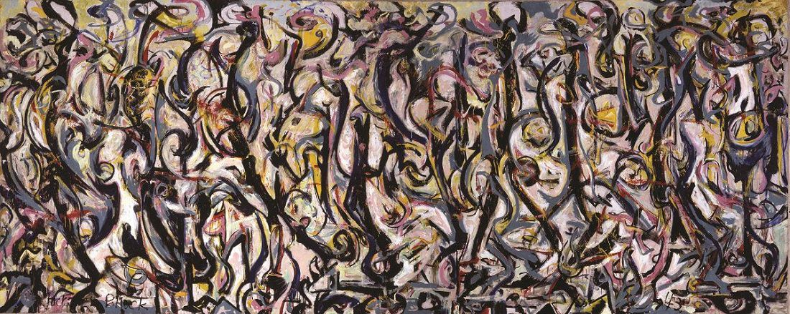
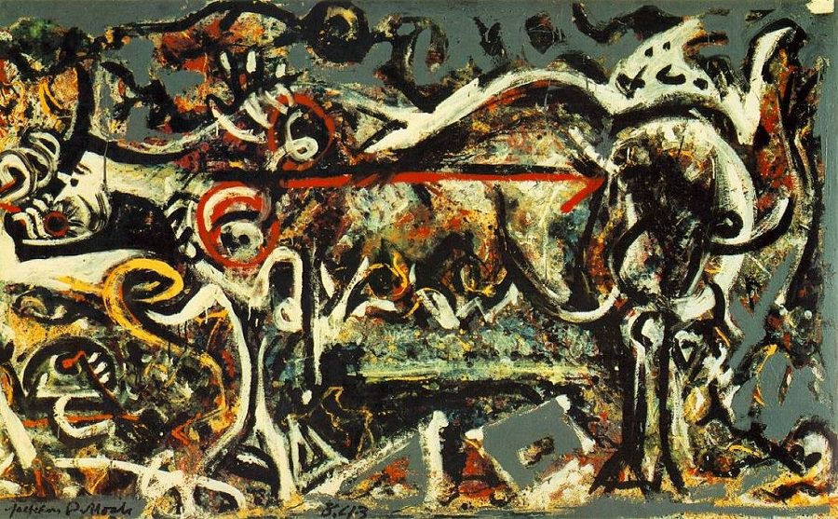
Art
Work
“Lavender Mist”
“No. 5”
Pollock’s technique was referred to as “drip technique”
Pollock has said “I want to express my feelings, rather than illustrate them.”
  What do you think he meant by this?
The painting “Mural” was commissioned by Peggy Guggenheim & the canvas was 160 sq ft! Pollock had to remove a part of the wall in his studio just to paint it
The painting “No. 5” became one of Pollock’s most iconic works, as well as his most expensive. In 2006, it was sold at auction for $165.4-million, making it one of the 10 most expensive paintings in history (along with works by Paul Cézanne, Pablo Picasso and Vincent van Gogh).
“Mural”
“The She-Wolf”

Slide 5
“She-Wolf”

Slide 6
“Mural”

Slide 7
“No.5”

Slide 8
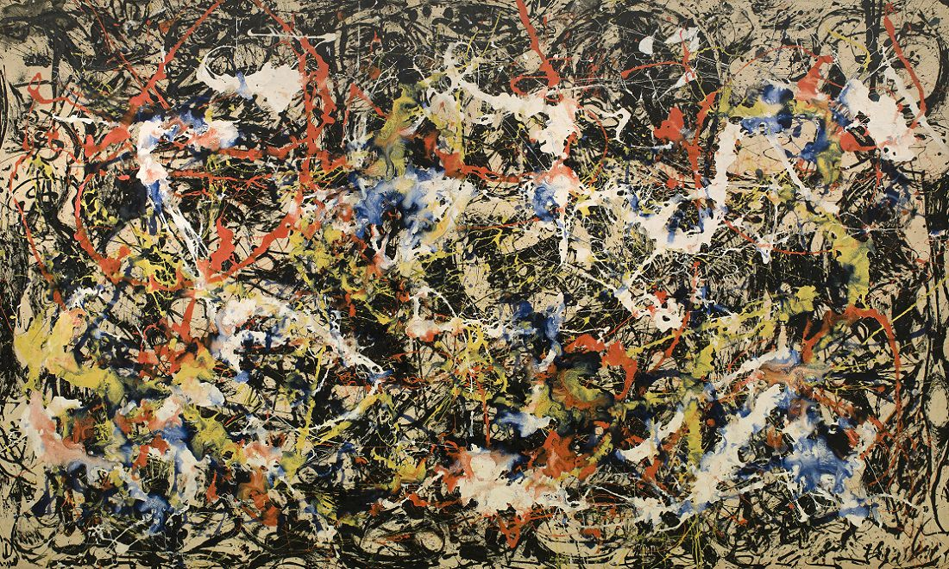
“Convergence”
Convergence—a black-and-white painting that Pollock flung primary colors onto—reflects the crisis of the Cold War. It is one of his master works of art and might also be the most well-known painting by an abstract expressionist.
In 1964, Springbok Editions produced a jigsaw puzzle of the painting, which was promoted as the “world’s most difficult puzzle,” and hundreds of thousands of Americans purchased it

Slide 9
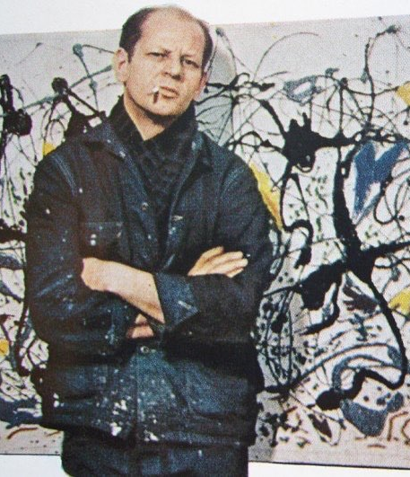
Discussion…
What’s going on in this artwork?
What was your first reaction to this artwork? Why do you think you had the reaction?
Does your opinion about the artwork change the longer you look at it? Why?
Describe the lines in this artwork
What verbs would you use to describe this artwork?

Slide 10
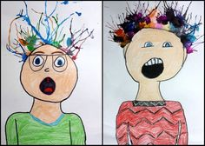

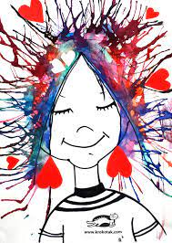

Today’s Art Project…
Crazy Hair Self Portraits

