Slide 1
Rembrandt
July 15 1606 – October 4 1669

Slide 2
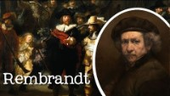

Slide 3
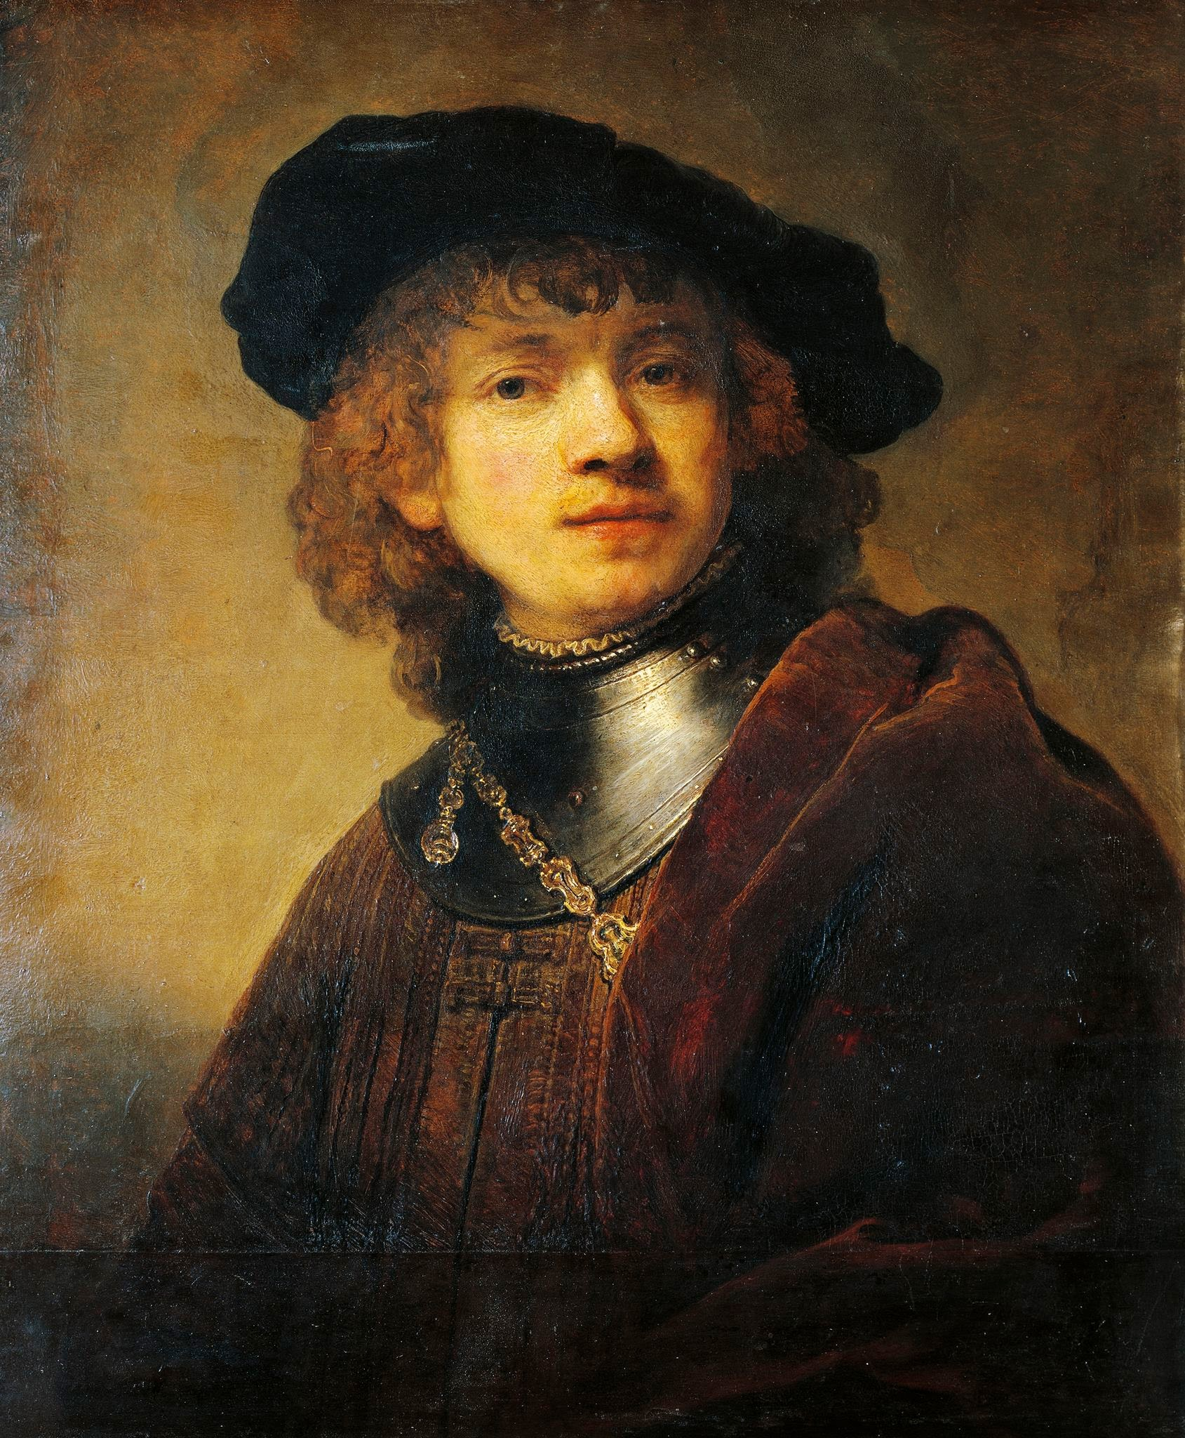
Life of Rembrandt
Born in Leiden, Netherlands
His full name is…
Rembrandt Harmenszoon Rijn
He was the youngest of 9 children
He was hired by many wealthy individuals to paint their portrait, since cameras were not invented
He liked dogs and included them in several of his paintings
Throughout his life he painted over 600 paintings
He is considered one of the greatest painters in history and was a large influence to painters later in history

Slide 4
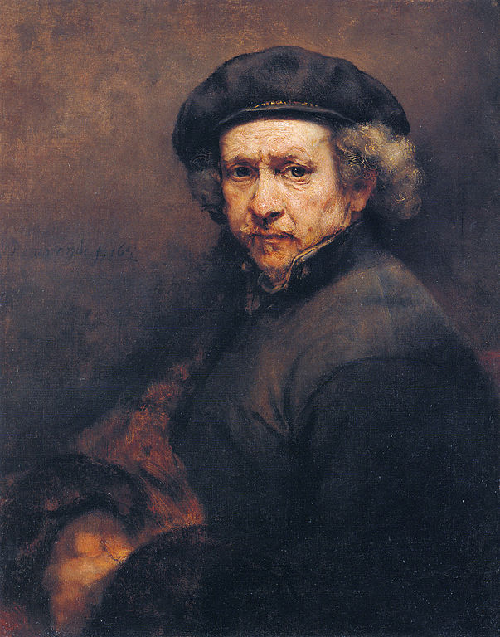
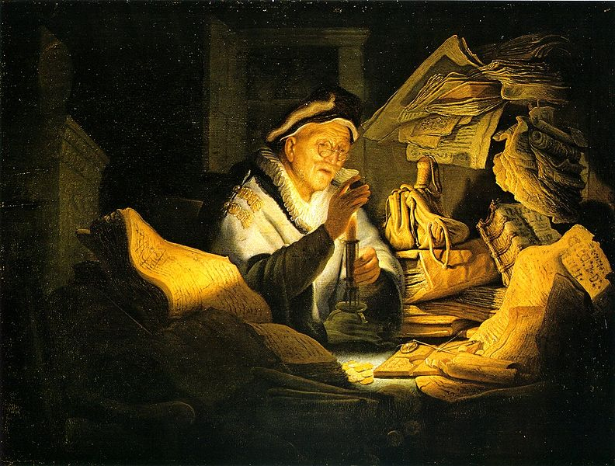
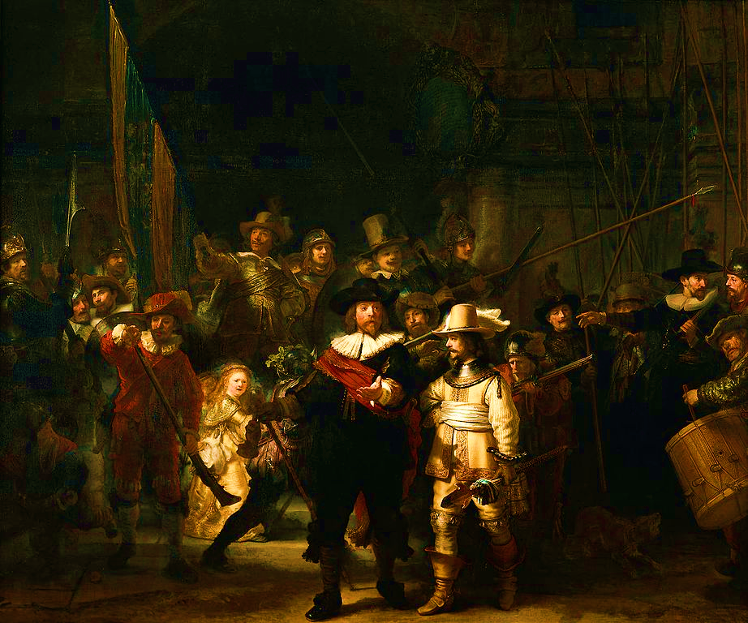
Art Work
The Night Watch:
Considered most famous painting
Painting was over 14 ft long & 12ft tall
A typical portrait at this time would have shown the men lined up in a row, each man looking similar and the same size. Rembrandt thought this would be boring. He painted each man doing something different in what looks more like a large action scene.
self-portrait of Rembrandt from 1659
The Money Lender

Slide 5
Discussion…
What’s going on in this artwork?
What was your first reaction to this artwork? Why do you think you had the reaction?
Does your opinion about the artwork change the longer you look at it? Why?
Describe the lines in this artwork
What verbs would you use to describe this artwork?

Slide 6
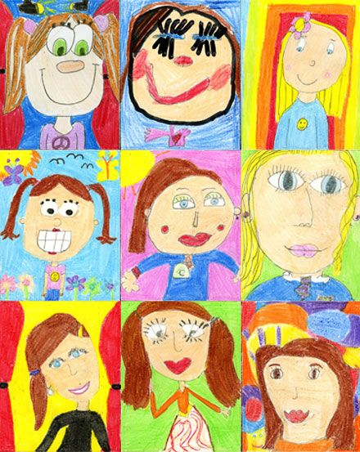
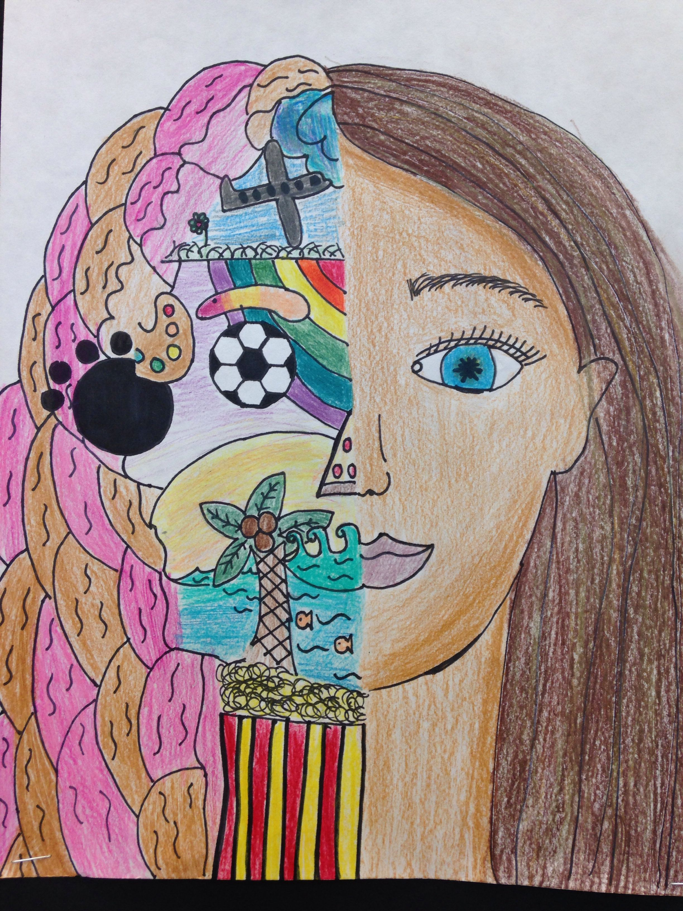
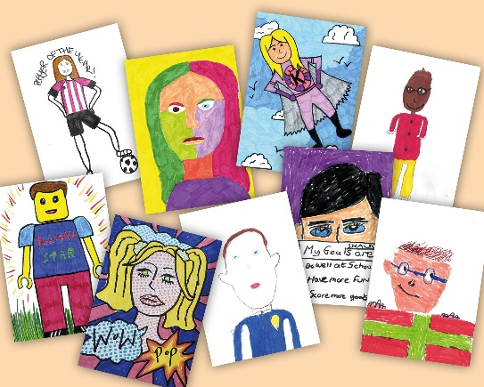
Today’s Art Lesson….
Self Portrait
Depict yourself using oil pastels, pencil, markers, colored pencils…whatever you like best!
Capture your personality, like Rembrandt did
Don’t stress – there is no right or wrong way to do this ☺
Have fun & be creative!

