Slide 1

Can Sound make things move?
Science Masterpiece

Slide 2
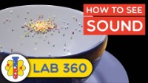

Slide 3
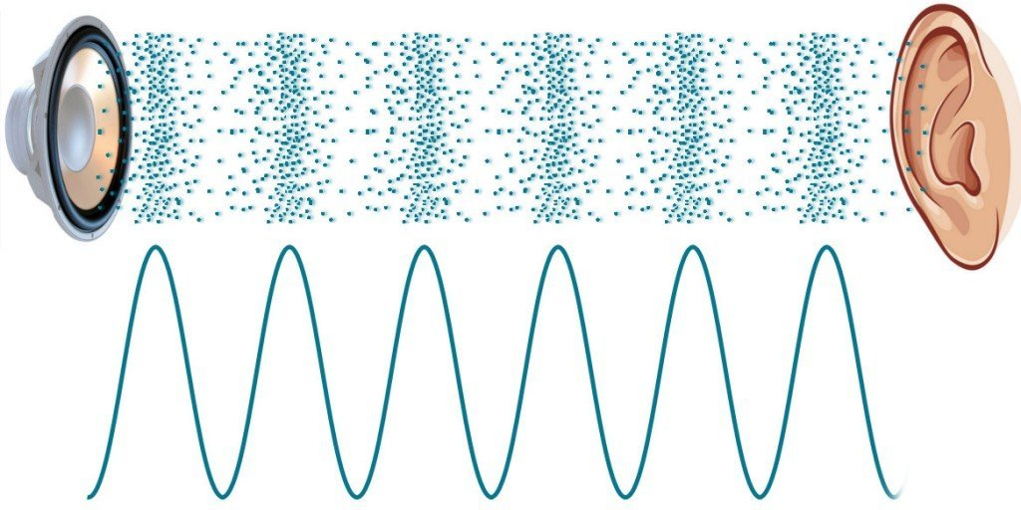
Sound
Sound is the result of vibrations that travel through the air in waves.
The sound wave bumps into the air molecules around it, until it reaches our eardrum, and we hear the sound.

Slide 4
Vocabulary
Eardrum – a thin, tightly stretched piece of tissue in the ear that vibrates when sound waves hit it.
Energy – power that can make things move
Sound – anything that can be heard
Sound waves – waves that form when a sound is made, moving through the air and carrying the sound to your ears
Vibrate – to move with fast, short, back and forth motions
Vibration – the movement produced from vibrating

Slide 5
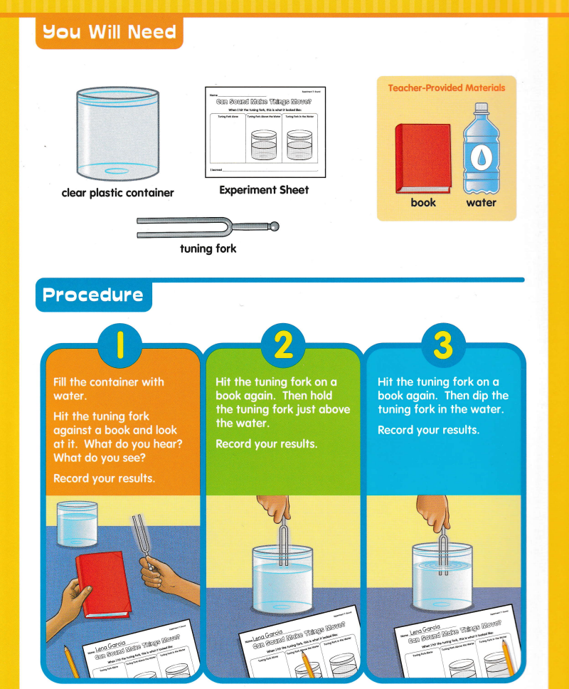
Experiment Time

Slide 6
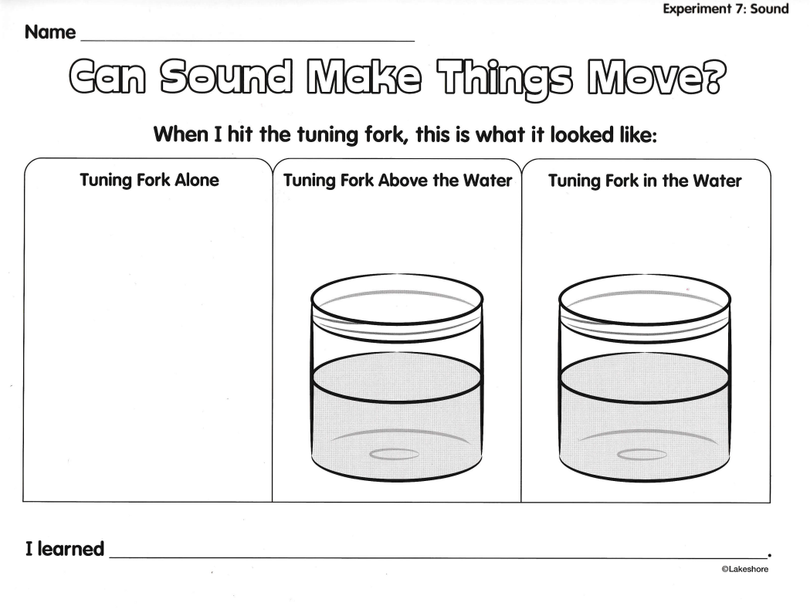

Slide 7
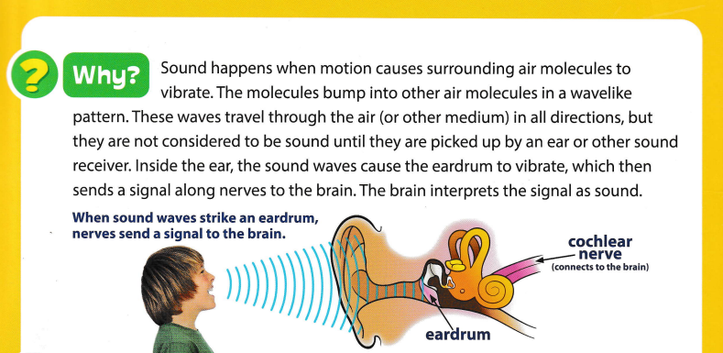
Conclusion

Slide 8
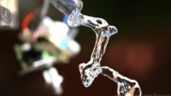
Cool Sound Video

Slide 9
Questions
What does a wave look like?
Where have you seen waves?
What do you feel when you hit the tuning fork?
What kind of sound does a tuning fork make?
Why do you think loud sounds can hurt our ears?

