Slide 1
Can you make it rain?
Science Masterpiece

Slide 2


Slide 3
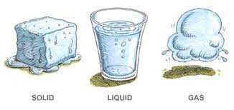
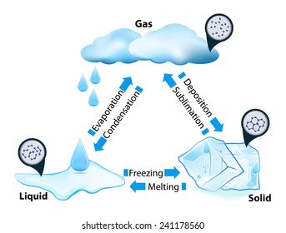
Water cycle
The water cycle is made up of Precipitation, Evaporation, and Condensation
Water can take the form of a liquid, solid, or gas

Slide 4
How is rain made?
Clouds form when water vapor rises and cools.
The cooling droplets condense and group together into larger drops that fall as precipitation.
The rain, snow, or hail then collects in rivers or lakes, and then in the ocean.
The cycle repeats.

Slide 5
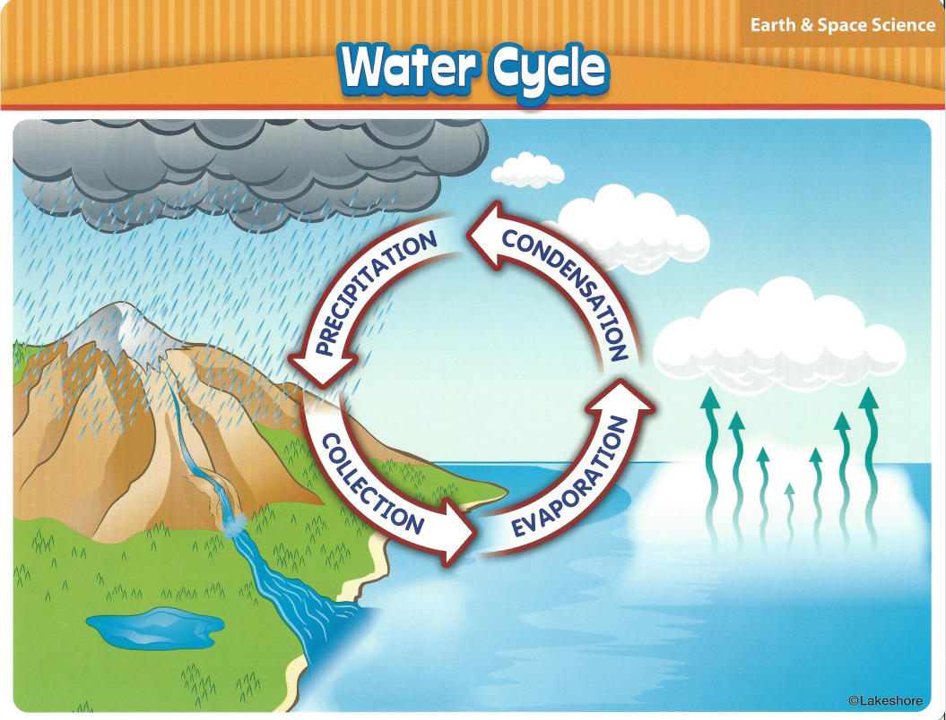

Slide 6
vocabulary
Cloud – a white or gray mass of water droplets floating in the sky
Condensation – the process of changing from a gas to a liquid
Droplets – a very small drop
Moisture – wetness in the air or on a surface
Precipitation – water that falls to the ground as rain, snow, hail, etc.
Rain – water that falls in drops from clouds
Water Cycle – the journey water takes as it circulates from the land to the sky and back again (also known as the hydrologic cycle)
Water Vapor – a gas formed of very small water drops or particles mixed with air

Slide 7
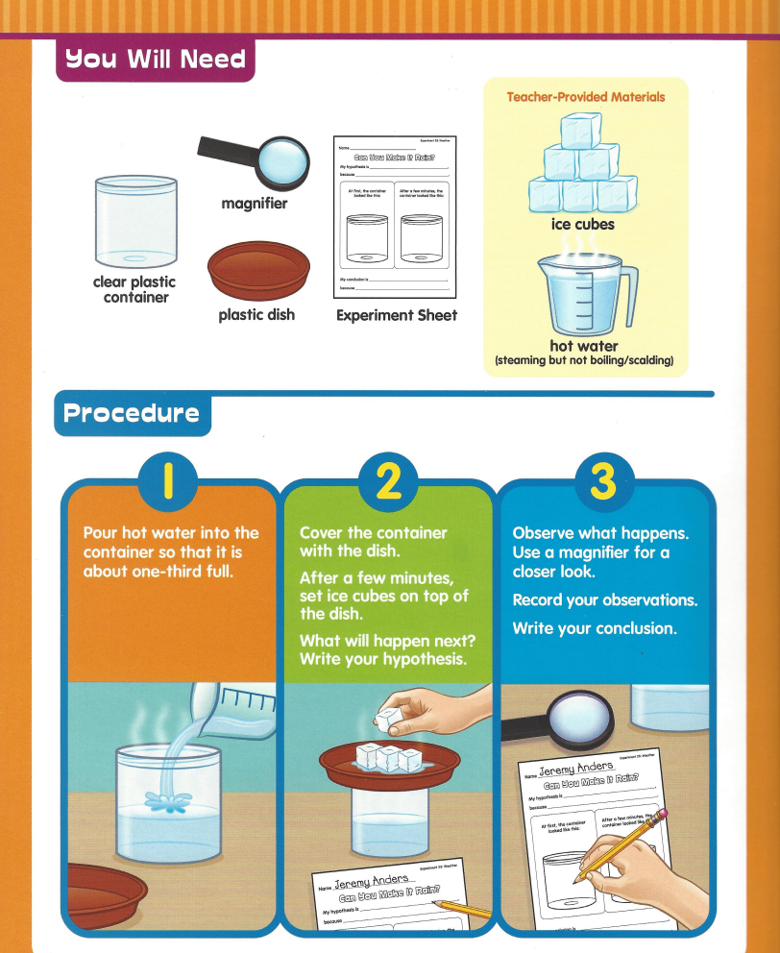
Experiment Time

Slide 8
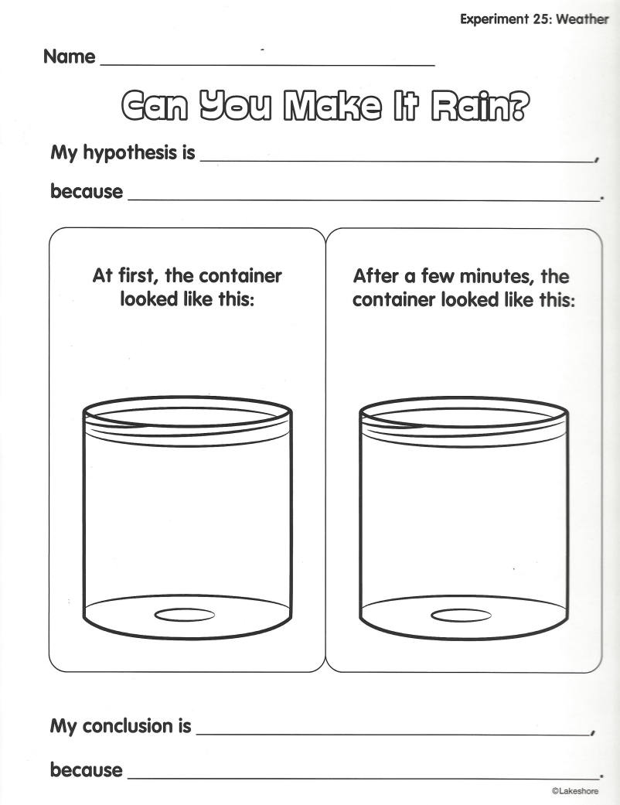

Slide 9
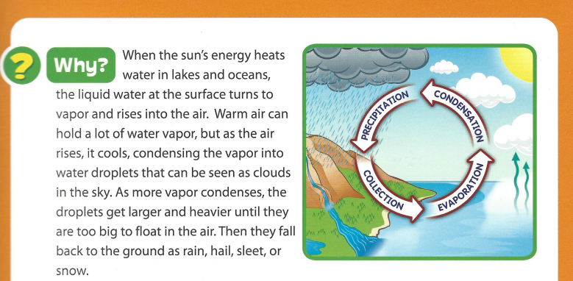
conclusion

Slide 10
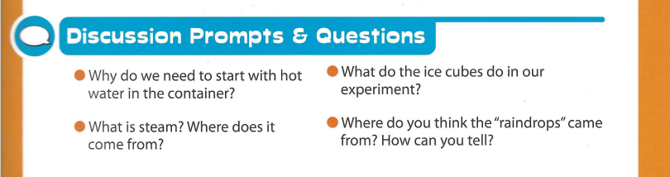
Questions

