Slide 1
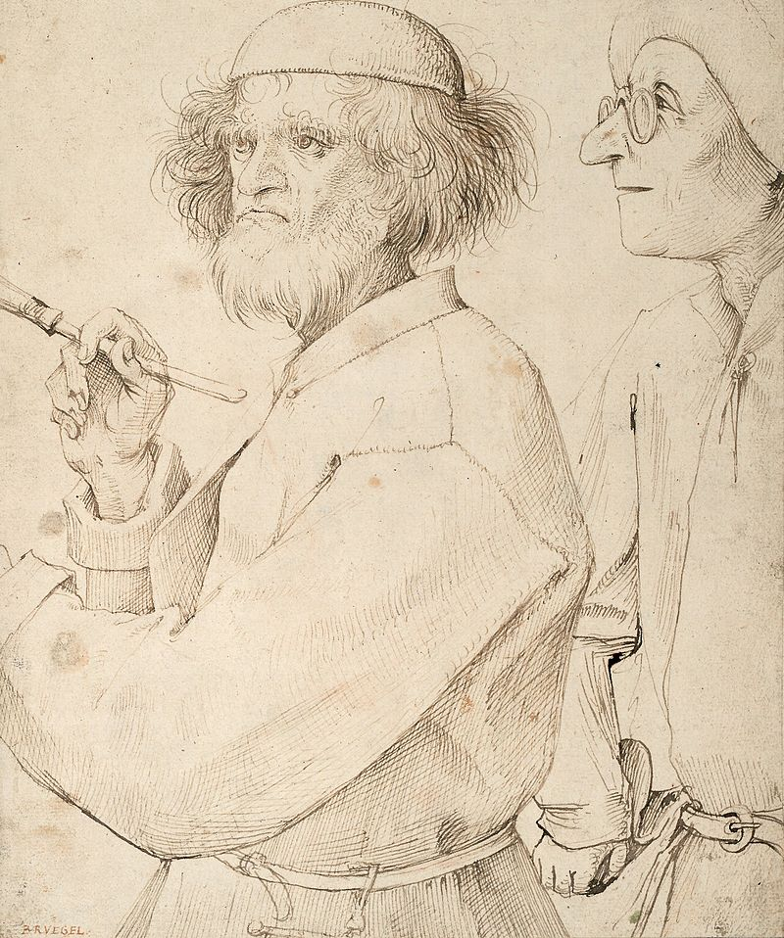
Pieter Bruegel the Elder
1525 – September 9, 1569
Pronounced: PEE-ter BROY-gull
Born around 1525 in the Netherlands
First born in a family of Flemish painters
Lived in Brussels, Belgium with wife & had two sons who also became famous painters
Nicknamed “Pieter Bruegel the Elder” to distinguish him from his Sons
His grandsons also became artists, this was quite an artistic family

Slide 2


Slide 3

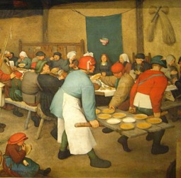
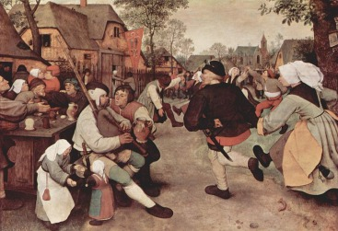
Art work
Known for painting scenes of Flemish peasant life
Paintings depicted everyday activities & were realistic and earthy
Peasant Wedding (1568)
The Peasant Dance (1568)

Slide 4
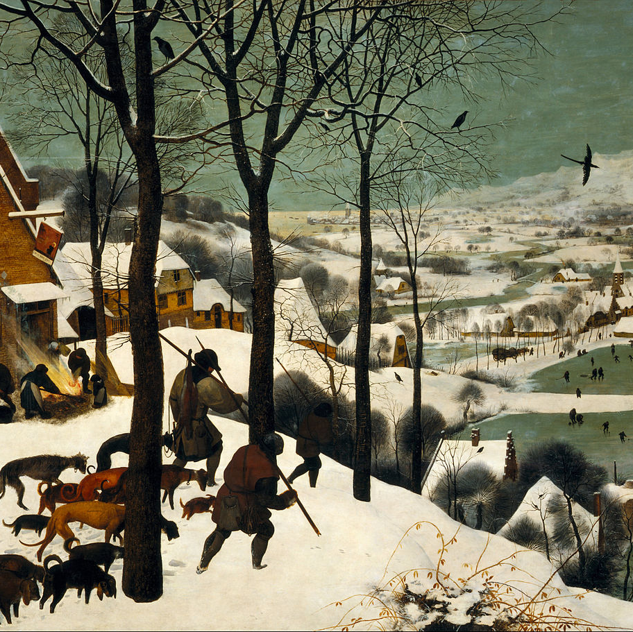
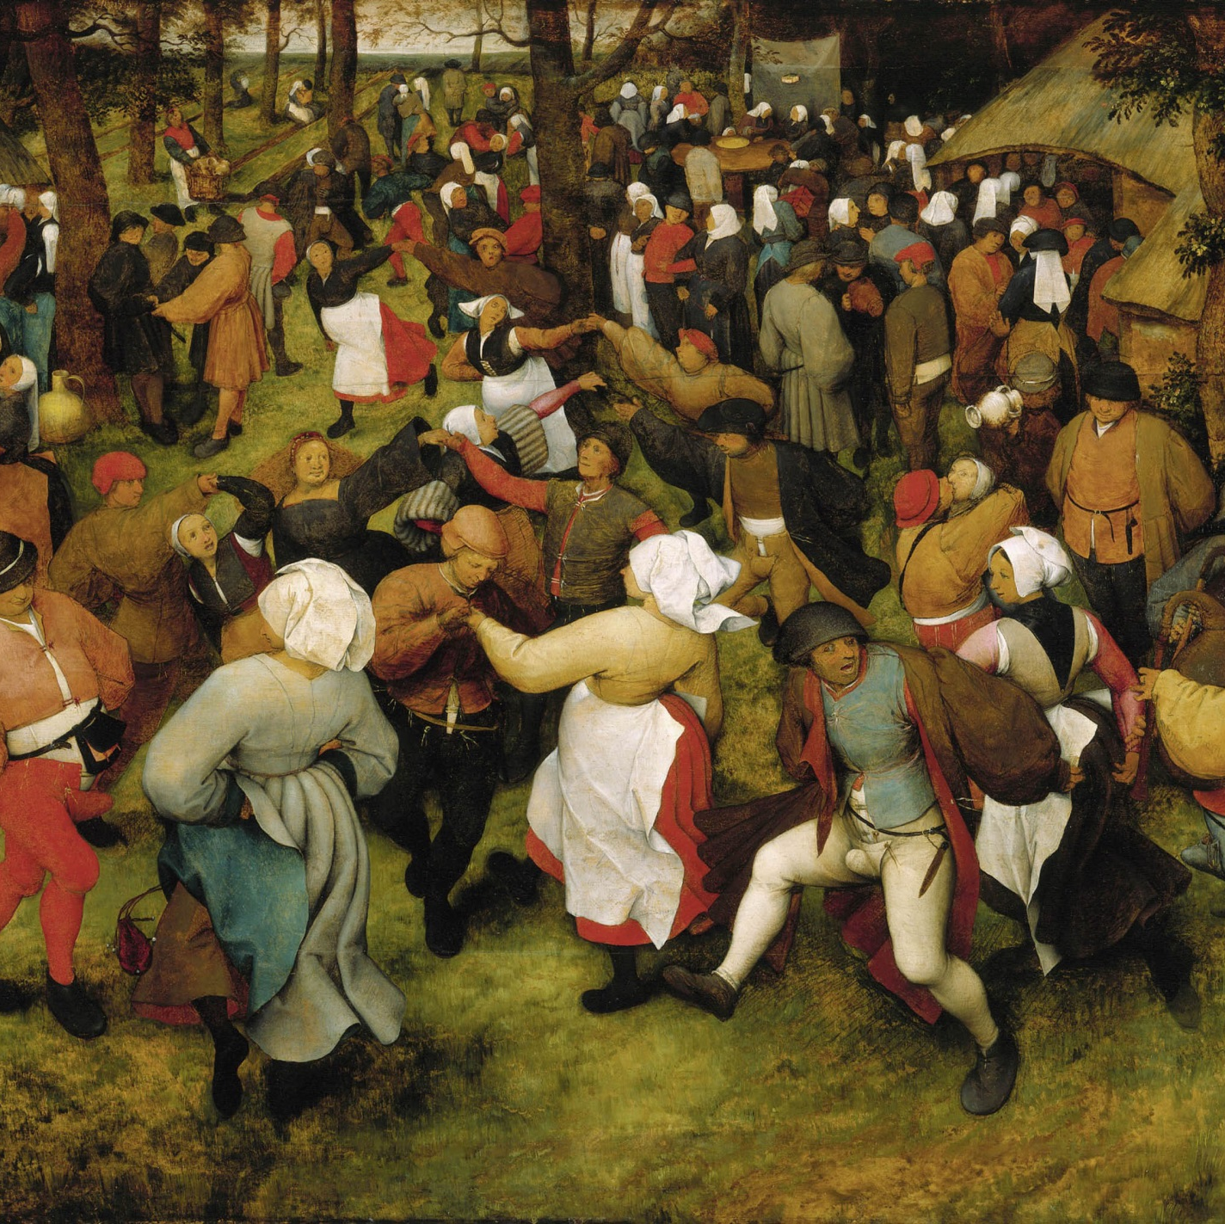
The Hunters in the Snow (1565)
The Wedding Dance (1566)

Slide 5
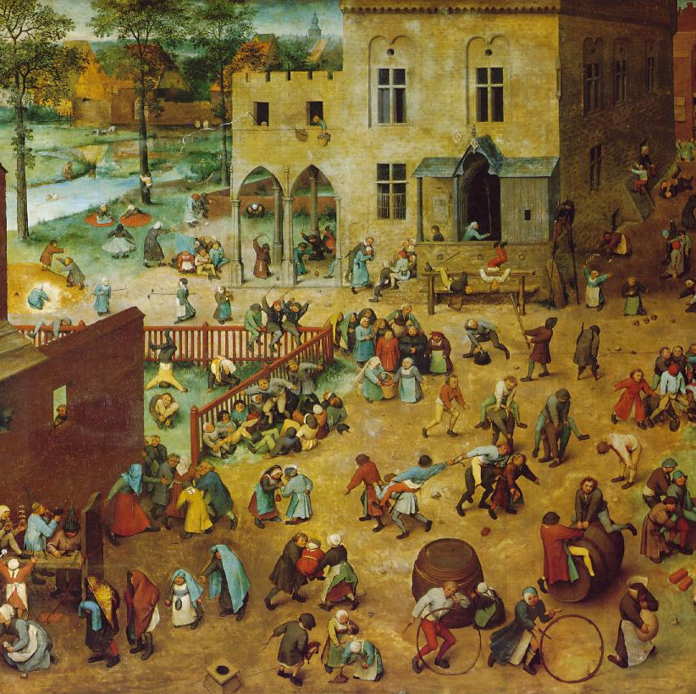
Children’s Game (1560)
While many of Bruegel’s paintings portray peasant folk culture, this painting is unique because there are no adults.
This painting is highly detailed featuring nearly 250 children playing in nearly 80 different games and activities
Some of the games included are:
  Skittles/marbles
  Tug-of-war
  Swimming
  Whirligig
  Fighting
  Leapfrog
  Jousting
  King of the castle
  Playing with dolls
  Making sandcastles
  Tree climbing
  Bridal procession
  Blowing soap bubbles
  Follow the leader
  Hockey
  Singing at doors
  Digging a well
  Top spinning
  Barrel riding
  Headstand
  Stirring mudpies
  Carrying torches
  Rolling hoops
  Blindman’s bluff

Slide 6

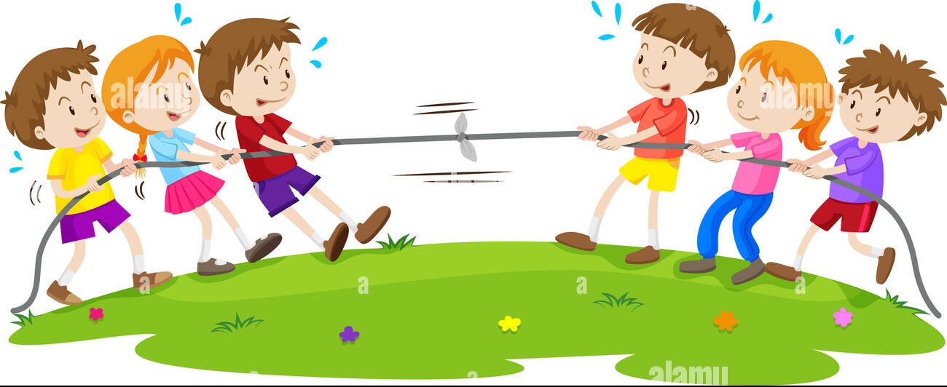
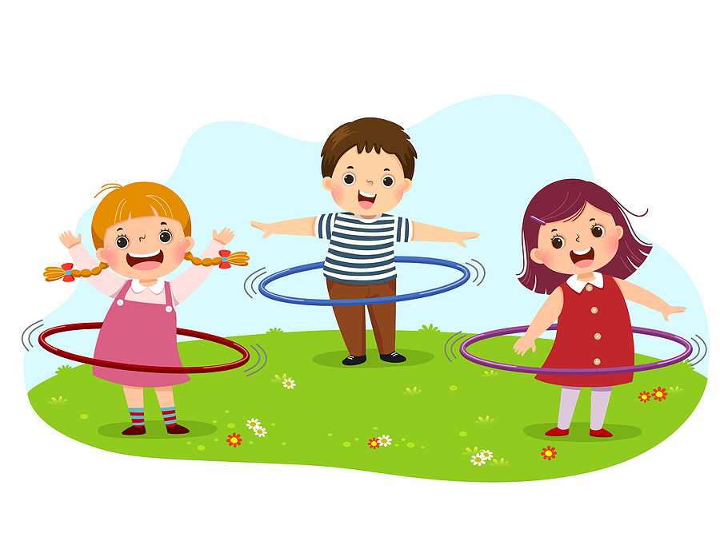

Let’s go outside & play!!
Ideas from the painting:
Tag
Leap Frog
Bubbles
Hoola Hoop
Red Rover
Wheel Barrow Races
Tug of War
Swinging
Cart Wheel
Sandcastles
Rock, paper, scissors
Use your imagination and include all your friends!!

