Slide 1
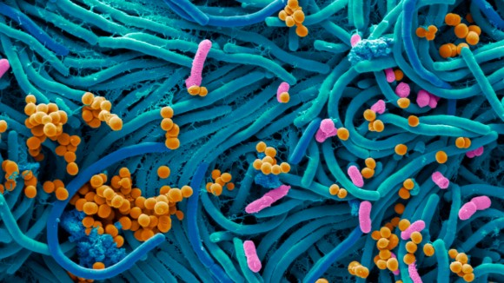
Microbiology
Science Masterpiece

Slide 2
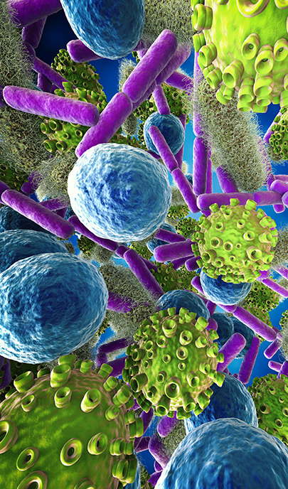
Microbiology
Is the study of all living organisms that are too small to be seen with the naked eye.
These include, bacteria, viruses, fungi, algae, protozoa, and more.

Slide 3
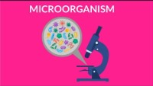

Slide 4
Microbes
Can be found in our bodies, on our skin, or in our environment (soil, surfaces, water)
Many of these microbes are beneficial to us. Such as helping us digest our food or break down dead tissue to help fertilize soil.
Sometimes microbes can be harmful. Such as making us sick or harming an ecosystem.

Slide 5
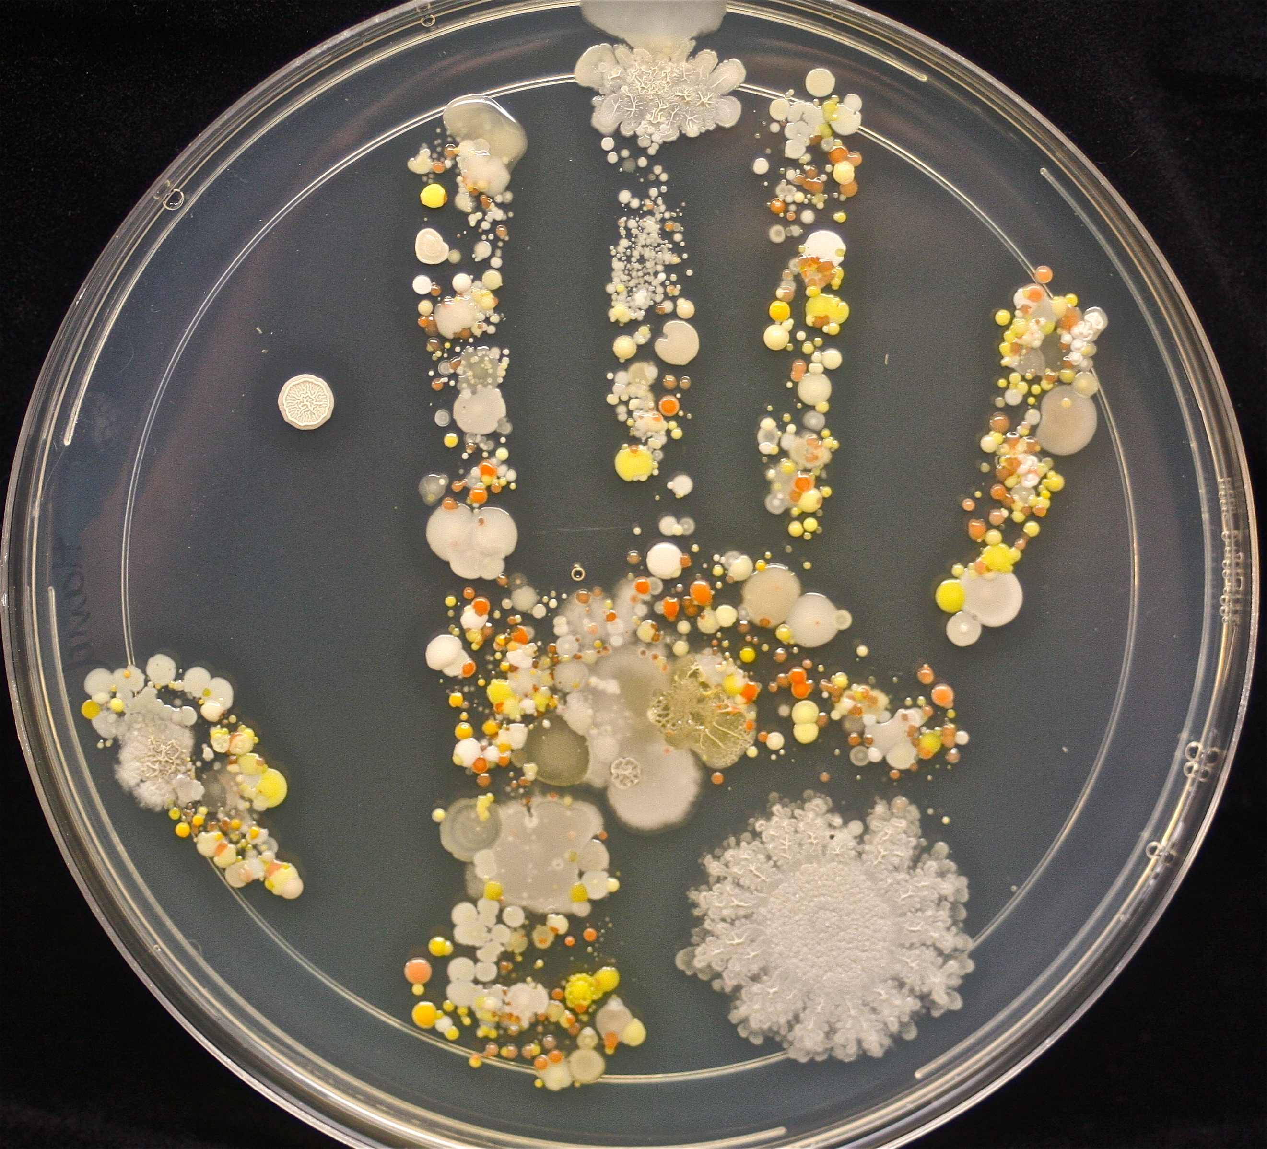
Pitre Dishes
Scientist can study microbes by collecting samples from people, animals, water, surfaces, etc.
They obtain samples by swabbing the item and applying it to the agar in a pitre dish.
Agar is the special medium that different microbes like to grow on. It gives the microbes the food it needs to grow.

Slide 6
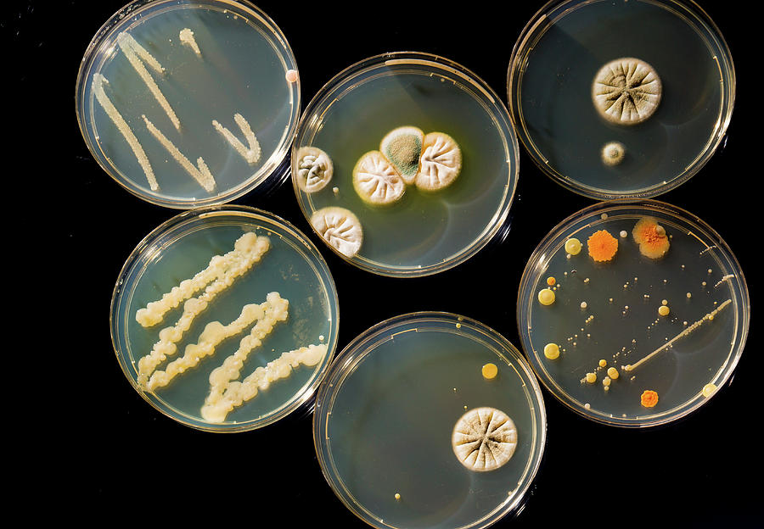
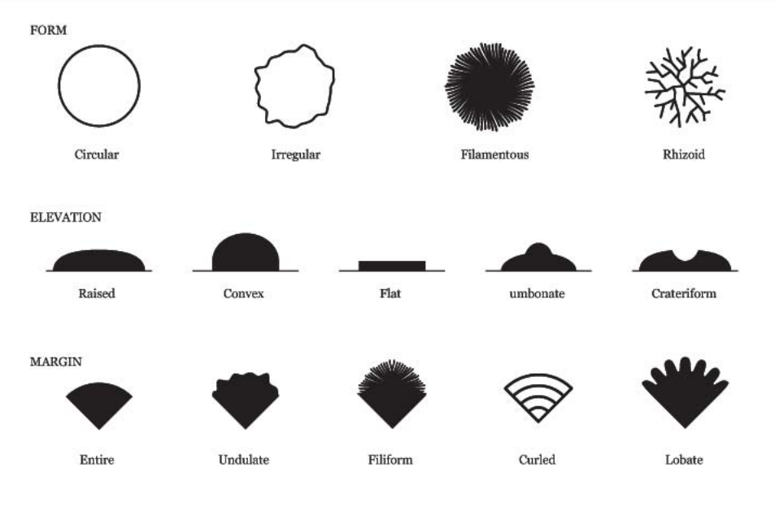
Types of Cultures
Different microbes will grow and look different.

Slide 7
Experiment Time
You will receive your own pitre dish and 4 cotton swabs.
Put your name on the BOTTOM of the pitre dish.
Divide the LID of the pitre dish into 4 quadrants.
Choose 4 surfaces to swab.
  For a hard surface moisten the cotton swab distilled water.
  For a moist surface (mouth, nose) you do not need to moisten the swab.

Slide 8
Experiment Time
Gently swab your quadrant, horizontally and then vertically.
  Repeat for the other 3 quadrants
Tape the lid closed and label the quadrants with what you swabbed.
The pitre dishes will be collected and sealed in a paper bag and left sitting for a week.

Slide 9

Experiment Time – 1 Week Later
Hand the pitre dishes back to the students.
Observe the cultures that colonized.

Slide 10
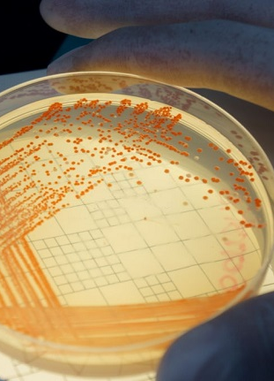
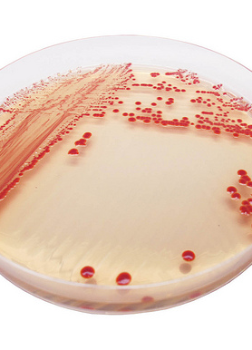
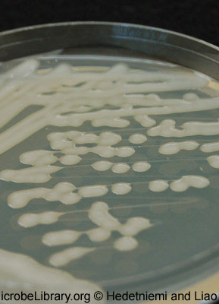
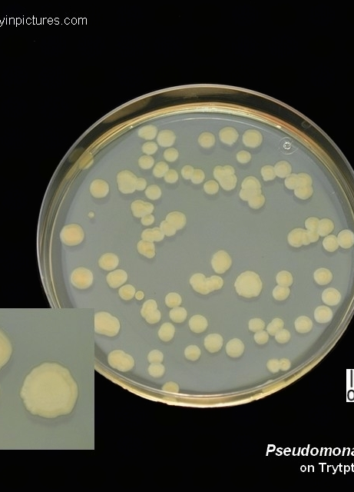
Serratia marcescens
Acinetobacter
Klebsiella pneumoniae
Pseudomonas aeruginosa
Common Microbes Found in the Environment

Slide 11
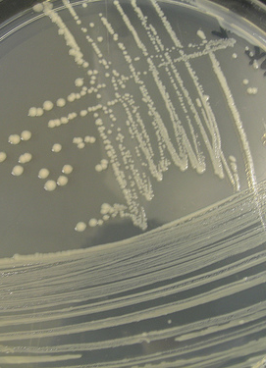
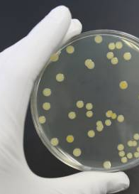
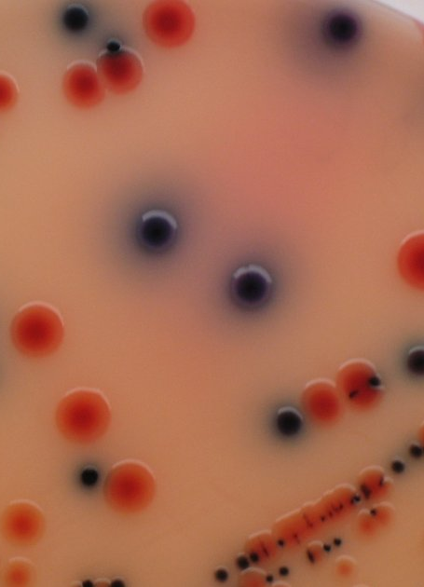
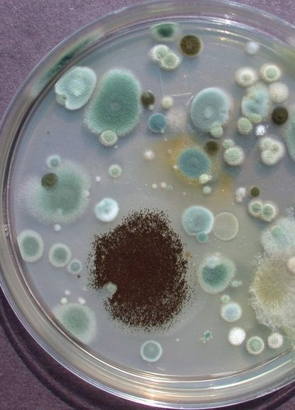
Escherichia Coli, or E. Coli
Staphylococcus aureus
Salmonella
Yeast or Mold
Common Microbes Found in the Environment

Slide 12
Conclusion
If we’re surrounded by all these microbes everyday, how come we’re not always sick?

