Slide 1

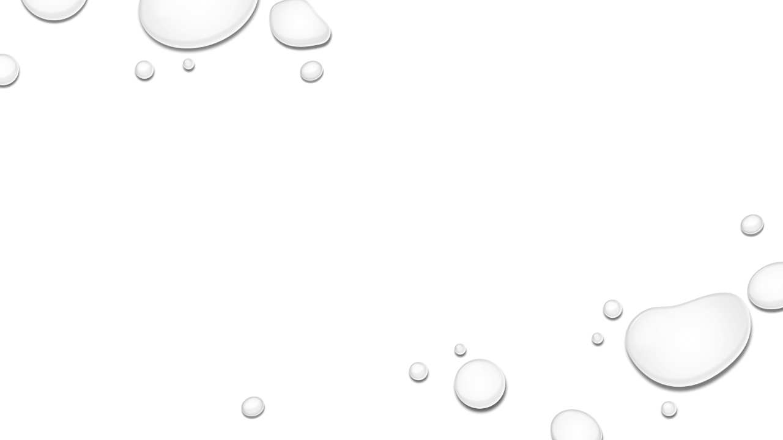

Do oil and water mix?
Science Masterpiece

Slide 2
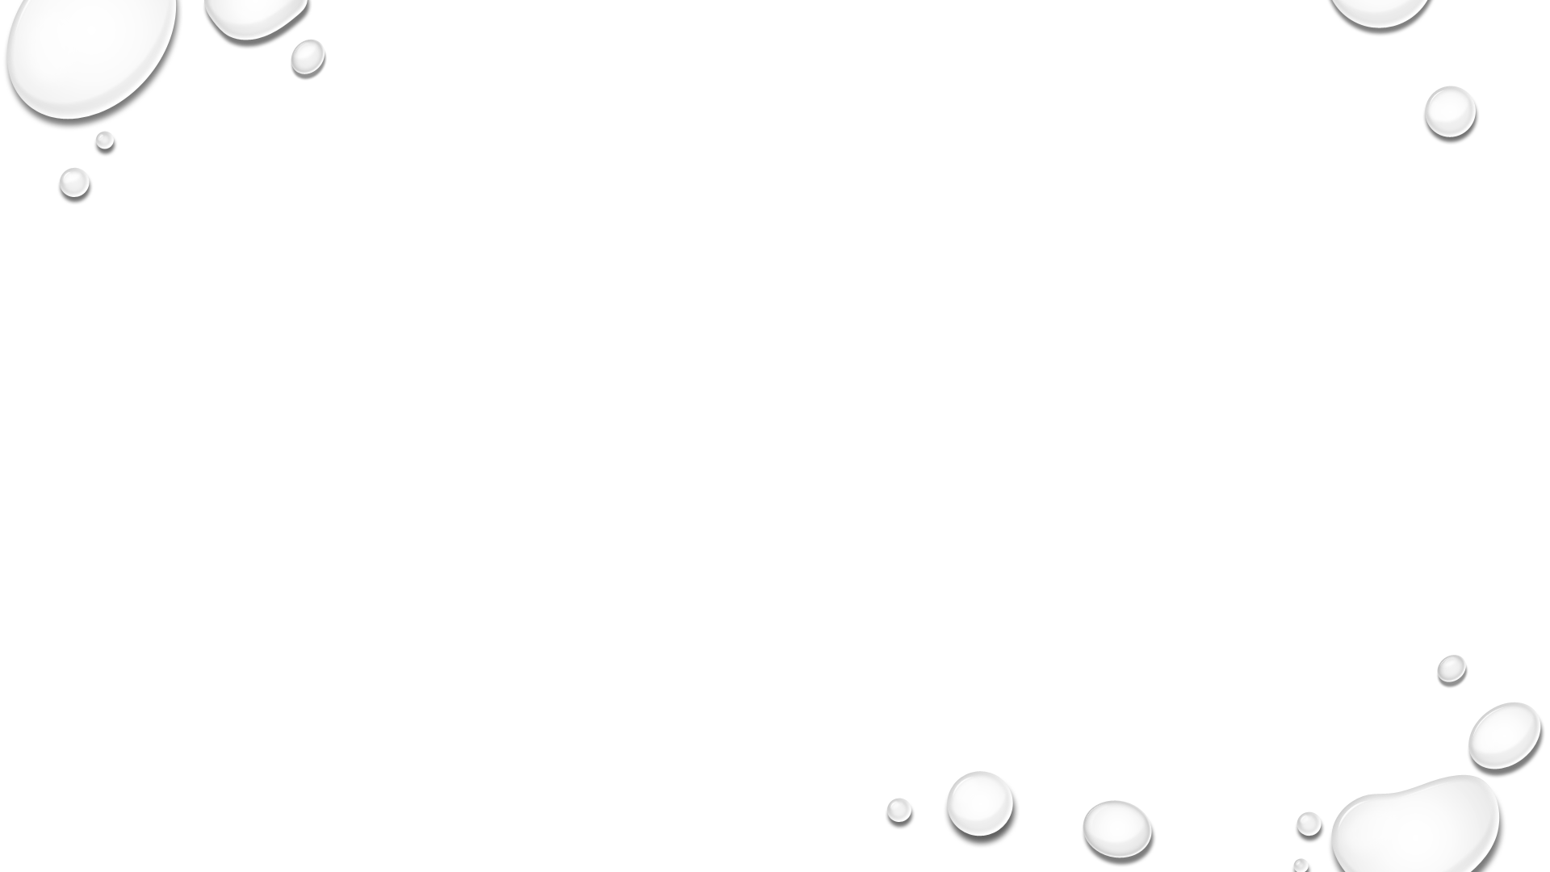
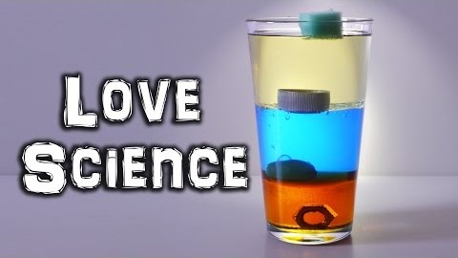
https://www.youtube.com/watch?v=Z50jEi1igNQ

Slide 3

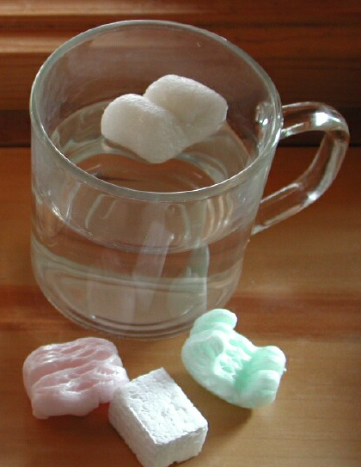
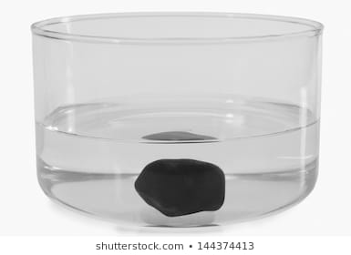
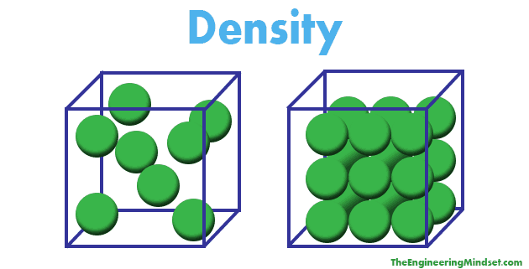
Density
Matter that is similar in size can have different densities, for example a rock and a foam packing peanut.
The rock is denser than the foam peanut, because its molecules are closer together.

Slide 4
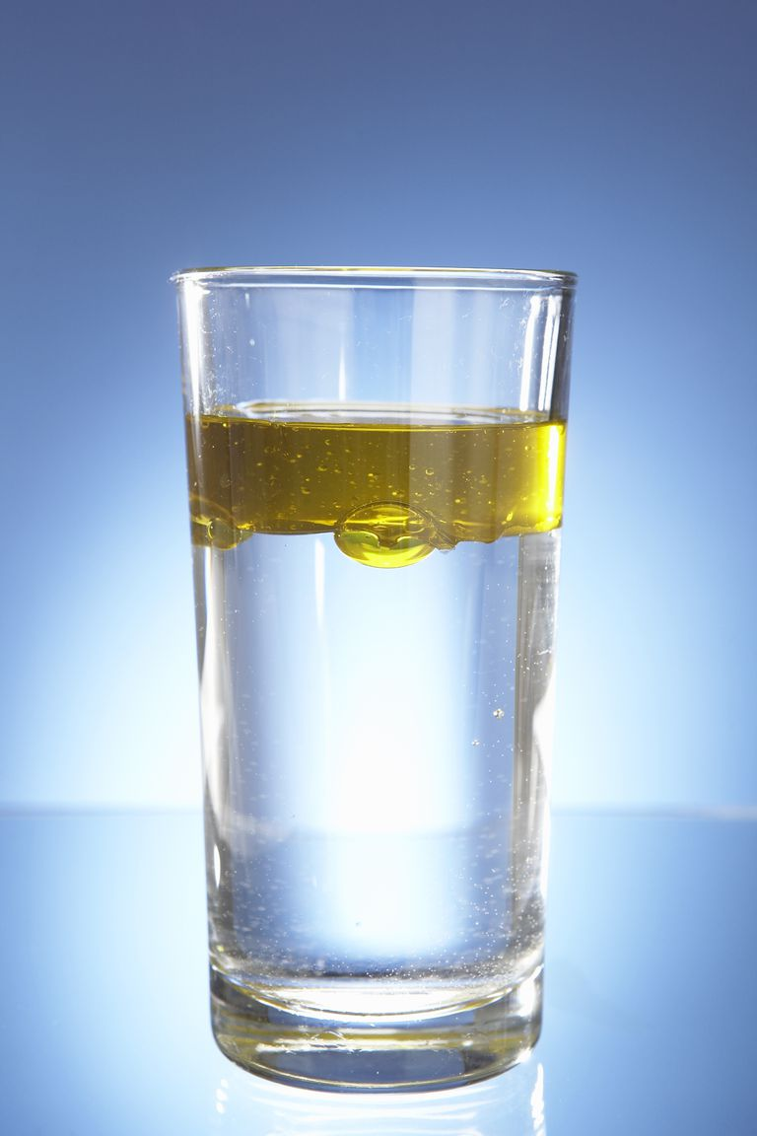
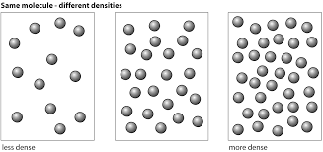
Density
Liquids also have density, some are denser than others.
For example, water is denser than oil. Which causes them to separate when mixed.
Oil is Less Dense; its molecules are more spread out.

Slide 5
Vocabulary
Density – How close together an object’s molecules are.
Liquid – A type of matter that flows and takes the shape of its container.
Matter – Anything – a solid, liquid, or gas – that occupies space and has mass.

Slide 6
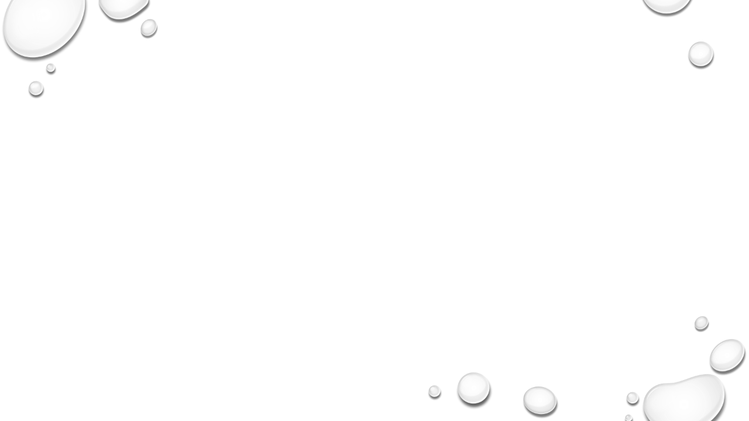

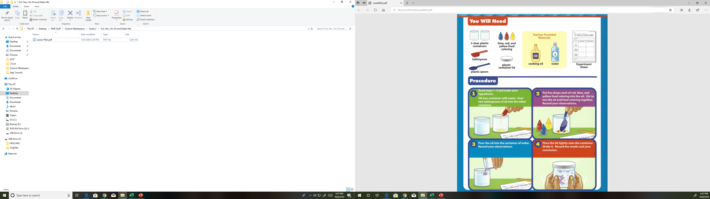
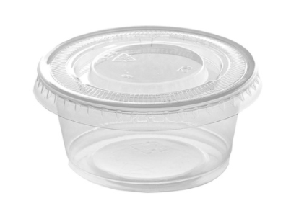
Experiment Time
plastic container
and cup

Slide 7
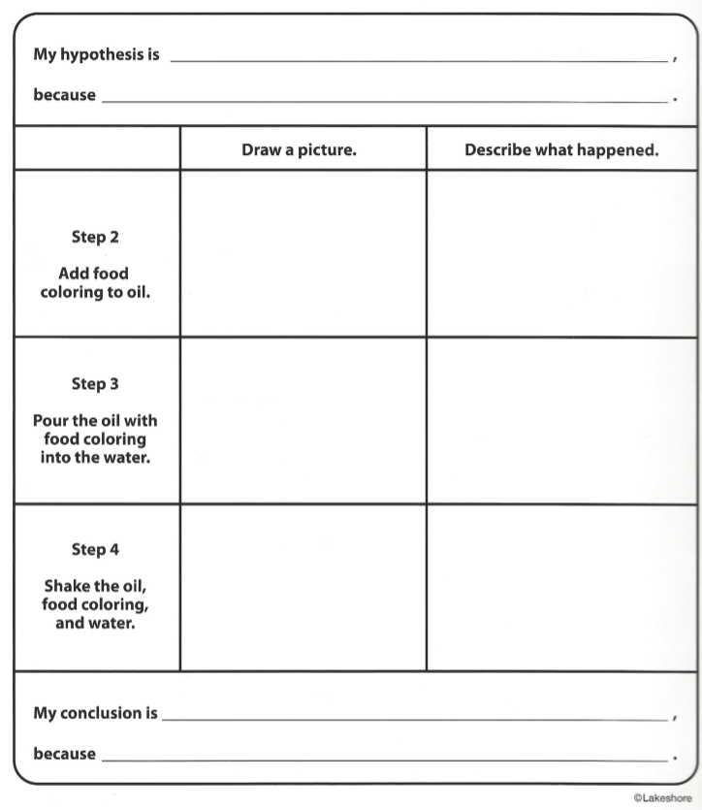
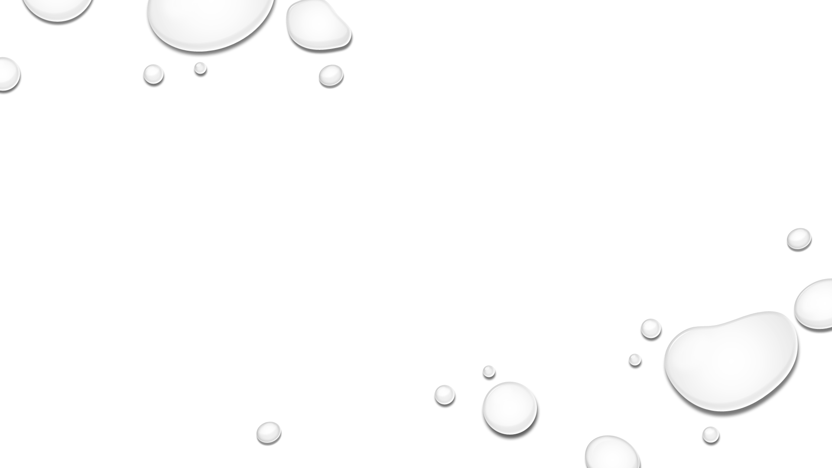

Slide 8
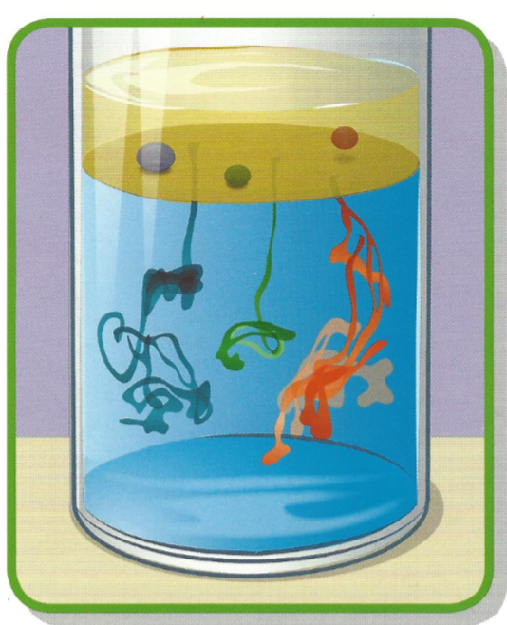
Conclusion
Oil floats on water because it is less dense than water.
Since food coloring is mostly made of water, it never completely mixes with the oil.
You should have noticed the food coloring formed little drops that were suspended in the oil. Eventually, the food coloring sank toward the bottom and mixed with the water because it was denser than the oil.

Slide 9
Questions
What did the food coloring look like in the oil?
What did the food coloring look like in the water?
Why did the oil float on top of the water?
Is the density of food coloring more like that of the oil or the water? Why?

