Slide 1
Sound Station
Science Masterpiece

Slide 2
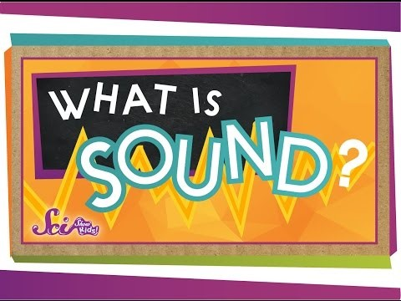
Introduction to sound

Slide 3
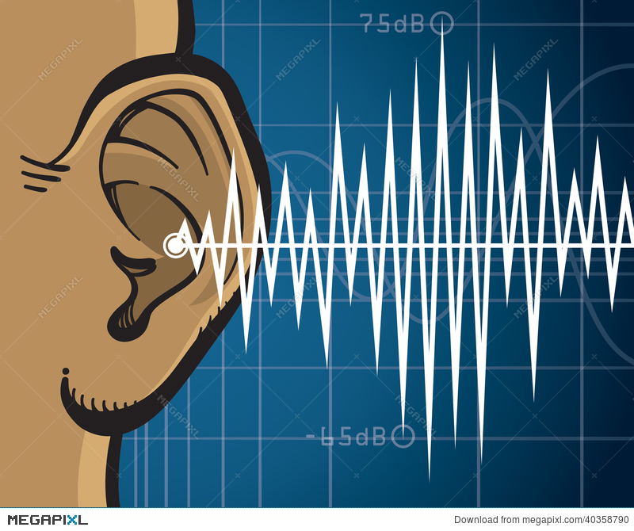
Vocabulary words
Sound – anything that can be heard
Sound Waves – waves that form when a sound is made, moving through the air and carrying the sound to your ears.

Slide 4
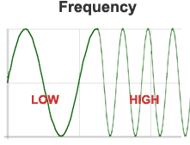
Vocabulary words
Frequency – the number of times that something (such as a sound wave or a radio wave) is repeated over a period of time.

Slide 5

Vocabulary words
Vibrate – to move with fast, short, back-and-forth motions.
Vibration – the movement produced from vibrating.

Slide 6
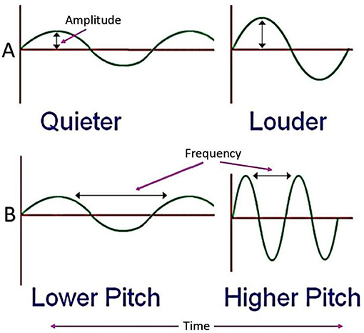
LOUD
Whisper
HIGH
DEEP

Slide 7
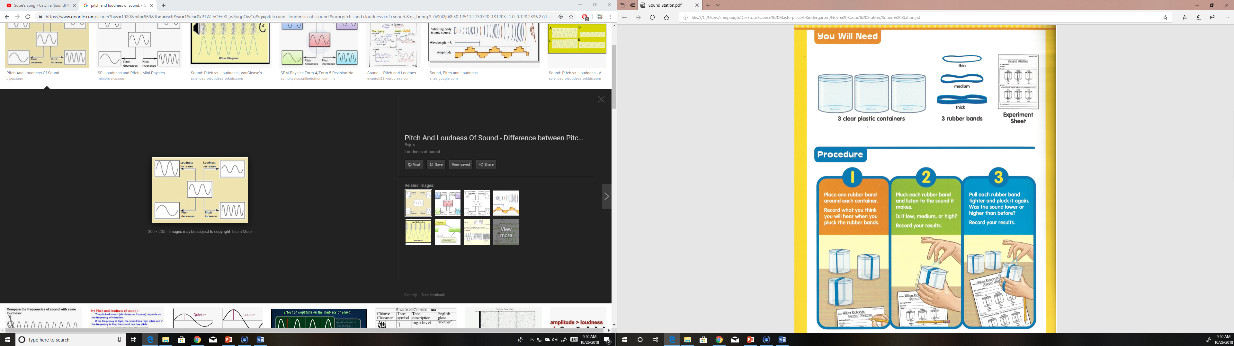
Experiment time

Slide 8
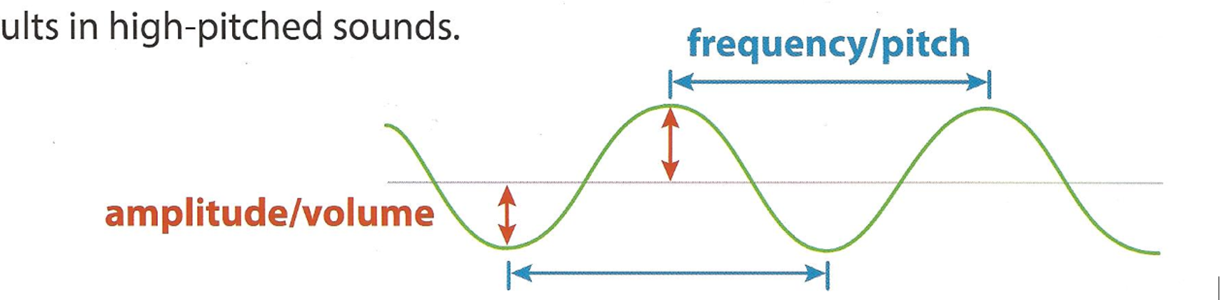
Why?
Sound happens when a vibration moves through the air and is picked up by the ear or other sound receiver.
Vibrations with more energy create bigger waves (higher amplitude), which makes louder sounds (higher volume). Faster vibrations makes waves that are closer together (high frequency), which makes high-pitched sounds.

Slide 9
What happened?
Which rubber band made the lowest sound?___________
Which rubber band made the highest sound? ___________
What sound did the rubber make when we pulled it tighter? ___________
How would I make a low sound with the rubber band? ___________

