Slide 1


What Are the Properties of Rocks?
Science Masterpiece

Slide 2


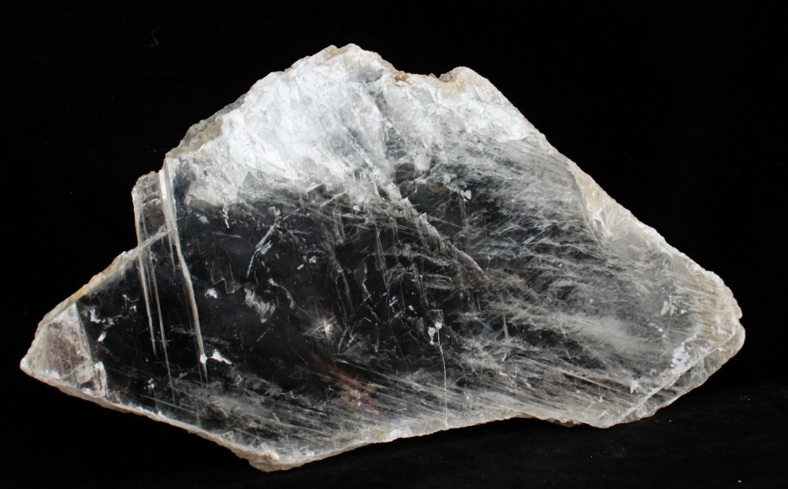
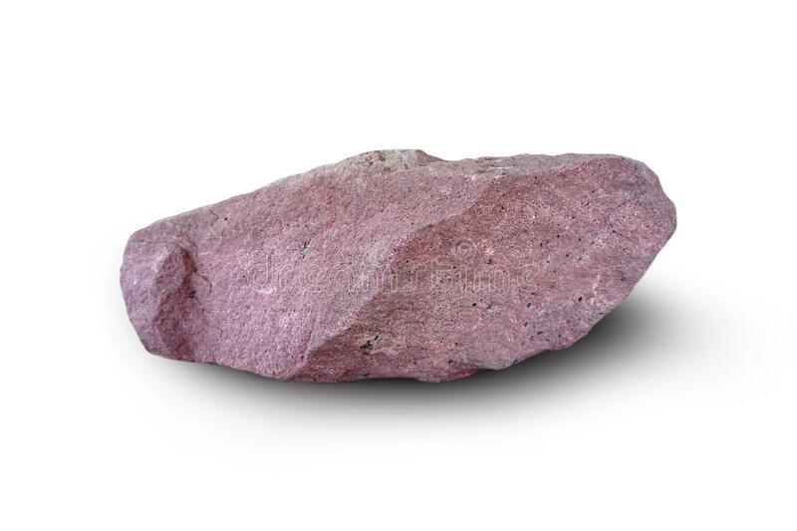
What is a Rock?
Selenite
Here are 2 examples of naturally occurring rocks.
Selenite is also a pure mineral.
All rocks are made up of 1 or more minerals.
Scientists classify rocks based on properties: color, texture, size, hardness.
For this lesson, we will focus on the on the hardness of rocks.
Sandstone

Slide 3


Slide 4
Vocabulary
Classify – to arrange into groups based on similar characteristics
Mineral – a naturally occurring solid substance that takes the form of a crystal and forms different rocks
Property – a special quality or characteristic of something
Rock – a naturally occurring solid substance made up of one or more minerals; it makes up Earth’s surface
Texture – the feel or look of a surface

Slide 5

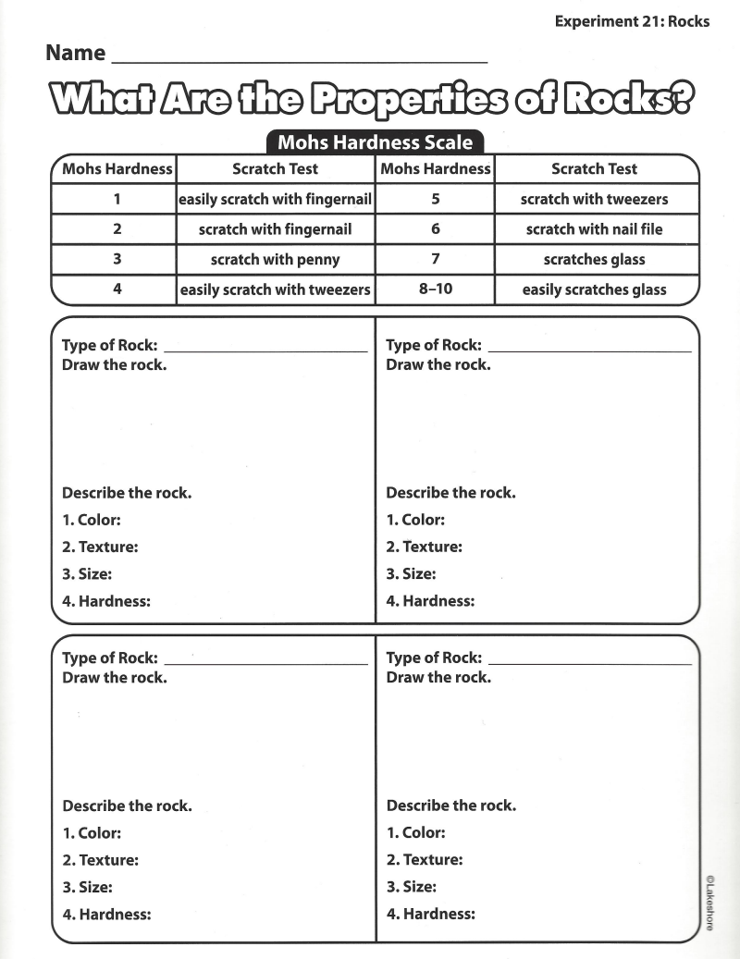
Experiment Time

Slide 6
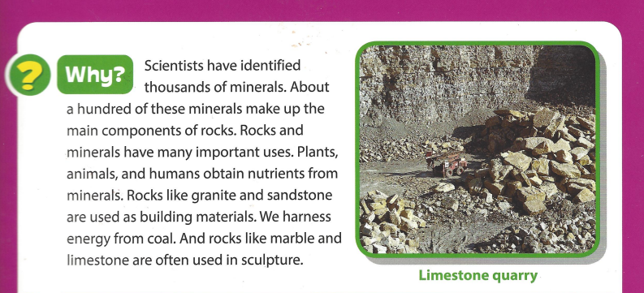
Conclusion

Slide 7
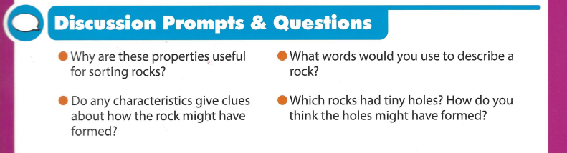
Questions

