Slide 1
What Do These Animals Eat?
Science Masterpiece Experiment 19

Slide 2

Introduction to Teeth
Link to Video

Slide 3
Animal Teeth
Looking at an animal’s teeth helps us learn about what the animal eats.
Their teeth are adapted to their diet.

Slide 4
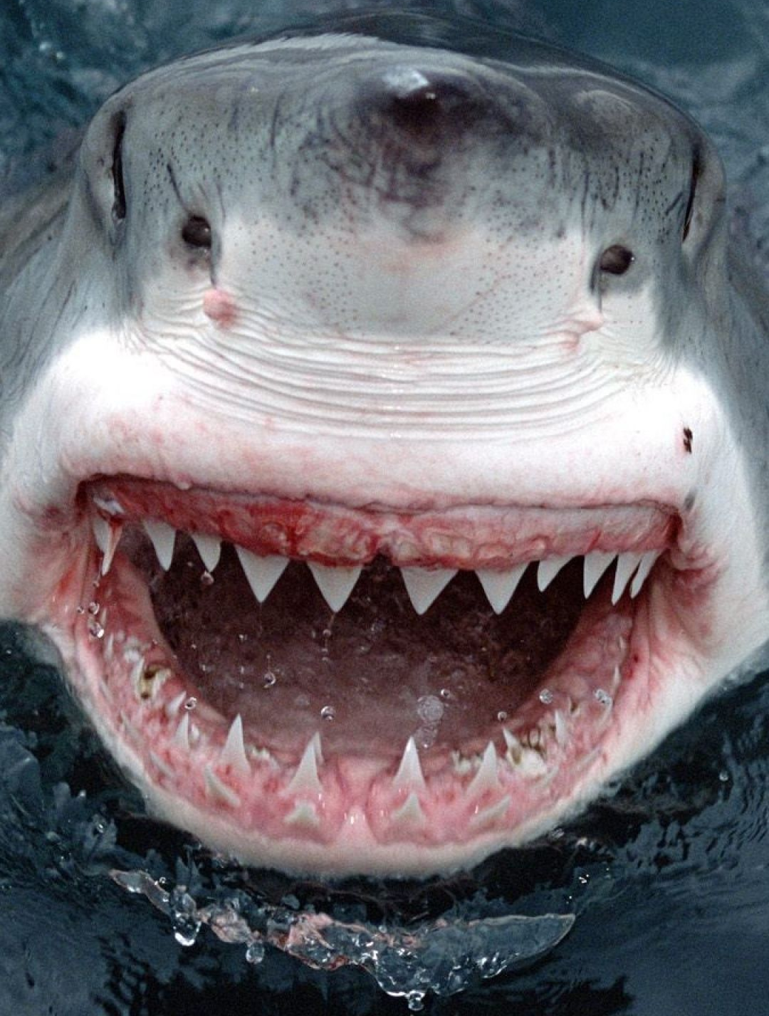
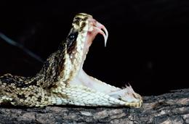
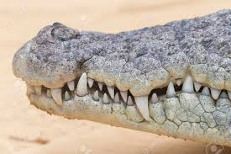
Carnivores
Animals that eat only meat are called carnivores and have large canines and incisors.

Slide 5
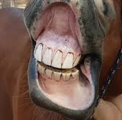
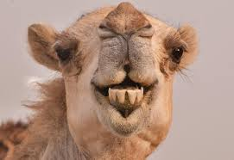
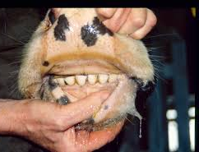
Herbivore
Animals that eat only plants and vegetables are called herbivores and have mostly molars.

Slide 6
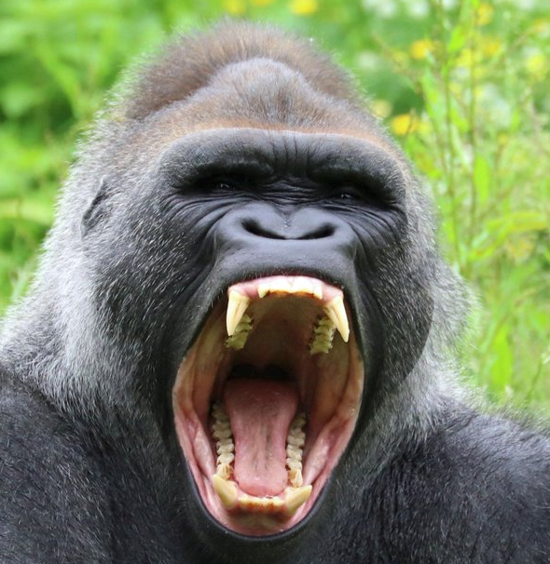
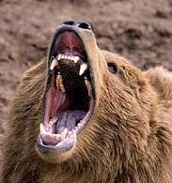
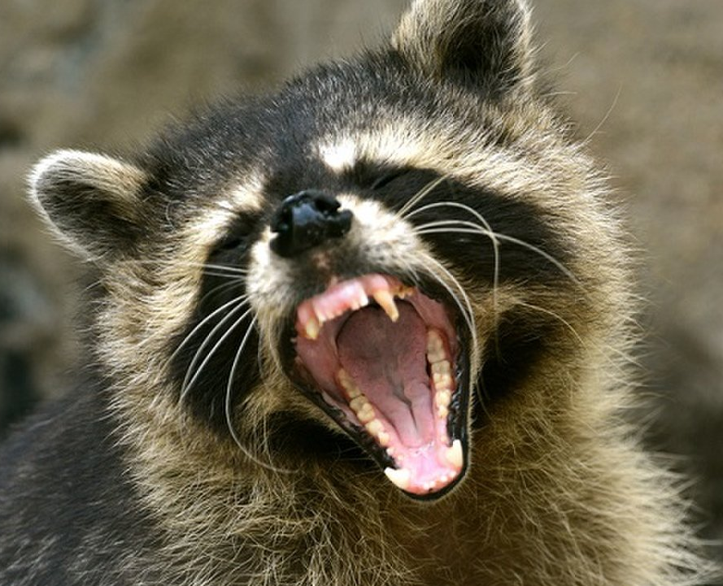
Omnivores
Animals that eat both plants and meat are called omnivores and have both canines and molars.

Slide 7
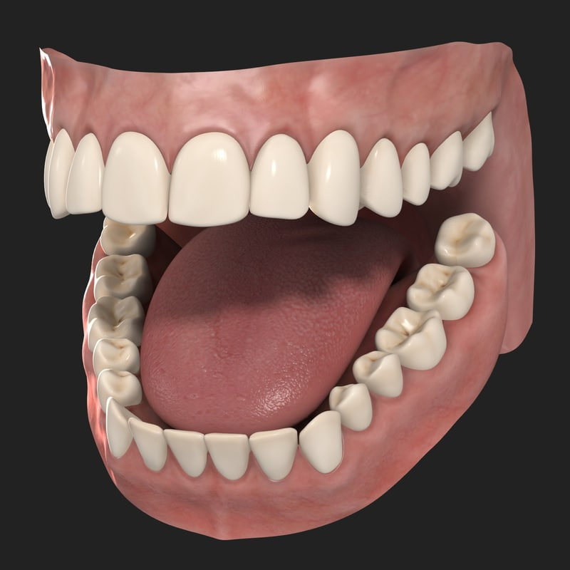
What Do Our Teeth Do?
Front Teeth are sharper and thinner and used for biting. The sharp teeth act like knives, tearing meat and cutting food.
The back teeth are flatter and wider used for crushing and grinding the food. The molars act like hammers that smash up food.
What do your teeth look like?

Slide 8
Vocabulary
Adaptation – a change that helps an animal survive in its particular habitat
Diet – the food an animal usually consumes
Incisor – one of the four sharp teeth between the canines at the front of the mouth
Canine – one of the pointed teeth between the incisors and molars
Molar – a large, wide tooth found in the back of the mouth
Carnivore – an animal that eats meat
Herbivore – an animal that eats only plants
Omnivore – an animal that eats both plants and meat

Slide 9
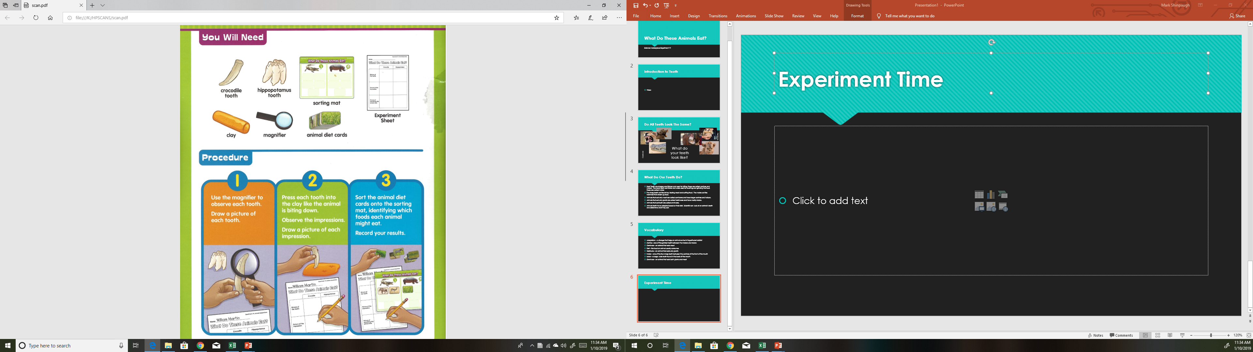
Experiment Time

Slide 10
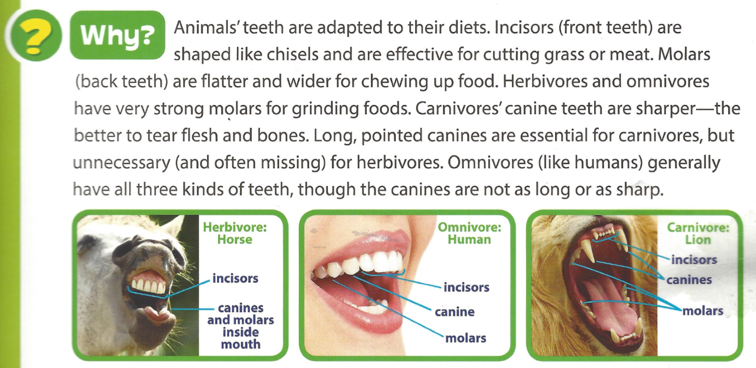
knives

Slide 11
