Slide 1
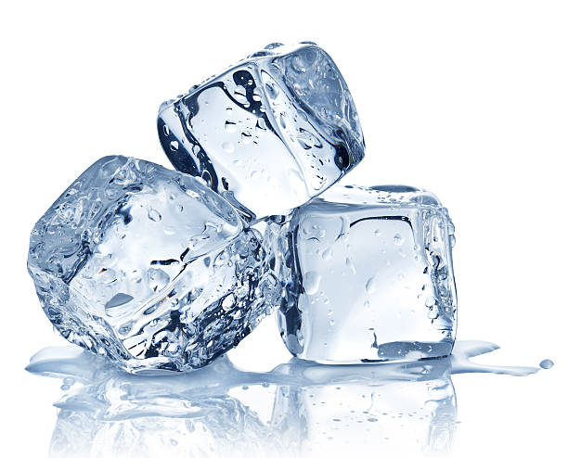
What does salt do to ice?
Science Masterpiece

Slide 2
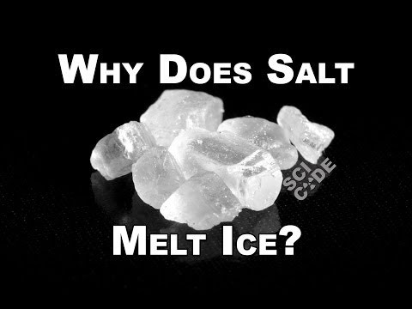

Slide 3
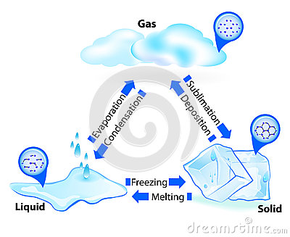
Water can exist as a
Solid (ice), Liquid (water), or a Gas (steam).
Changing the temperature of water can change it from one state to another.

Slide 4
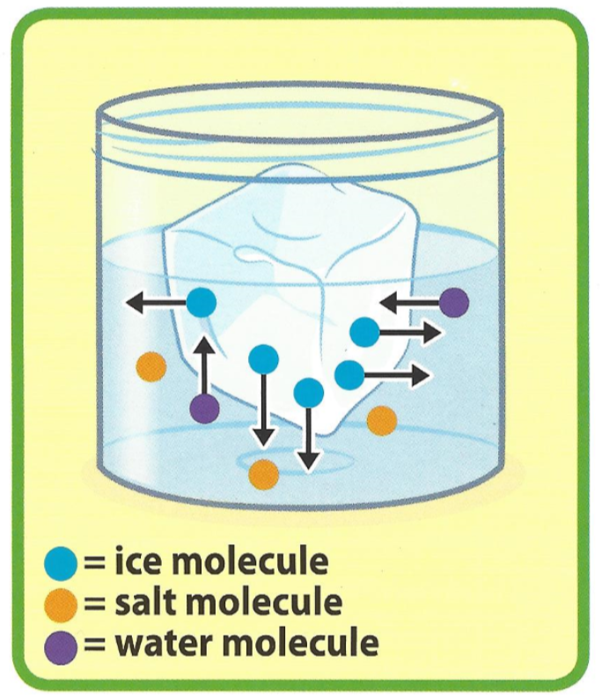
Melting/Freezing Point
When ice is placed in a glass of water and exchange of molecules takes place.
Some of the ice molecules melt into the water and some of the water molecules freeze back onto the ice.
Adding salt lowers the freezing point of water making it harder for the water to freeze back onto the ice.

Slide 5
Vocabulary
Contract – to become smaller
Expand – to become larger
Gas – a form of matter that has no shape of its own and fills any container, such as air
Liquid – a form of matter that flows and takes the shape of its container, such as milk
Matter – anything that takes up space
Molecule – the smallest particle of a substance; it has all the properties that make up a substance
Solid – a substance that is firm or hard and is not a gas or liquid
Temperature – how hot something is

Slide 6
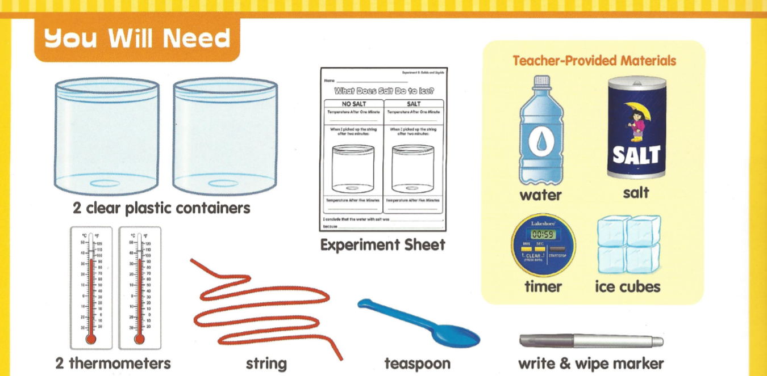
Experiment Time
2

Slide 7
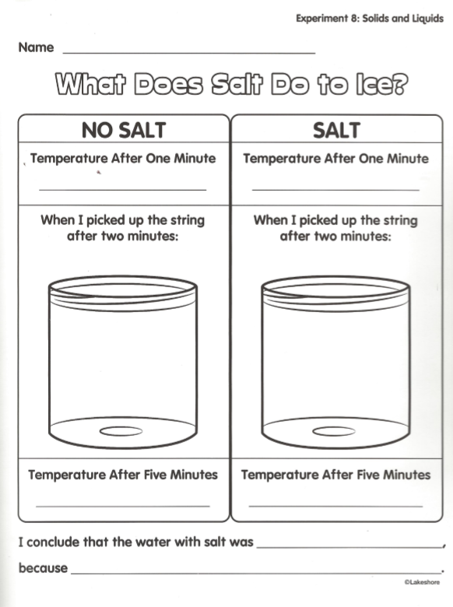
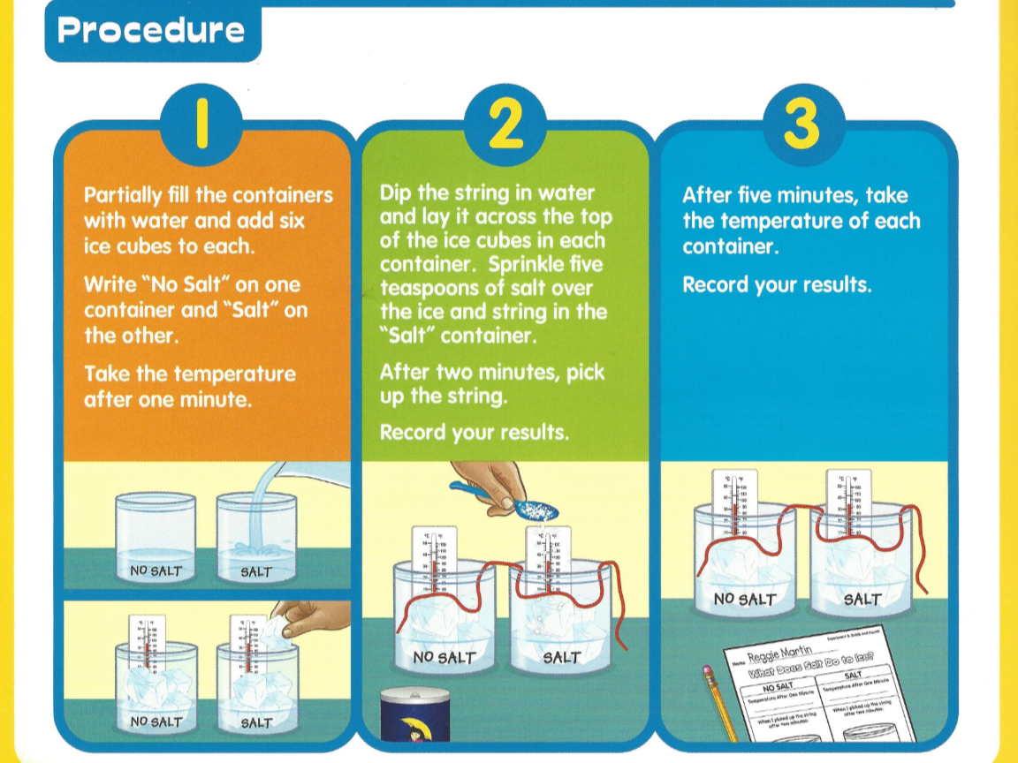

Slide 8
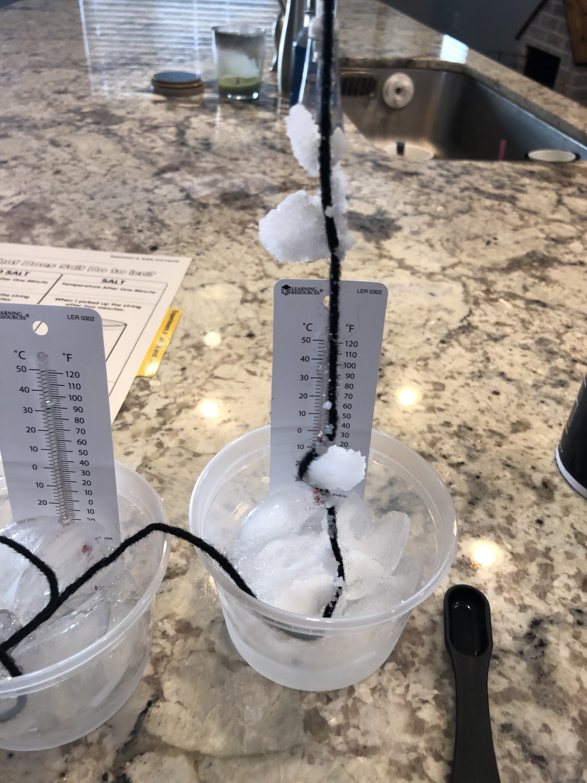
Observations
The salt “melts” the top of the ice cube momentarily, allowing the string to be saturated with water.
The melted water then refreezes onto the ice cube, trapping the string to the ice.

Slide 9
Conclusion on States of Matter
What happens to a solid when it’s heated?
Is ice a solid or a liquid?
What is ice made of?
What makes water freeze? What makes ice melt?
How are solids and liquids different?

