Slide 1

What is a Solution?

Slide 2
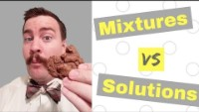

Slide 3
Vocabulary
Solid – a type of matter that has a definite shape
Liquid – a type of matter that flows and takes the shape of its container
Mixture – a combination of two or more substances; each substance of a mixture retains it’s own properties
Solution – a mixture of two or more substances that cannot be separated
Solvent – a liquid substance used to dissolve another substance
Solute – a substance that has been dissolved

Slide 4
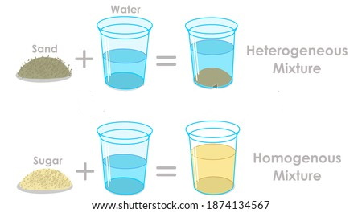
Mixture vs. Solution
Solids and liquids can combine to be a mixture.
In some mixtures, the solid does not dissolve in the liquid. This is called a heterogeneous mixture.
In other mixtures, the solid will dissolve creating a combined mixture with all substances equally dispersed throughout. This is called a homogenous mixture, or solution.

Slide 5
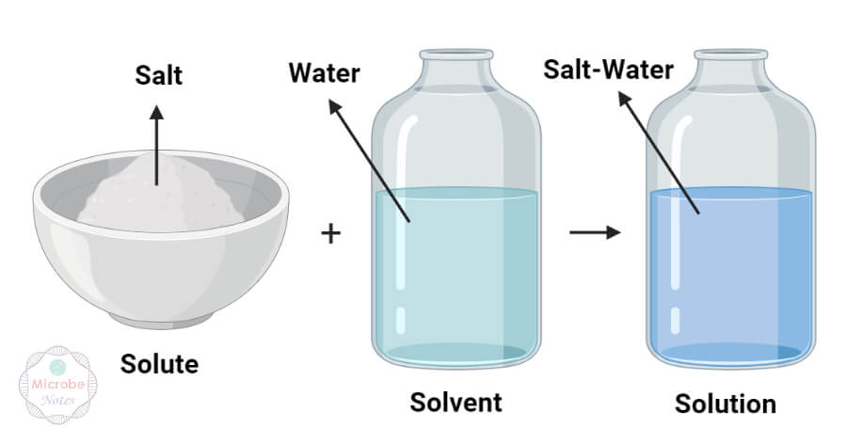
Example of a Solution

Slide 6
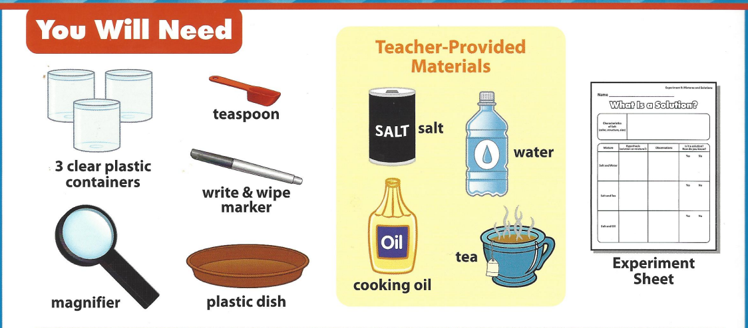
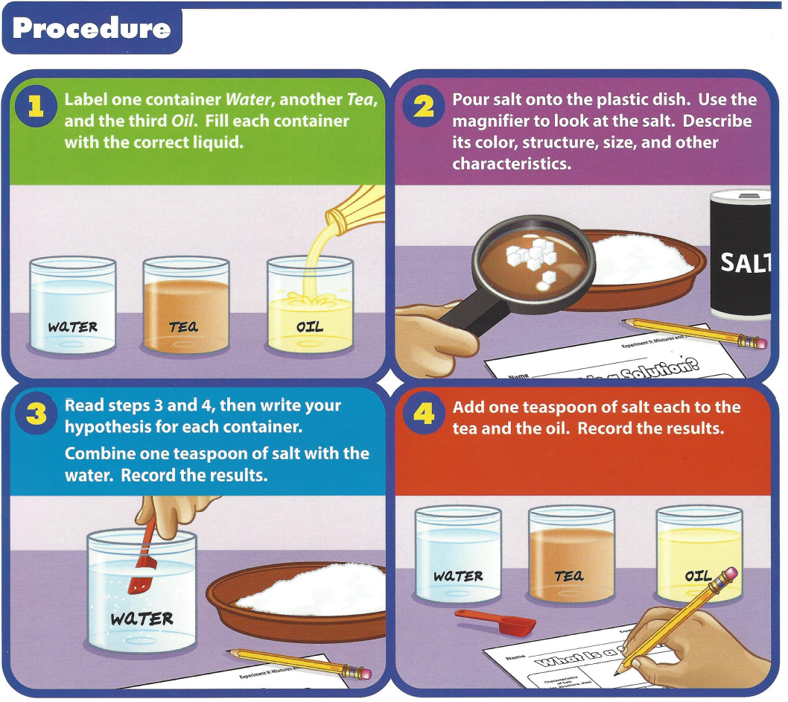
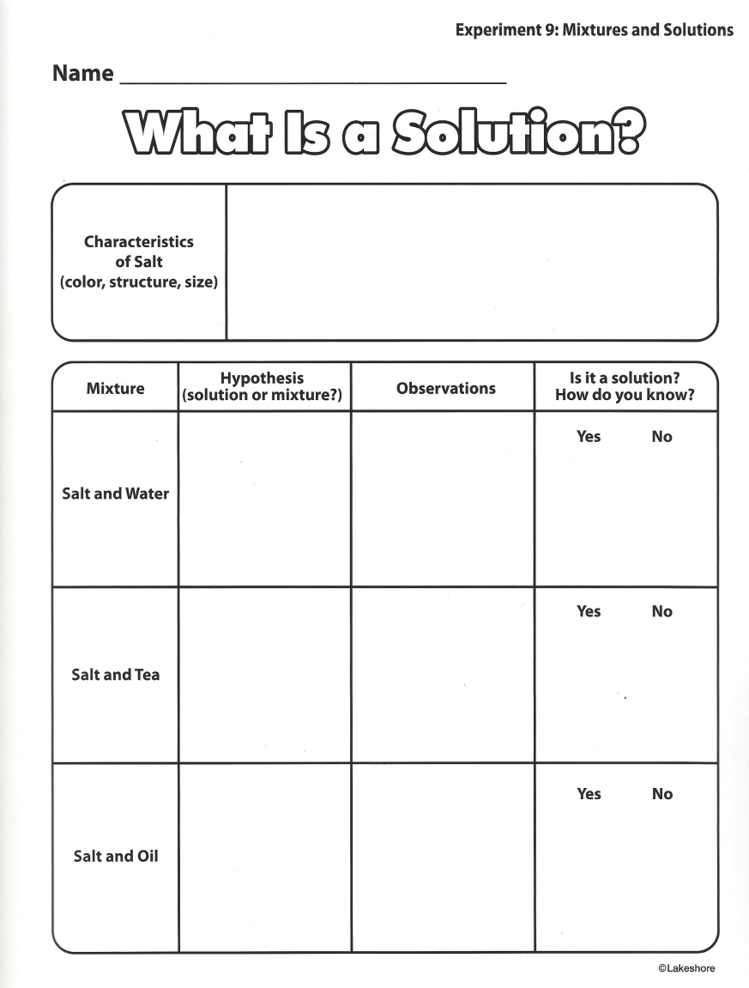
Experiment Time
2
3

Slide 8
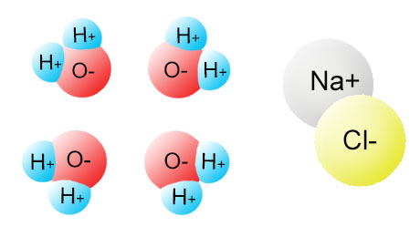
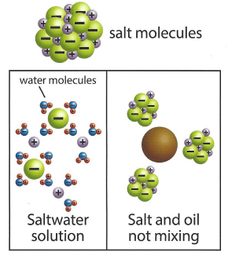
Conclusion
When a solid dissolves in a liquid, it breaks into individual molecules or ions.
These ions then mix with the liquid's molecules.

Slide 9
Conclusion
For a solid to dissolve in a liquid, the solid and liquid’s molecules need to interact in a certain way. For example, water can break salt molecules into their individual ions. Water can do this because its molecules are attracted to the different charges in the salt ions.
Oil molecules do not have the same properties as water. They cannot break the salt molecule into its ions. That is why salt dissolves in water, but not in oil.

Slide 10
Questions
1. What is a solution?
2. What is a mixture?
3. What liquid did the salt dissolve in?
4. What other liquids do you think salt dissolves in?
5. How could you reverse the oil and salt mixture?

