Slide 1
What’s Inside a Seed?
Science Masterpiece

Slide 2
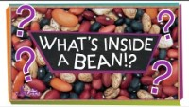

Slide 3
Vocabulary
Cotyledon – The part of a seed that stores food; it is one of the first leaves developed by the embryo of a plant.
Embryo – the part inside a seed from which a plant grows; it is usually a simple, underdeveloped plant.
Seed – the part of a plant that can grow into a new plant.
Seed Coat – The outer protective covering of a seed.

Slide 4
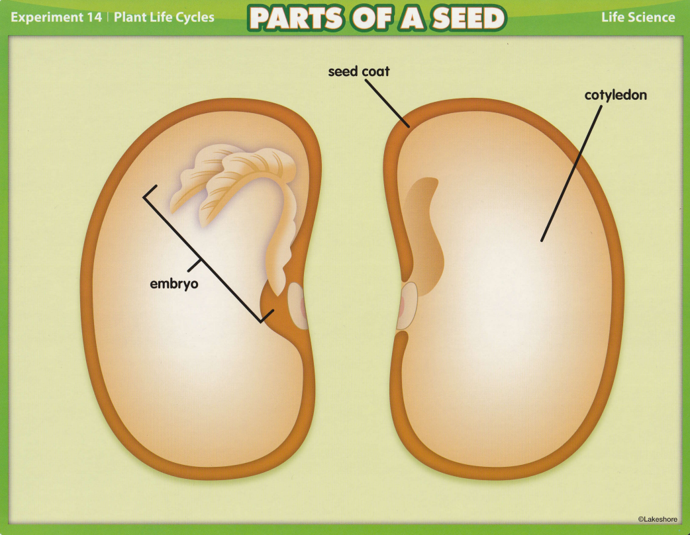
Parts of a Seed

Slide 5
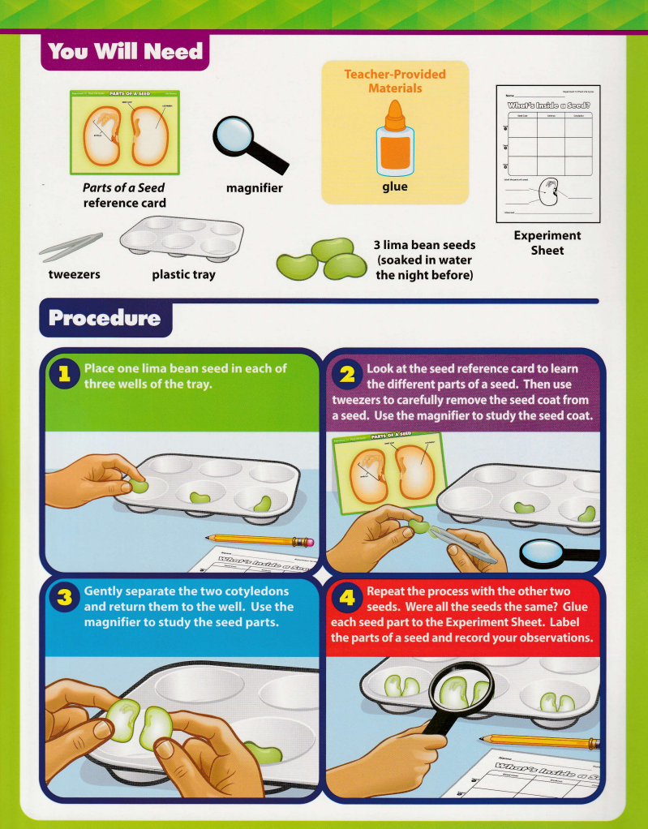
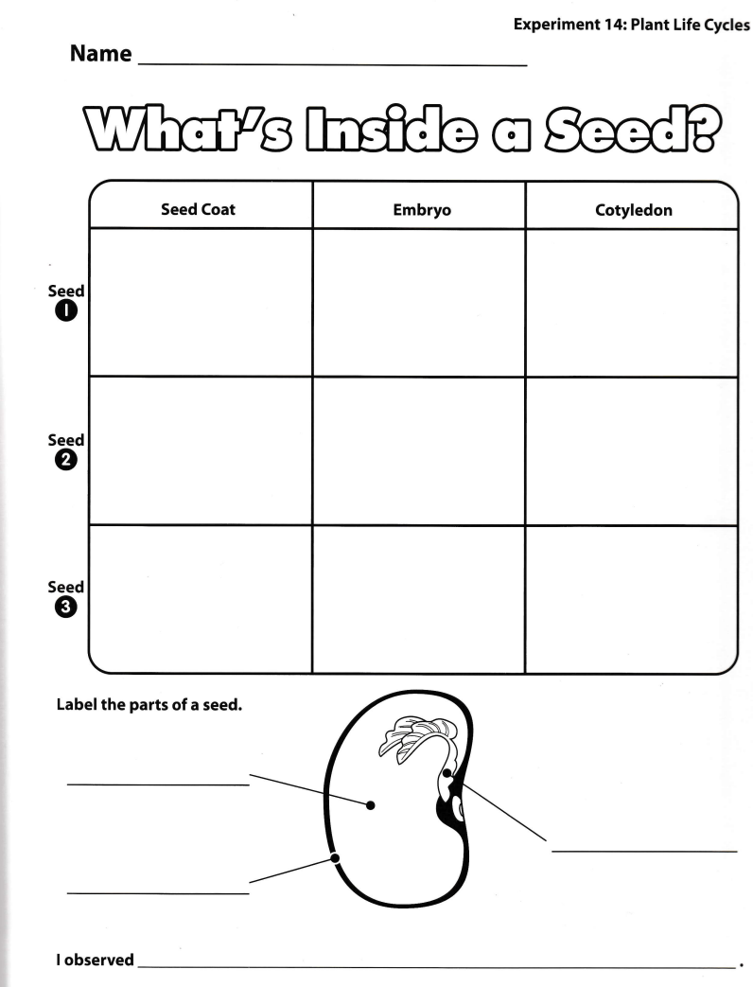
Experiment Time

Slide 6
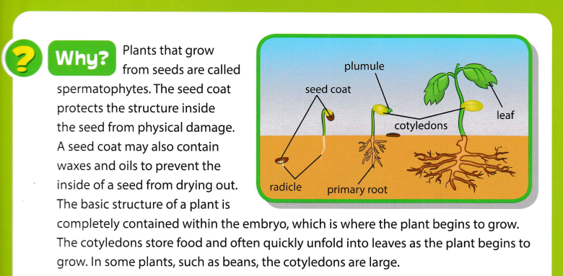
Conclusion

Slide 7
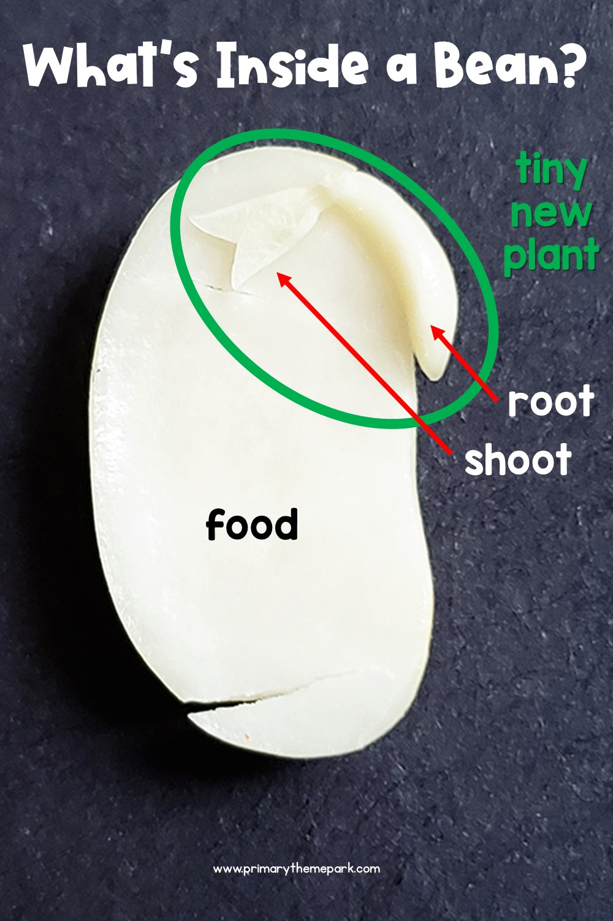
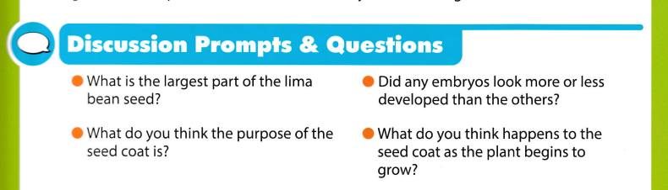
Questions

