Slide 1
Which Magnet Is Strongest?
Science Masterpiece

Slide 2

Agenda

Slide 3
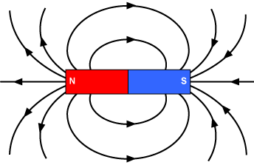
Magnets
Magnets are a piece of metal that can attract or pull certain metals to itself.
Each magnet is surrounded by a magnetic field.
Magnets have 2 sides or poles, North and South.
Some magnets have a magnetic field that is greater than others.

Slide 4
Vocabulary
Attract – to pull or draw in.
Magnet – a material that attracts certain metals, such as iron and steel.
Magnetic Field – the area around a magnet in which the magnetic force can be detected.
Magnetic Force – the force that makes an object magnetic.
Strength – how powerful something is.

Slide 5
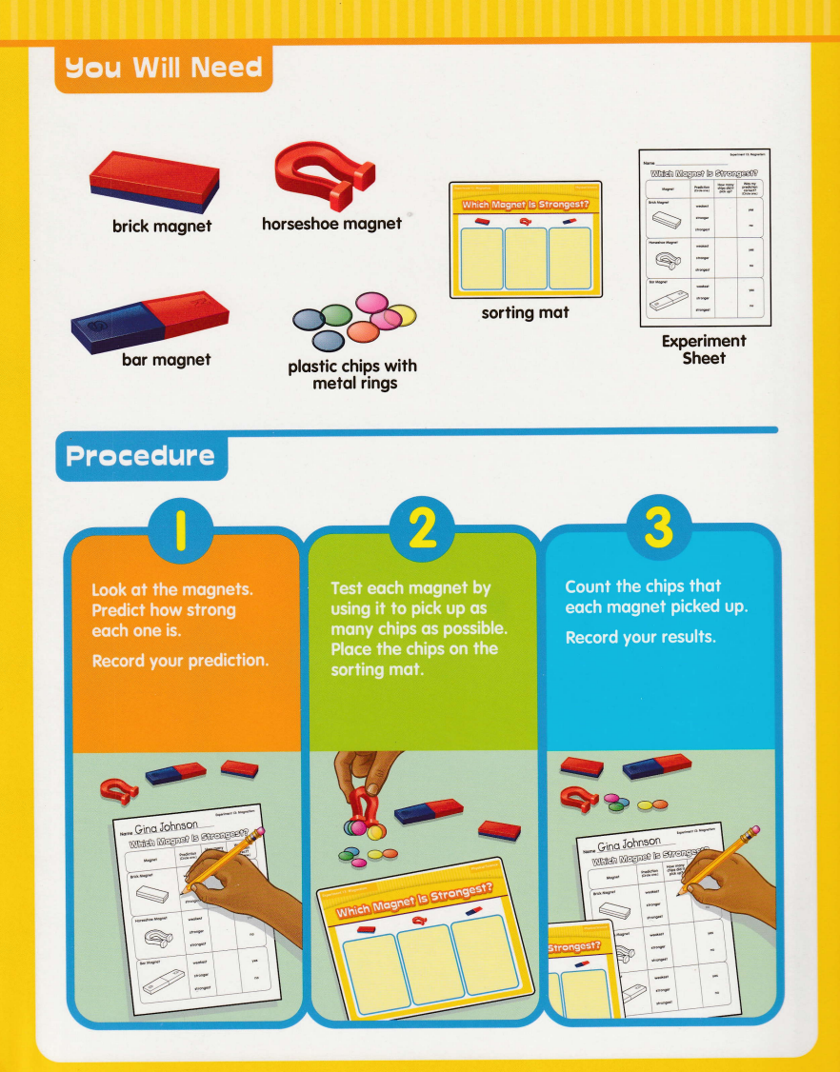
Experiment Time

Slide 6
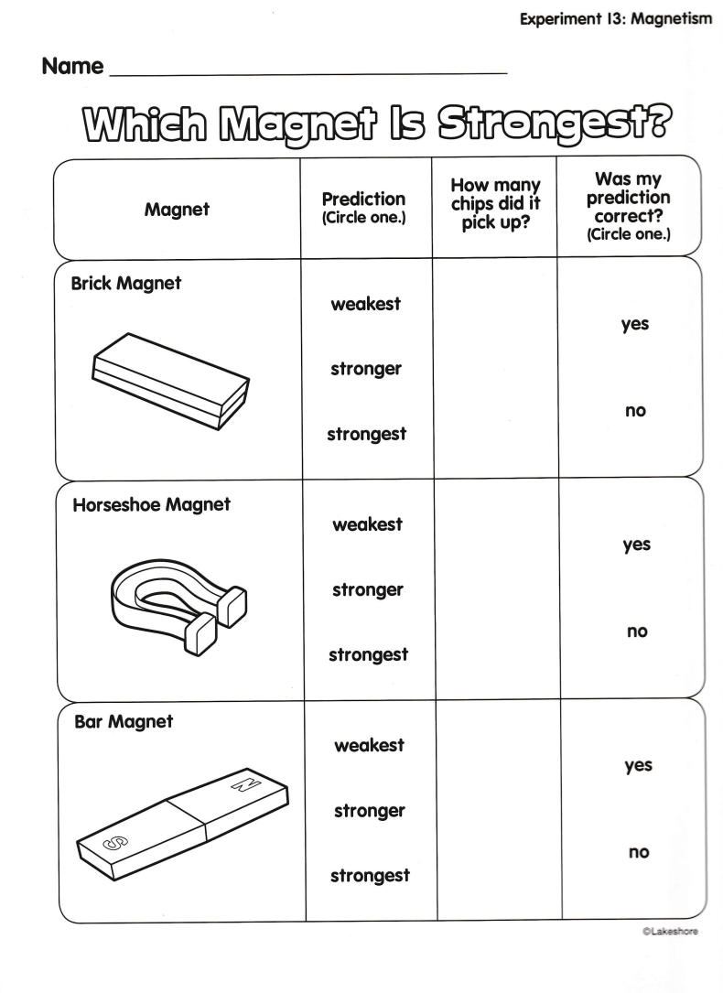

Slide 7
Conclusion
All magnets are surrounded by invisible magnetic fields that run from one pole to the other.
This is the area which magnetic objects are attracted to the magnet.
Stronger magnets have bigger magnetic fields and can attract objects from farther away.
The size of the magnetic field depends on the several factors, including the shape and size of the magnet itself.

Slide 8
Questions
Does it matter how you hold the magnet?
Does it make a difference if you though the magnet to the chip or touch the chip to the magnet?
Why do you think some magnets have different shapes?
What do you think makes some magnets stronger that others?
Can you think of something that uses magnets?

